Slide 1
This powerpoint was made by diversity_mel. It is part of a large series designed to encourage debate and discussion around issues of equality in a bid to make more children happier and thoughtful. You can find more assemblies/ discussion ppts on my website.
You can contact me via my website too. I love to hear how you’ve used my powerpoints and to get your ideas for any you’d like me to make.
You can follow my work on Instagram @diversity_mel
Please do share my powerpoints with other teachers who may be interested.
My website is www.diversitymel.com

Slide 2
Dresses for boys and for girls
This assembly is one of a series encouraging children to recognise we can learn from each other.
This one focuses on Harry Styles and his choice to wear a dress despite public criticism. It then links to the evolution of trousers for women following the invention of the bicycle. It is designed to encourage discussion on gender and clothing.
Check out my many other assemblies – contact details at the end of this powerpoint.

Slide 3
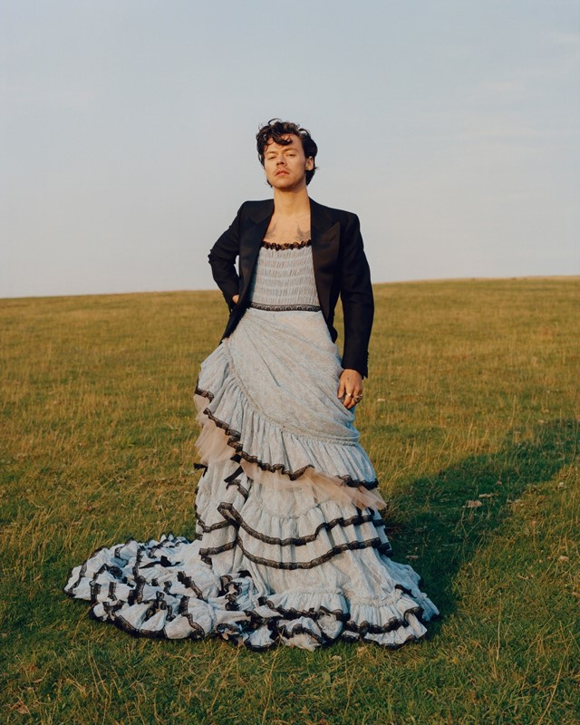
Recently, the singer Harry Styles, was the first man to appear alone on the cover of Vogue – a famous fashion magazine aimed at women. Look what Harry chose to wear…
What are your thoughts when you see this picture?
Do you think everyone agrees with you?

Slide 4
Recently, the singer Harry Styles, was the first man to appear alone on the cover of Vogue – a famous fashion magazine aimed at women. Look what Harry chose to wear…

Slide 5
A few people were critical…
But lots of men and women praised Harry…
Harry is plenty manly, because manly is whatever you want it to be
He’s not ‘manly’ enough
Men should dress like men
We are told to be manly, but I say ‘be yourself’
I think you don’t understand what being a man is – it’s whatever you want it to be
I love that Harry wears whatever he wants to
And Harry’s Mum said she was very proud of him too

Slide 6
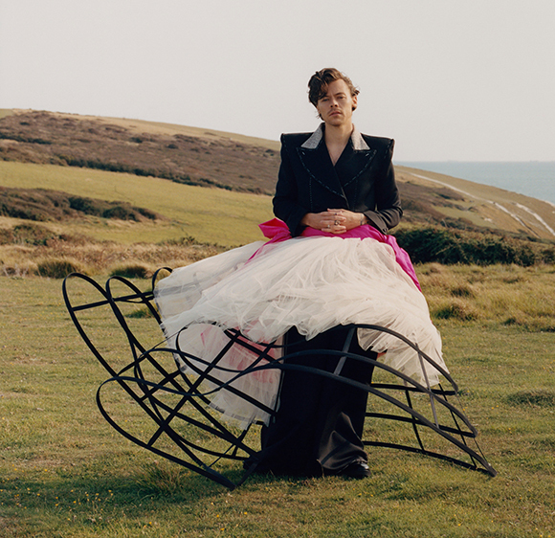
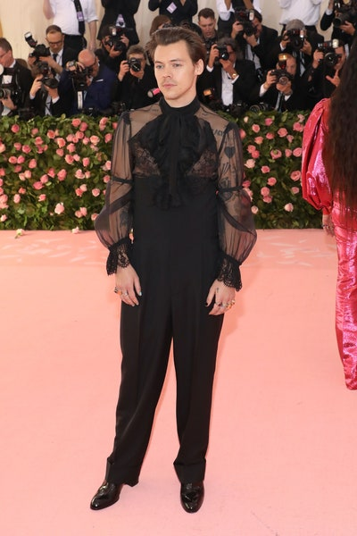
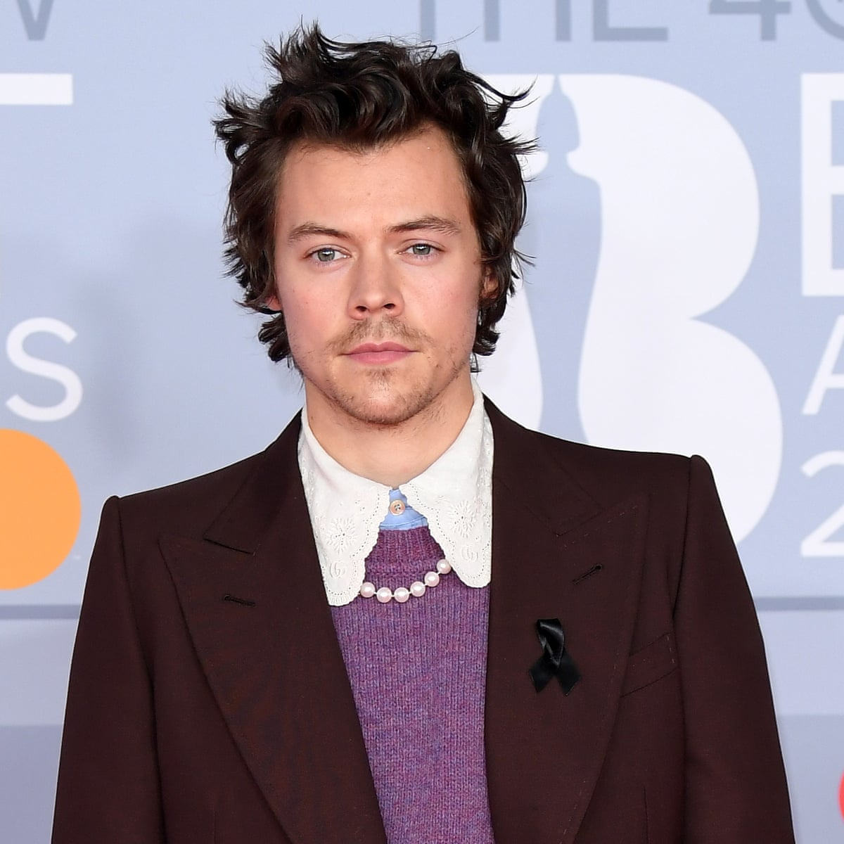
What did Harry say?...
Do you agree with Harry?
I think we should stop saying there are men’s clothes and women’s clothes.
Don’t limit yourself!

Slide 7
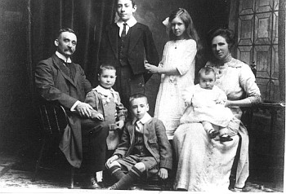
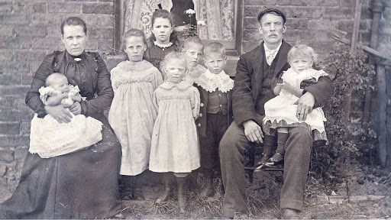
You might think that dresses were only for women in the past…
Maybe you have seen photographs of women in long dresses and men in suits

Slide 8
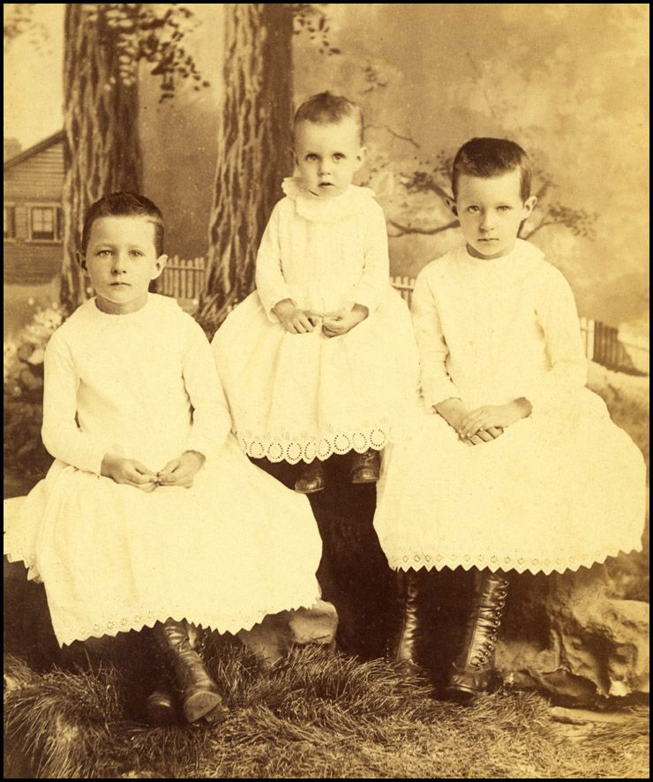
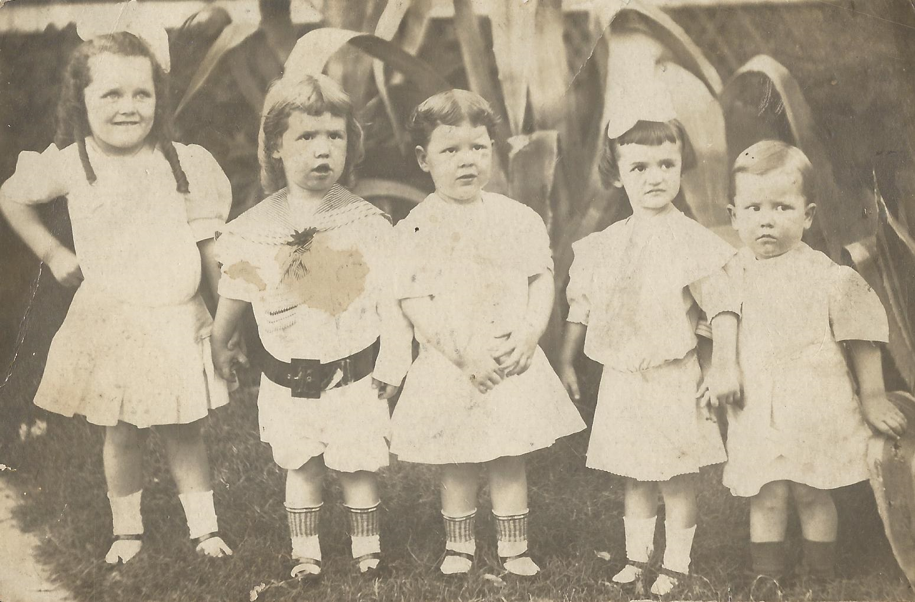
But let’s look a little more closely…
One hundred years ago, it was perfectly normal for young girls and boys to wear dresses.
Are you surprised?
Dresses helped to protect their clothes in a time before disposable nappies!

Slide 9
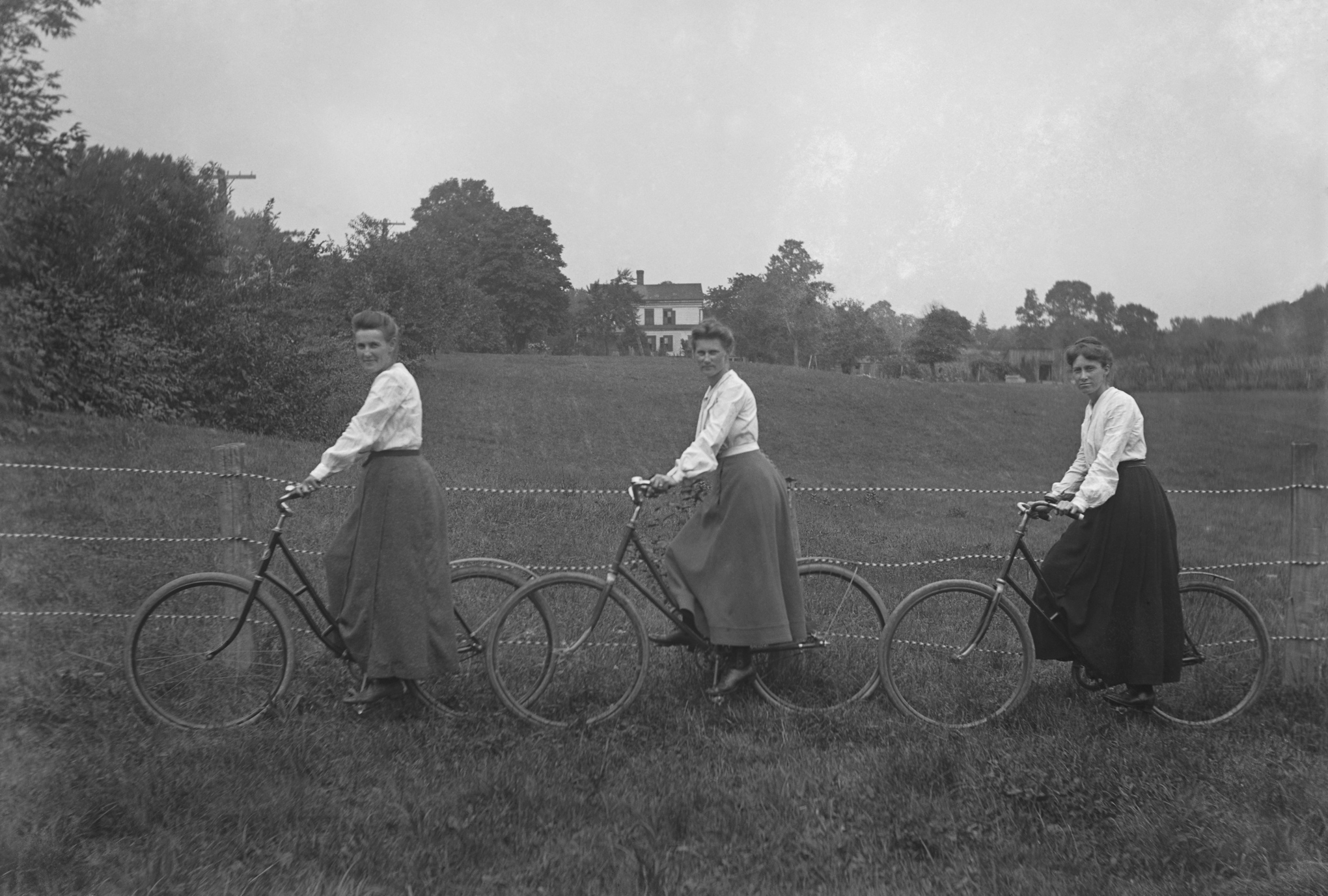
The invention of the bicycle allowed women to get out and about in a way they never had before, but their clothing was a problem, with skirts getting caught up in the wheels.
Can you guess why women stopped wearing skirts and started to wear trousers?
Here’s a clue…

Slide 10
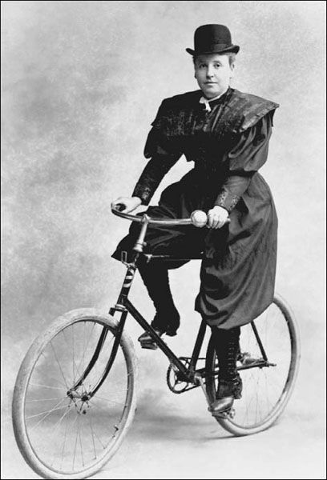
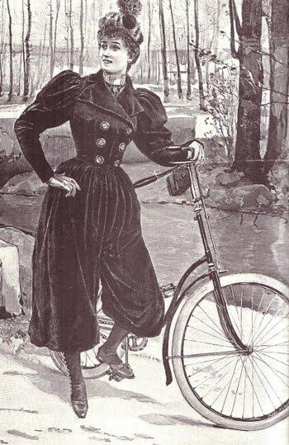
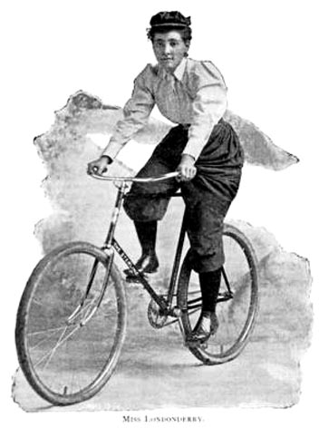
So a whole new range of clothing was invented…trousers for women, well almost!

Slide 11
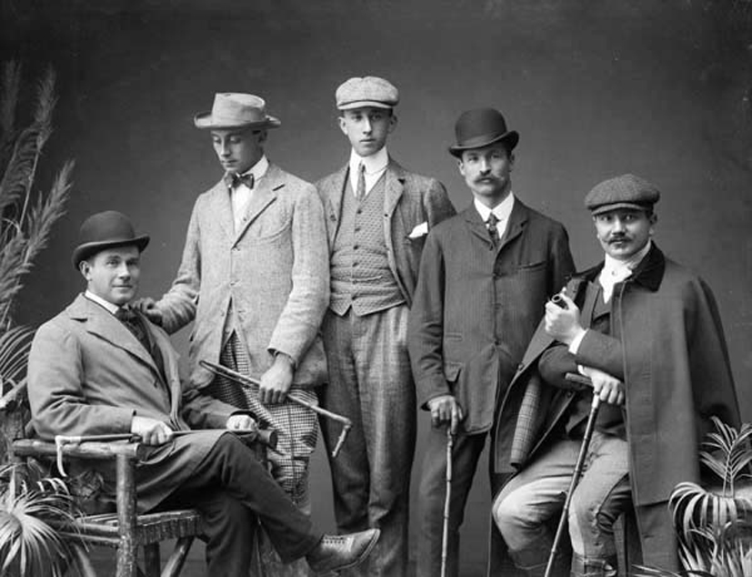
What do you think the reaction was from people?
Women should dress like women!
It’s really, rather shocking!

Slide 12
Does that sound like something we’ve heard before?
What do you think? Is if OK for people to dress how they want to?
Women should dress like women!
Men should dress like men!

Slide 13
This powerpoint was made by diversity_mel. It is part of a large series designed to encourage debate and discussion around issues of equality in a bid to make more children happier and thoughtful. You can find more assemblies/ discussion ppts on my website.
You can contact me via my website too. I love to hear how you’ve used my powerpoints and to get your ideas for any you’d like me to make.
You can follow my work on Instagram @diversity_mel
Please do share my powerpoints with other teachers who may be interested.
My website is www.diversitymel.com

