Slide 1
This powerpoint was made by diversity_mel. It is part of a large series designed to encourage debate and discussion around issues of equality in a bid to make more children happier and thoughtful. You can find more assemblies/ discussion ppts on my website.
My website is www.diversitymel.com
You can email me via my website too. I love to hear how you’ve used my powerpoints and to get your ideas for any you’d like me to make.
You can follow my work on Instagram @diversity_mel
Please do share my powerpoints with other teachers who may be interested.
Please Note: I make no money from making these resources.

Slide 2
Mary Anning – A New Statue
This assembly is one of a series encouraging children to recognise we can learn from each other.
This one focuses on Mary Anning, the pioneering fossil collector, who often didn’t receive credit for her work in her lifetime and Evie, who, together with her Mum, Anya, led a crowdfunding campaign to raise a statue of Mary in her home town of Lyme Regis.
The video has been checked, but please check it yourself before watching with your class. Thank you.
Check out my many other assemblies on www.DiversityMel.com

Slide 3
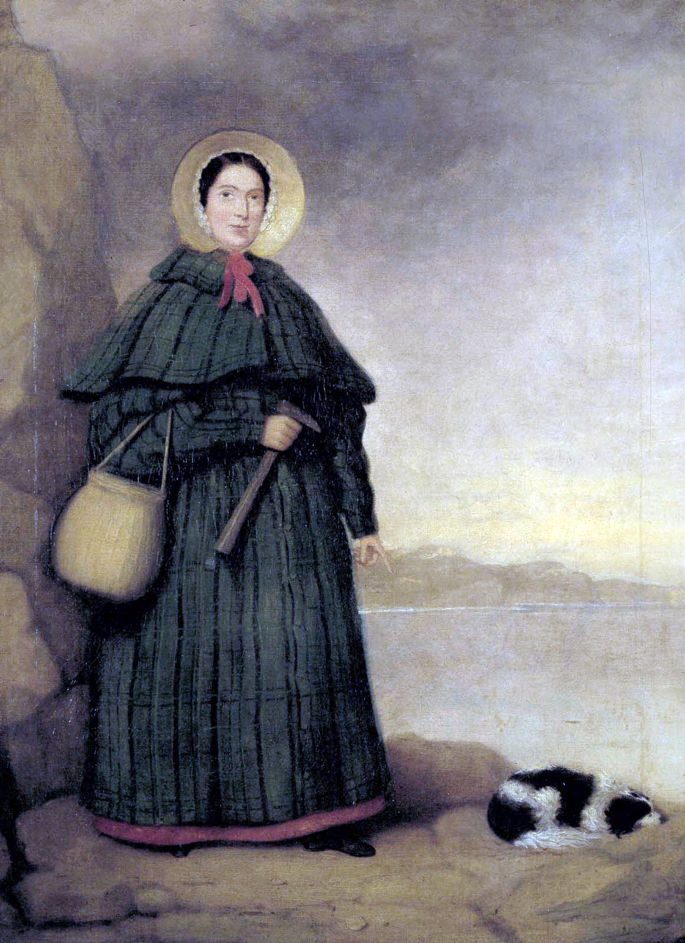
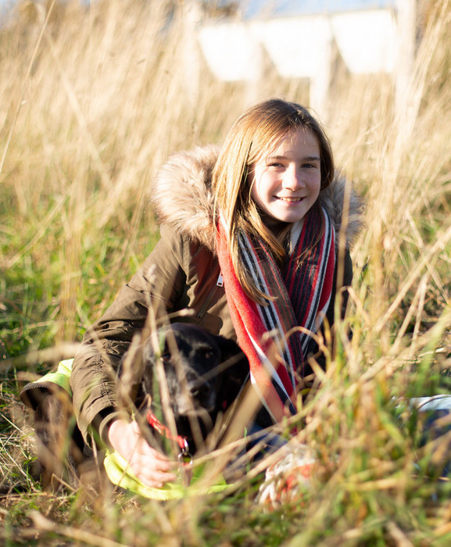
Do you recognise either of these people?
How could they be connected?
This is Mary Anning and she lived in Dorset, 200 years ago
This is Evie and she lives in Dorset now
Let’s find out more…

Slide 4
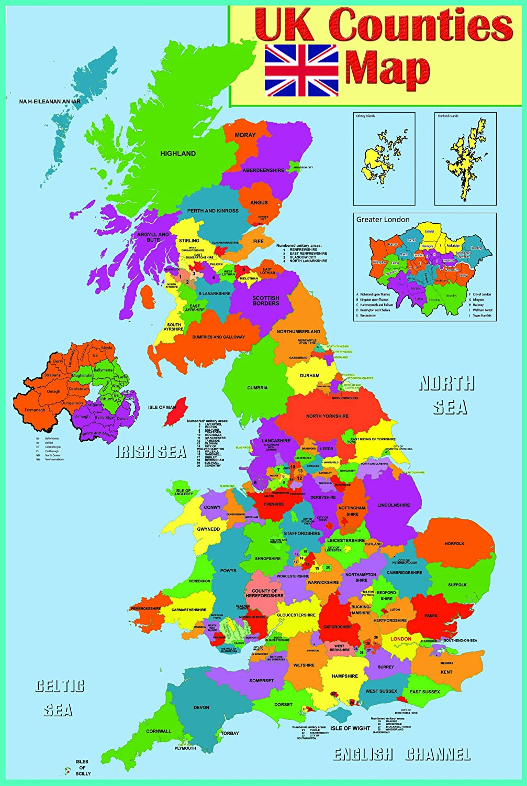
Mary lived in Lyme Regis. She came from a very poor family.
Lyme Regis

Slide 5
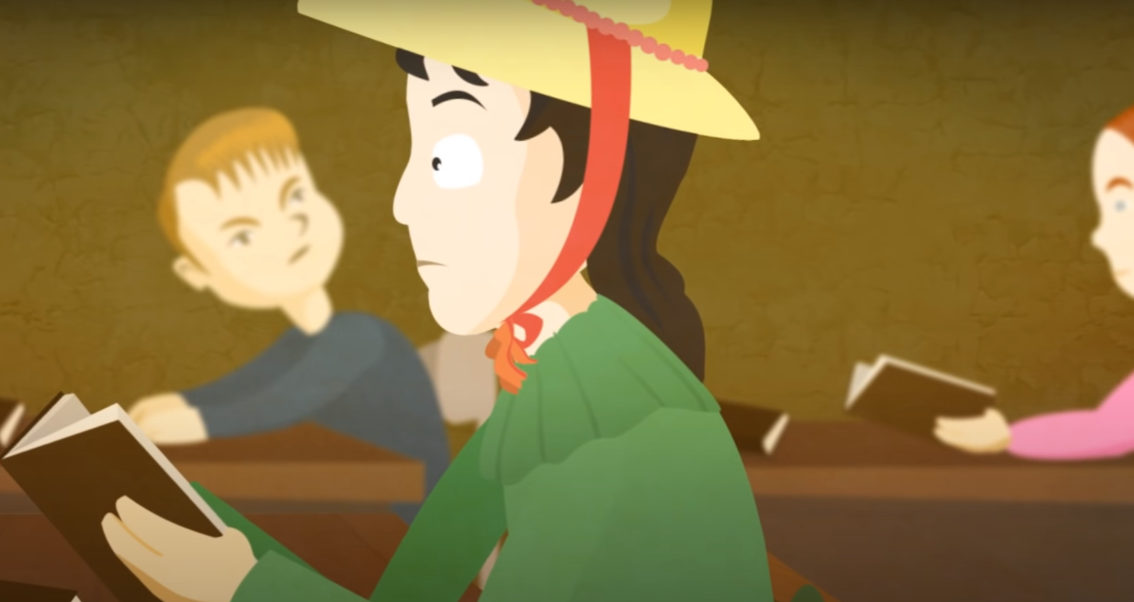
Mary didn’t get much chance to go to school. She learned to read and write in church at Sunday School.

Slide 6
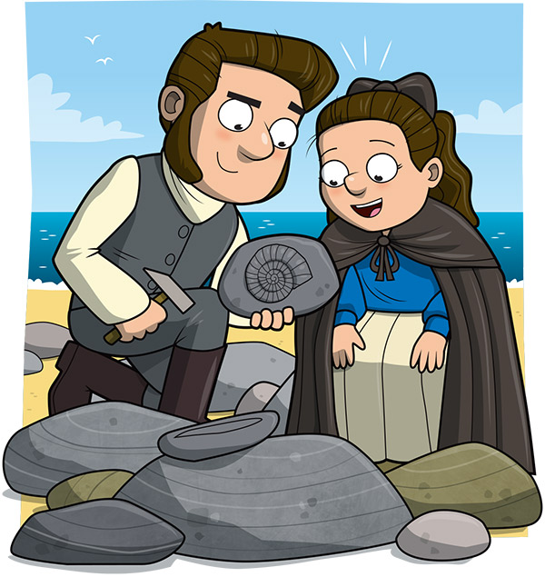
As a child, Mary helped her Dad to dig up fossils. They cracked open rocks and found fossils in fallen cliffs. It was dangerous work.

Slide 7
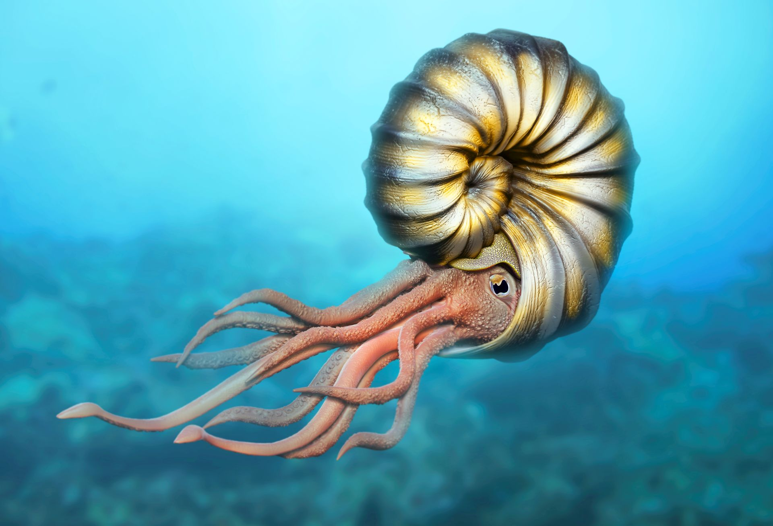
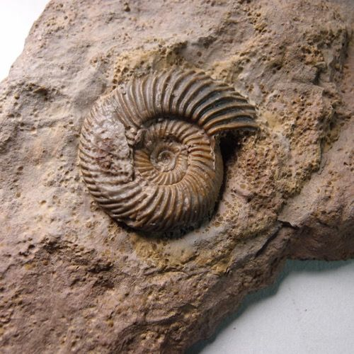
Do you know what this fossil is?
It is called an ammonite and it is like a rock imprint of a creature that lived in the sea millions of years ago.

Slide 8
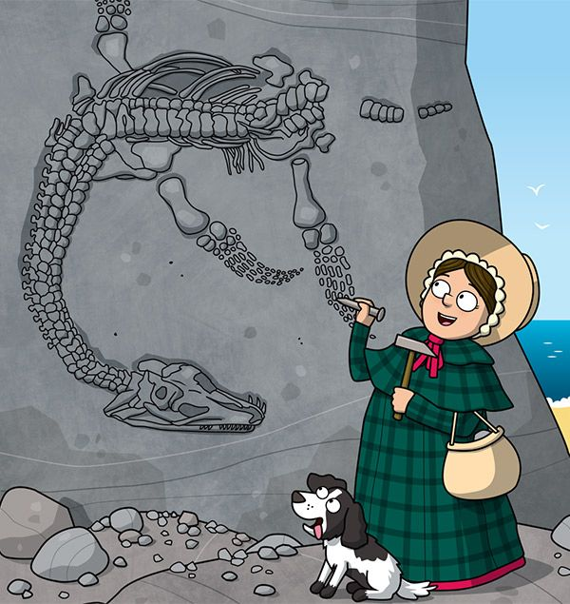
Sadly, Mary’s Dad died when Mary was still young, leaving the family very poor. Mary continued to search for fossils, carefully digging them out and selling them to help pay for food for her family.
For many years, her dog, Tray, was her faithful companion

Slide 9
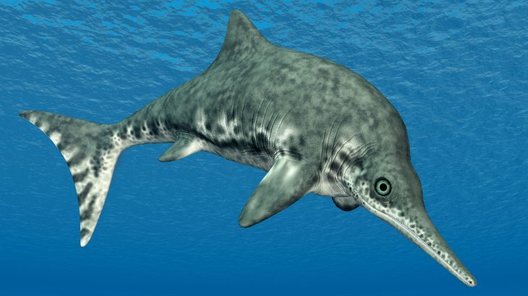
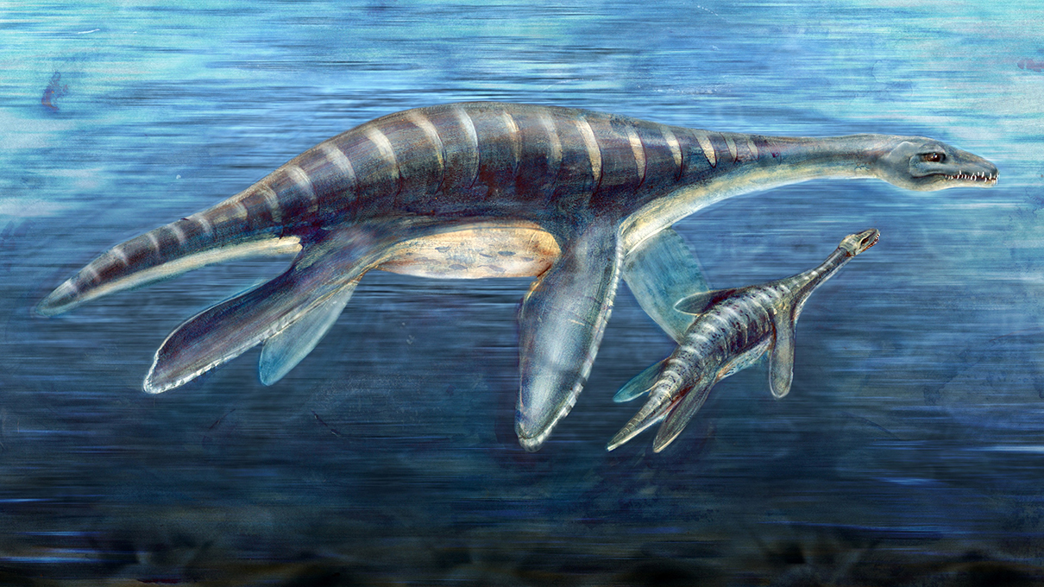
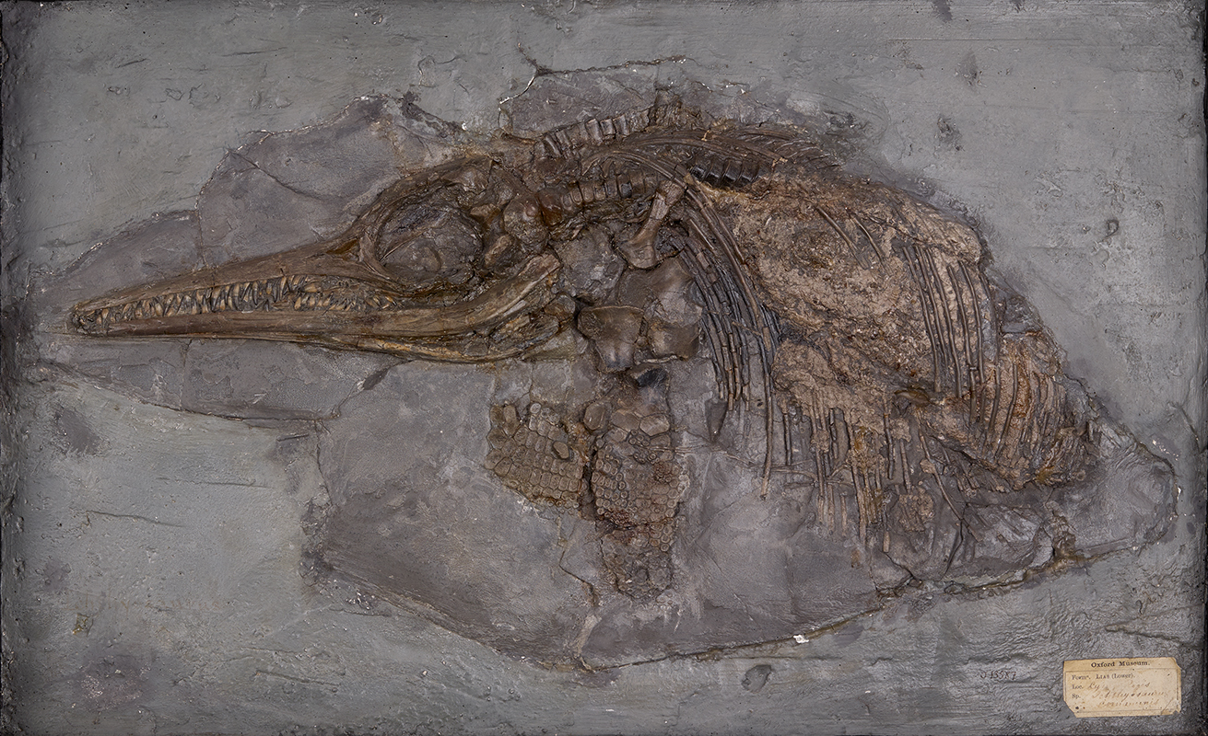
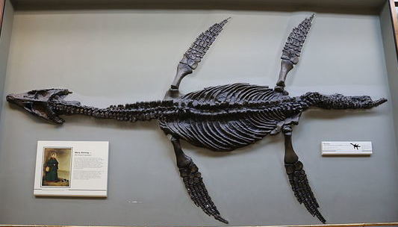
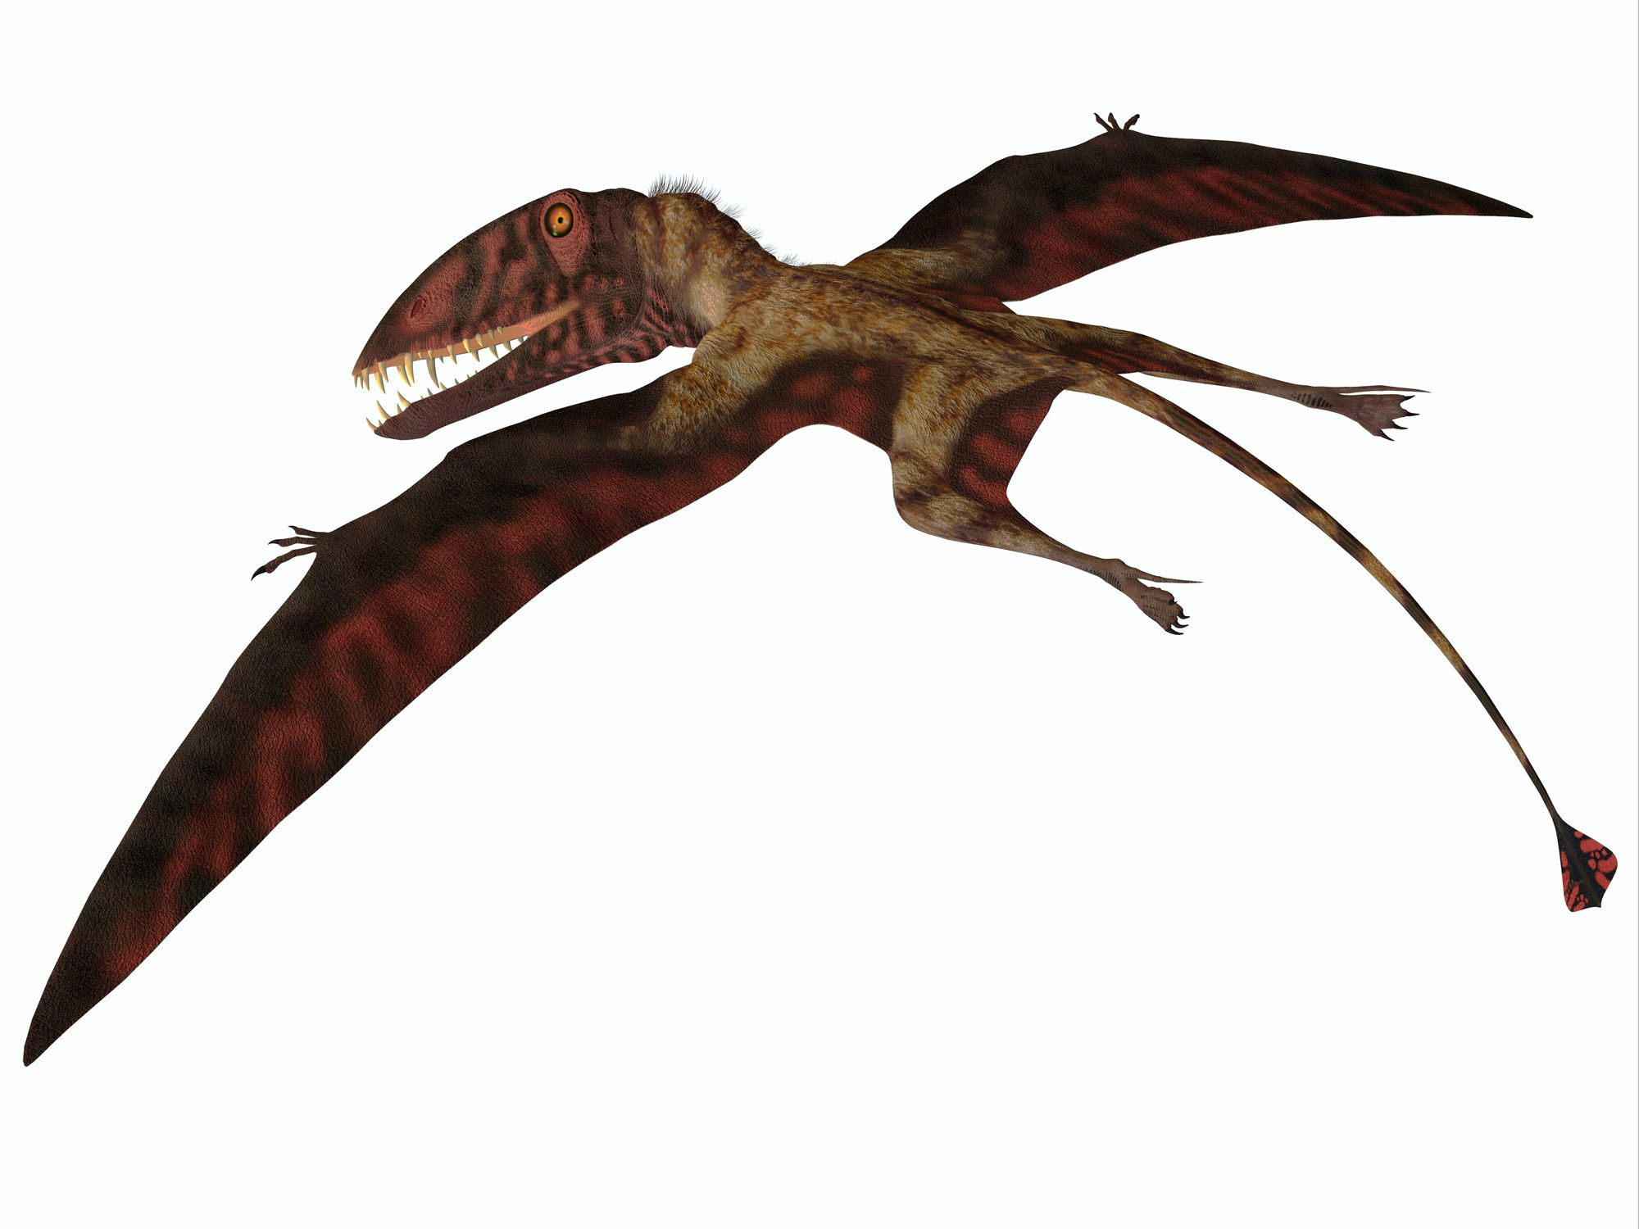
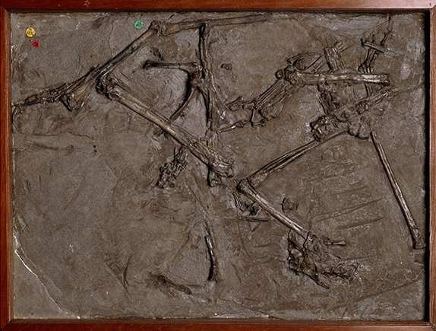
Plesiousaur
Ichthyosaur
Mary discovered all of these creatures. Can you guess what they were?
Dimorphodon

Slide 10
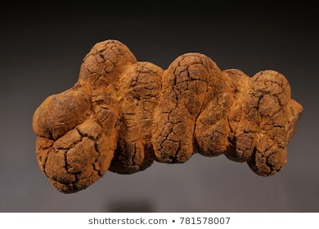
She even discovered fossilised poo!
Coprolite

Slide 11
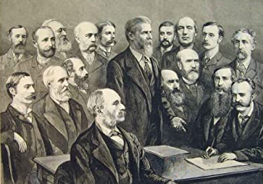
Mary’s plesiosaur fossil was so incredible, people didn’t believe she had found it
Mary wasn’t allowed into the meeting where her fossil was discussed
It’s a fake!
I agree!
Why don’t you let me tell you about it?
Eventually the men decided it was real after all!

Slide 12
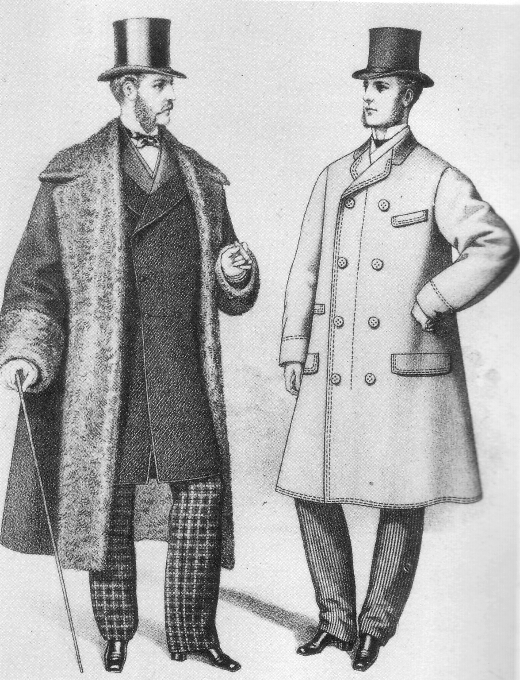
How do you think Mary felt about this?
Some men even wrote about Mary’s fossils as if they had found them
Let me tell you all about this incredible fossil…
The world has used me unkindly…

Slide 13
Click to watch a video of Mary’s life

Slide 14
Now, geologists and scientists know that Mary did some amazing work finding new and unusual fossils
But how is Mary connected with Evie, who we met at the start…?

Slide 15
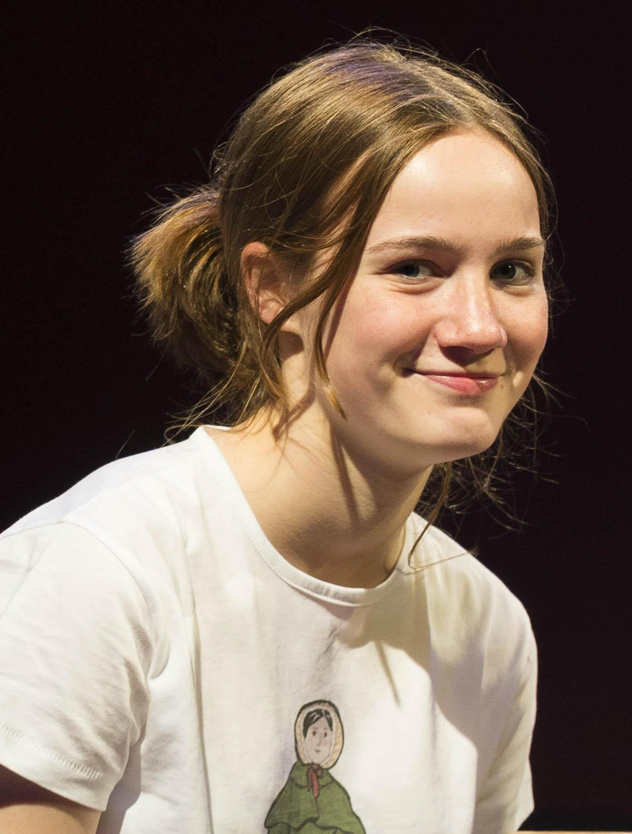
I live in Lyme Regis and think Mary is amazing. I was really shocked to discover there was no statue of her here.
Did you know that only 3 out of every 100 statues is of a named woman?
I think Mary deserves to be remembered.

Slide 16
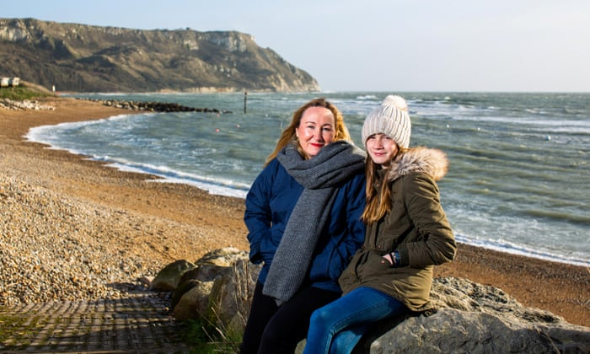
This is Evie with her mum, Anya. They gathered a team of people and crowdfunded over £100,000 to pay for a statue of Mary.
It took over four years and lots of hard work to make it happen.

Slide 17
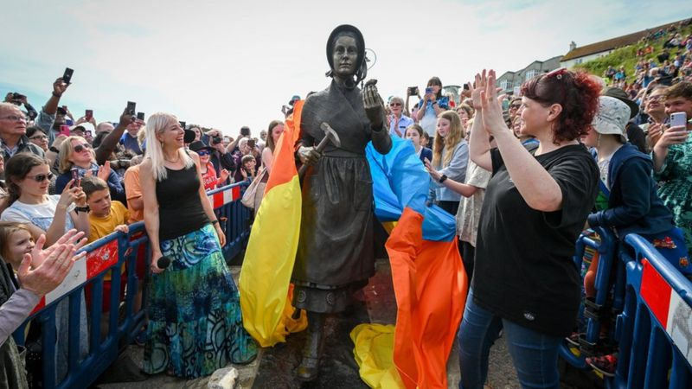
The statue was unveiled on what would have been Mary’s 223rd birthday.
Hundreds of people came to watch.

Slide 18
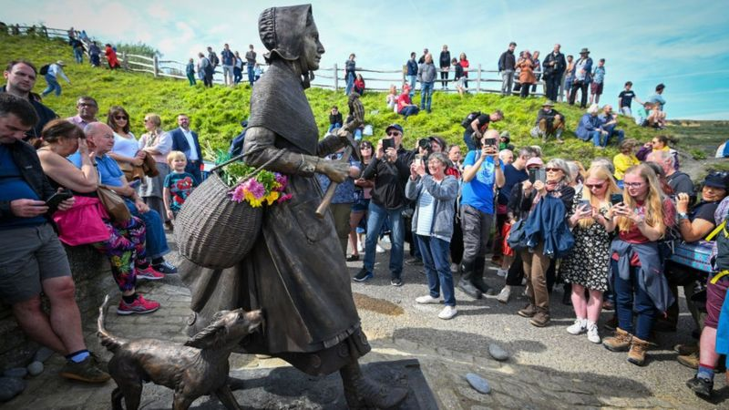
The statue is designed to show Mary as she really was – striding out to work on the cliffs with her dog, Tray.

Slide 19
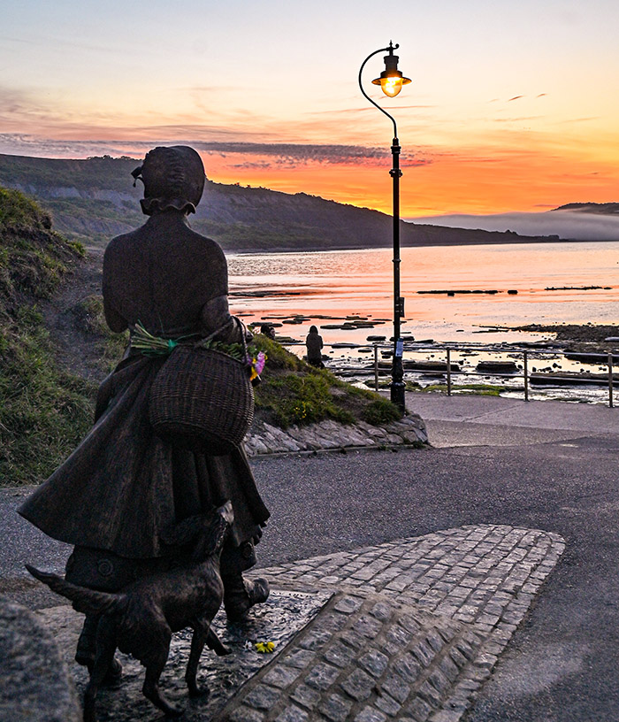
What do you think of the statue and Evie and Anya’s achievement?
Do you think we should have more statues of women?
Who would you choose?

Slide 20
This powerpoint was made by diversity_mel. It is part of a large series designed to encourage debate and discussion around issues of equality in a bid to make more children happier and thoughtful. You can find more assemblies/ discussion ppts on my website.
My website is www.diversitymel.com
You can email me via my website too. I love to hear how you’ve used my powerpoints and to get your ideas for any you’d like me to make.
You can follow my work on Instagram @diversity_mel
Please do share my powerpoints with other teachers who may be interested.
Please Note: I make no money from making these resources.

