Slide 1
This powerpoint was made by diversity_mel. It is part of a large series designed to encourage debate and discussion around issues of equality in a bid to make more children happier and thoughtful. You can find more assemblies/ discussion ppts on my website.
My website is www.diversitymel.com
You can email me via my website too. I love to hear how you’ve used my powerpoints and to get your ideas for any you’d like me to make.
You can follow my work on Instagram @diversity_mel
Please do share my powerpoints with other teachers who may be interested.
Please note: I make no money from making and distributing these resources.

Slide 2
Alan Turing
This assembly focuses on Alan Turing – maths and computing genius. Alan invented The Bombe – a machine for decoding Nazi messages, which is credited with shortening WW2 by two year and saving millions of lives.
Alan was gay at a time when it was illegal in the UK. He was given the difficult choice of imprisonment or taking medication to ‘change’ his sexuality. He chose the latter, but was unable to live with the consequences.
The videos have been checked, but I advise checking them yourself before viewing.
Find many more assemblies on my website DiversityMel.com

Slide 3
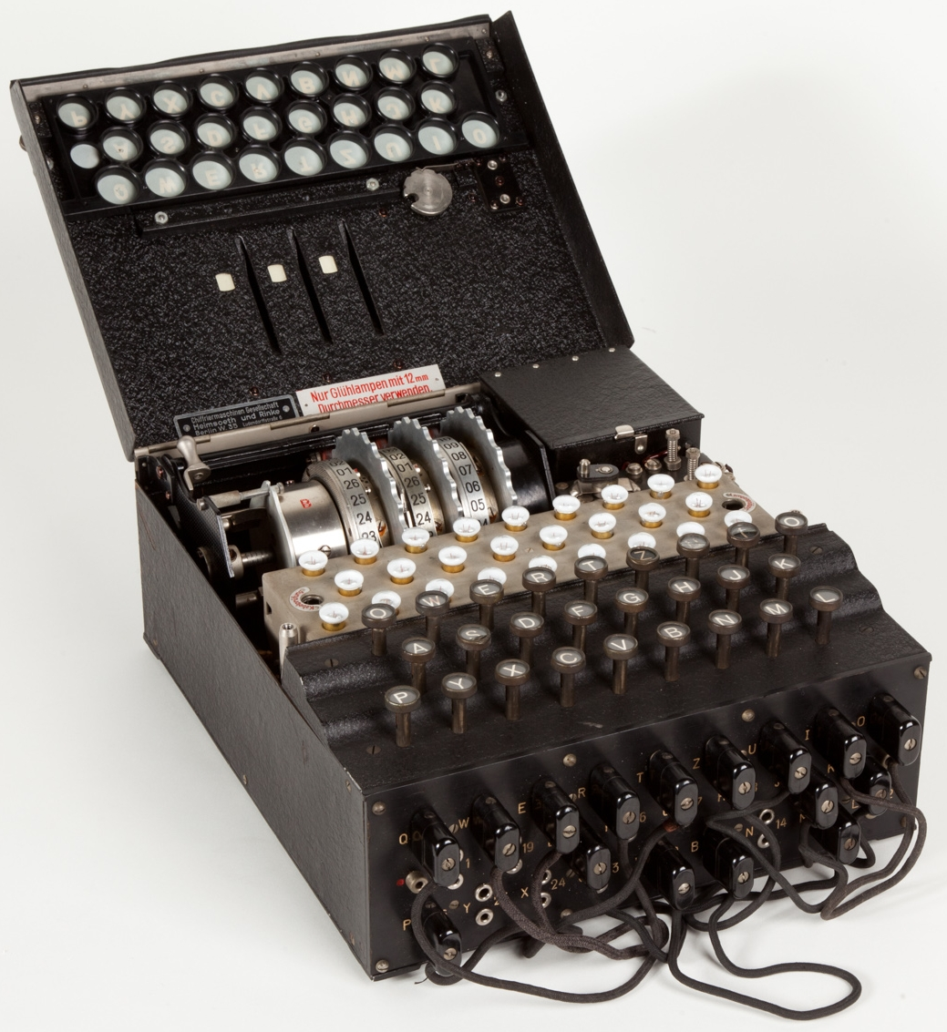
If you thought it was for sending messages, you’re right.
Can you guess what this machine might be for?
It’s called an Enigma Machine and was used by the Nazis in World War 2 to send coded messages.
It was a brilliant invention. Most people thought it would be impossible to crack the codes it made.
But one man eventually managed it…

Slide 4
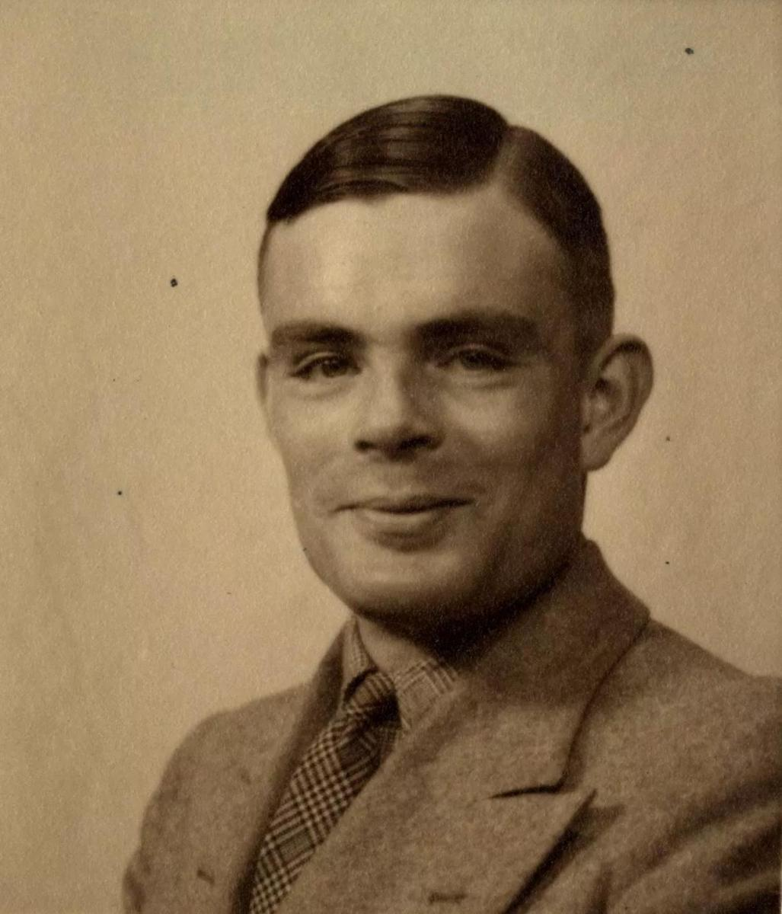
His name was Alan Turing and he was born in London in 1912.
Alan was a genius. His brilliant understanding of maths and science started when he was just a child. However, Alan’s secondary school in Dorset didn’t focus on these subjects, so Alan just studied by himself.

Slide 5
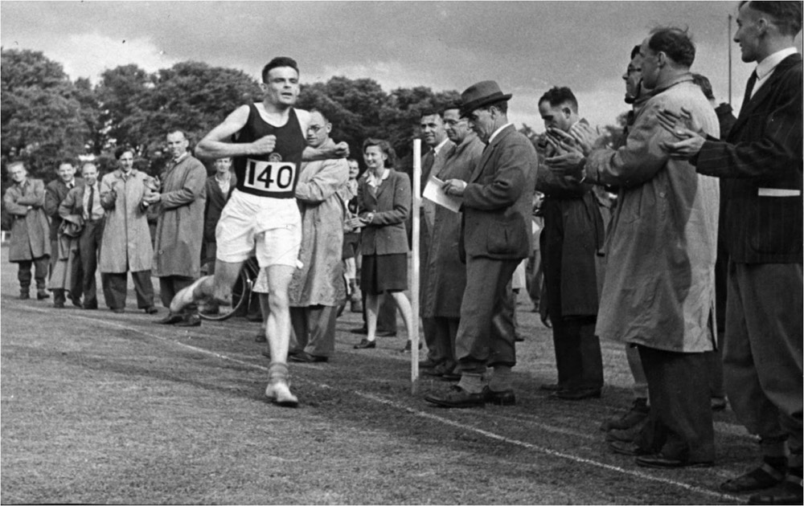
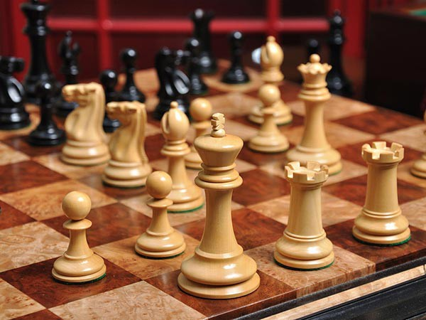
Alan was also an excellent runner, but it was his love of patterns, chess and solving problems that led to his work during WW2.

Slide 6
The Nazis were using Enigma machines to send coded messages all about their military activities.
If someone could crack the codes then many lives could be saved.

Slide 7
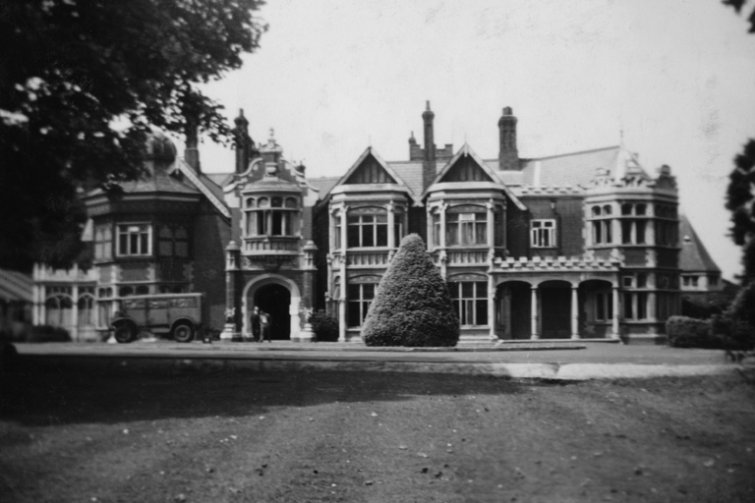
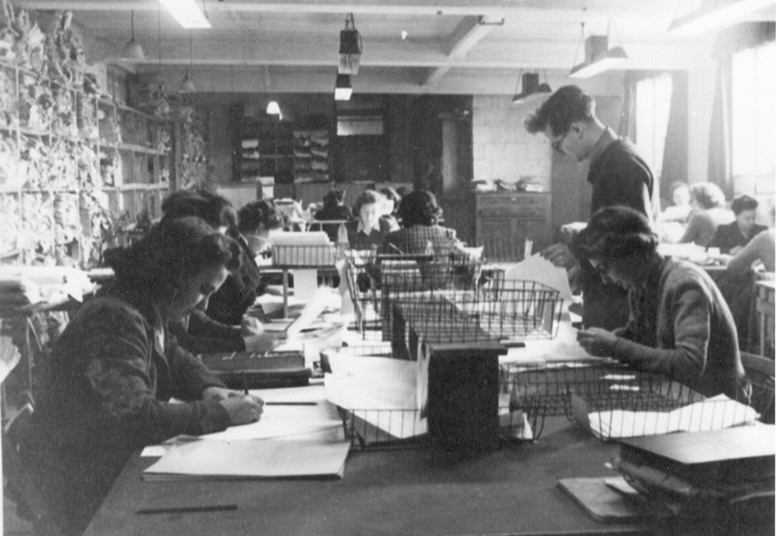
During World War 2, Britain ran an organisation of code-breakers based in a secret location, called Bletchley Park.
Men and women worked long hours trying to find ways to crack enemy codes and shorten the war.
It was a secret, completely hush hush! Nobody talked about what we were doing – even for many years after the war had finished.
Shhhhhh!

Slide 8
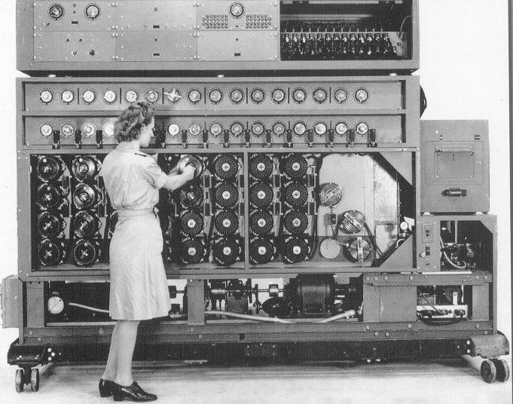
Alan designed a brilliant machine which could decode the enemy’s secret messages.
He called it The Bombe and it was operated mostly by women.
They worked very long hours and had to be very careful never to make a mistake or the codes wouldn’t be broken.

Slide 9
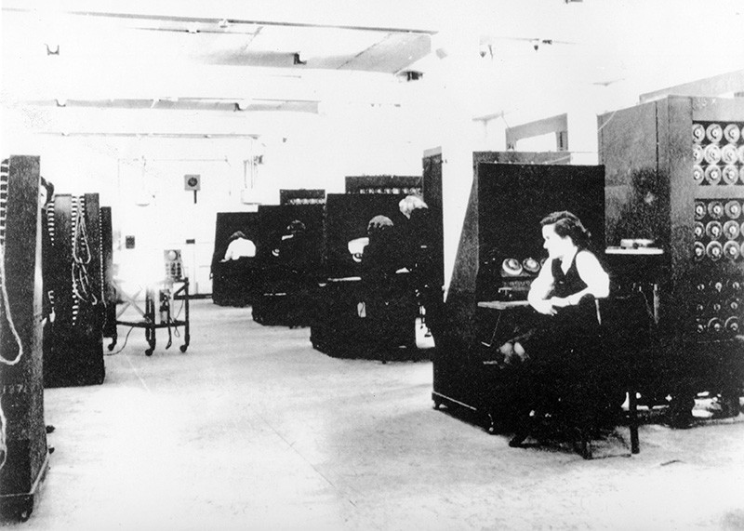
What do you think it felt like to spend hours every day doing this work?
By cracking the codes, it is said that the war was shortened by two years and millions of lives were saved.
It was very dull, repetitive work. We worked long hours in dark and stuffy rooms. I was always very tired!

Slide 10
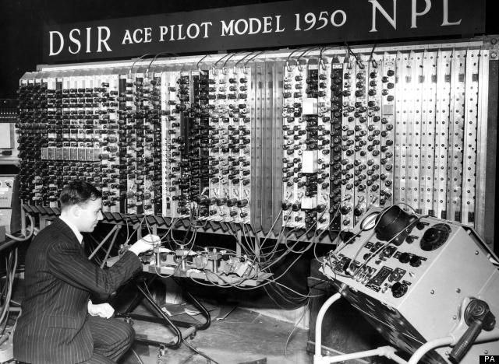
After the war, Alan continued to work on machines. He invented the Automatic Computing Engine,
or ACE for short.
The ACE was the very first digital computer, able to solve problems and store information in its memory.

Slide 11
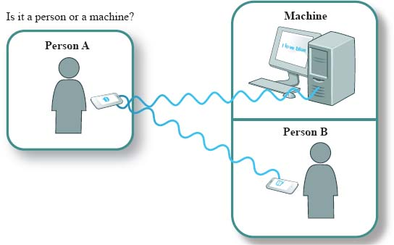
Alan also invented a brilliant test for working out if a machine could really ‘think’.
A machine and a person are hidden in different rooms. Another person has a typed ‘conversation’ with both of them, asking them the same questions. If the questioner cannot work out which one is the machine and which one is the human then Alan said that proves the machine is ‘intelligent’ and can ‘think’.
People can’t agree. Some say we do have intelligent machines who can think and others say we aren’t there yet.
Do you think some machines would pass the Turing Test now?
Alan called it the Imitation Game, but we know it as the Turing Test

Slide 12
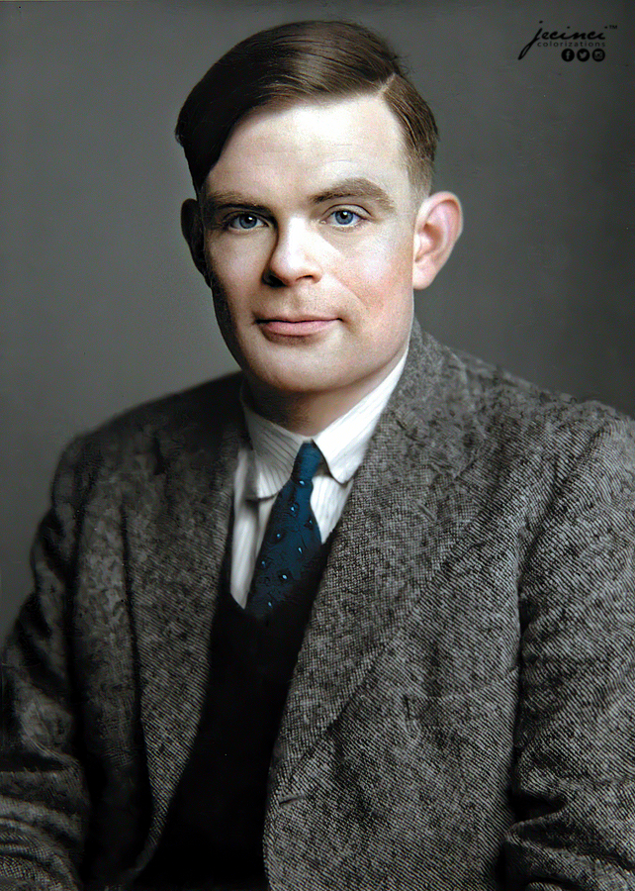
Sadly, things went terribly wrong for Alan in the early 1950s.
Alan was gay at a time when this was illegal in the UK. In 1952 he was taken to court and given a terrible choice. He could either go to prison or have a medical treatment designed to stop his romantic feelings.
How do you think Alan felt about this terrible choice.?

Slide 13
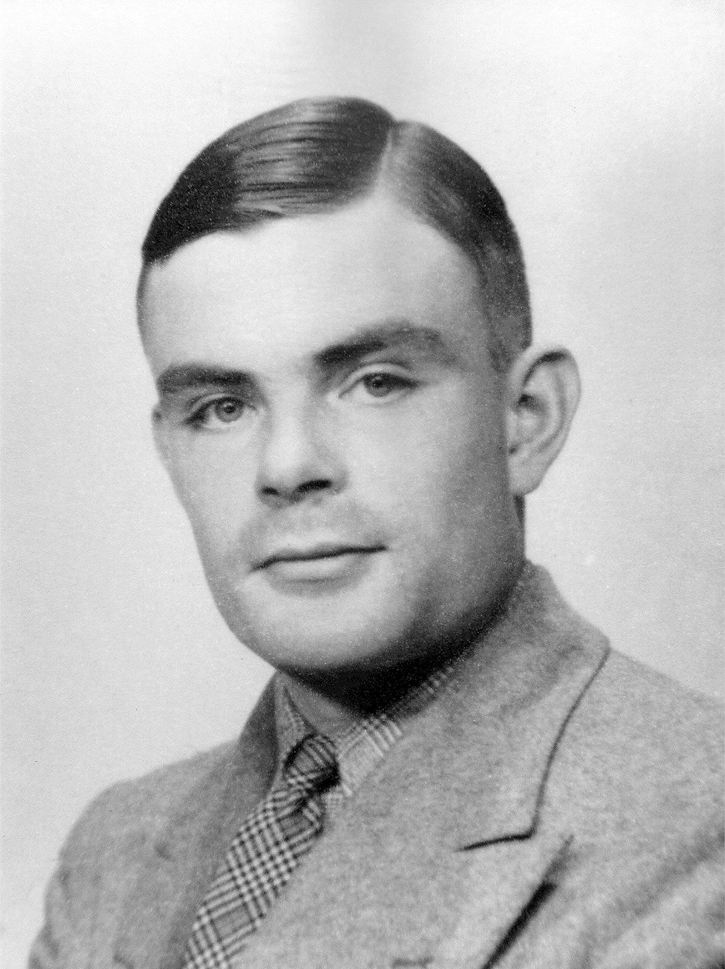
Now we know that being gay is just another way of being a human and that it’s not something we can or should try and change, but in the 1950s people hadn’t learned that yet.
Alan didn’t want to go to prison so chose the medical treatment, but it made it made him feel terrible and sadly he was found dead in 1954.

Slide 14
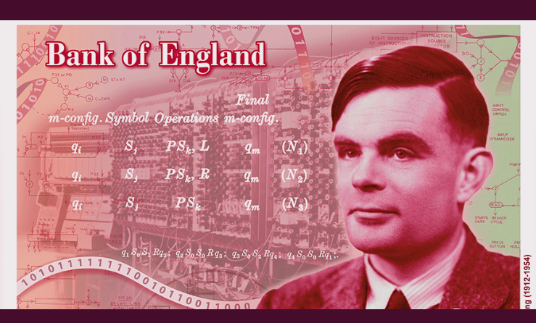
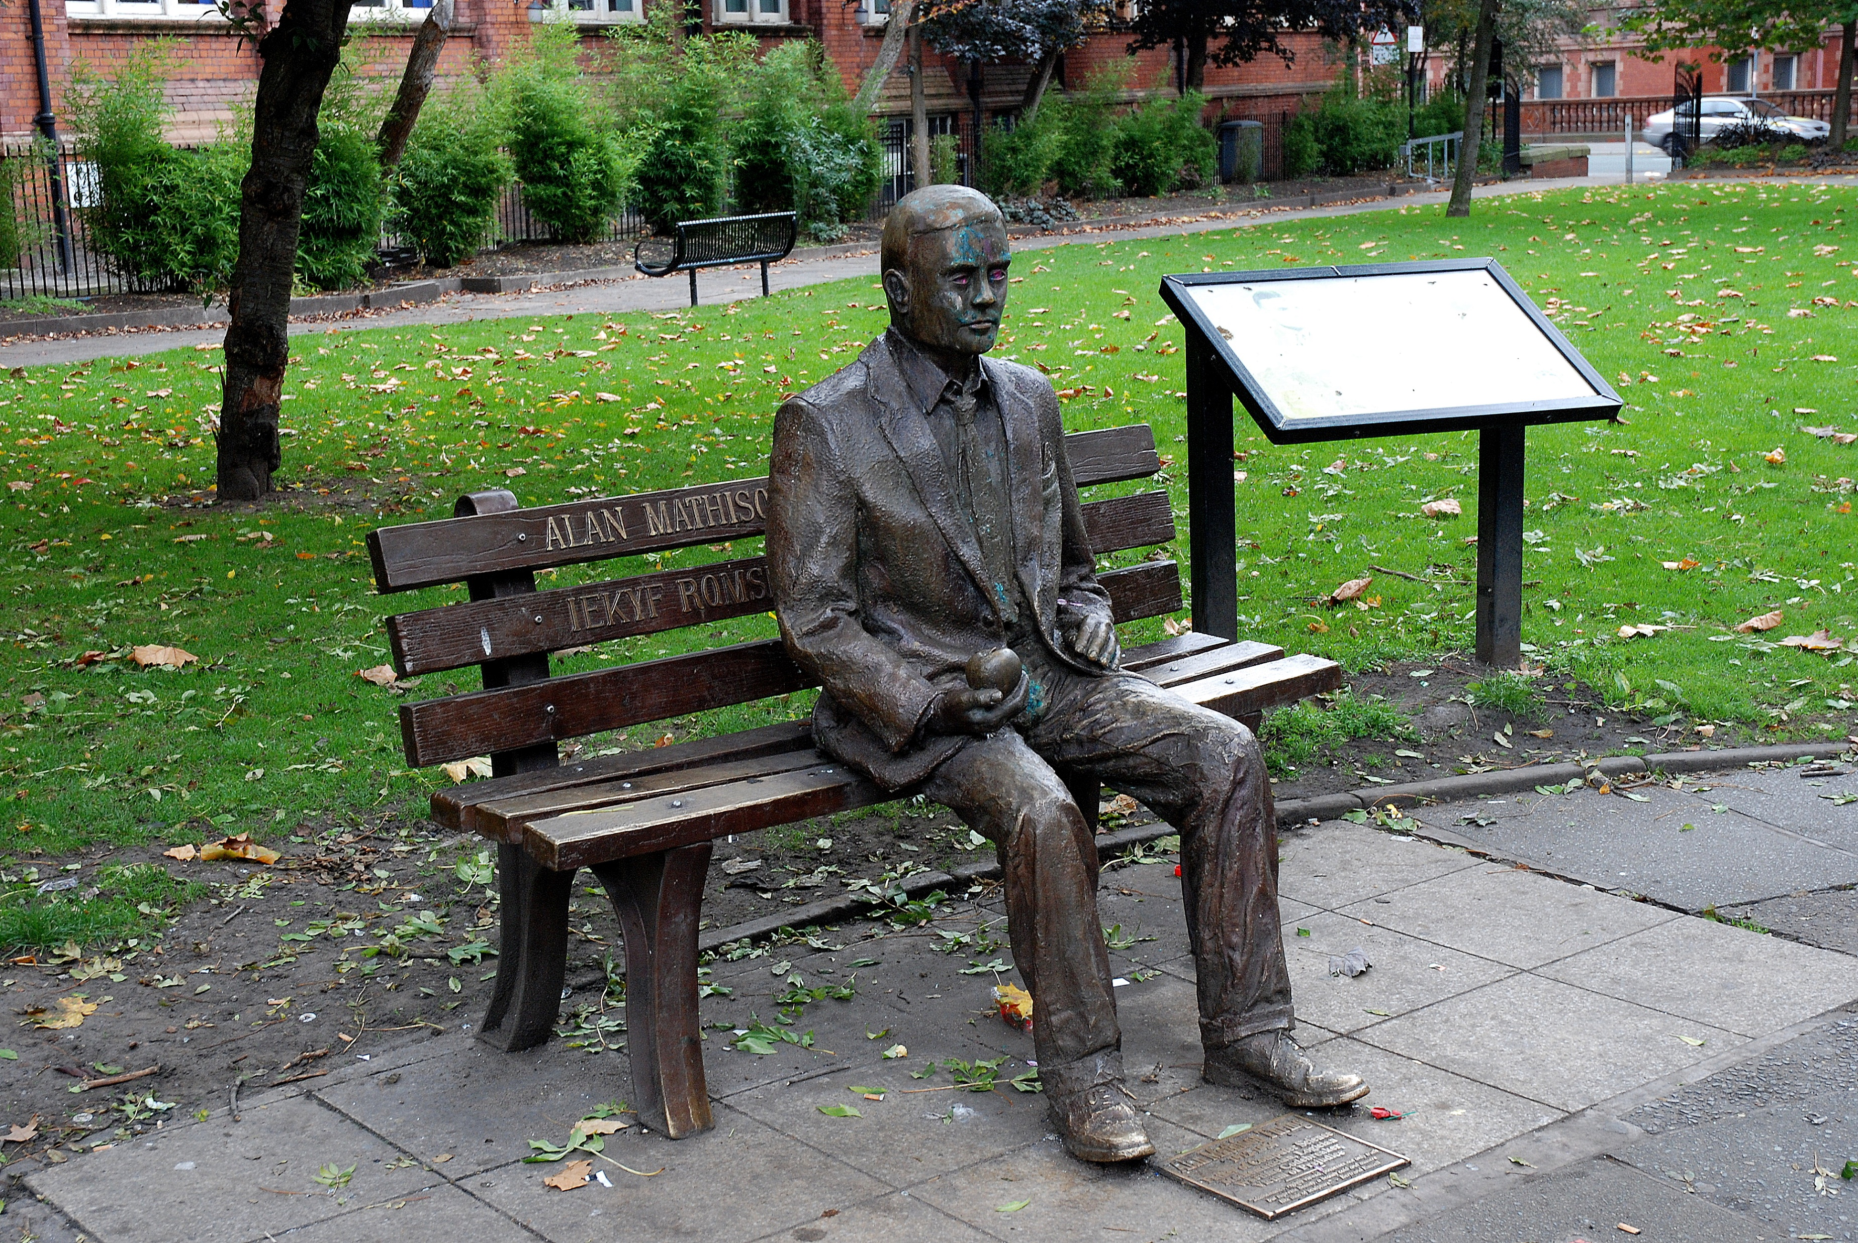
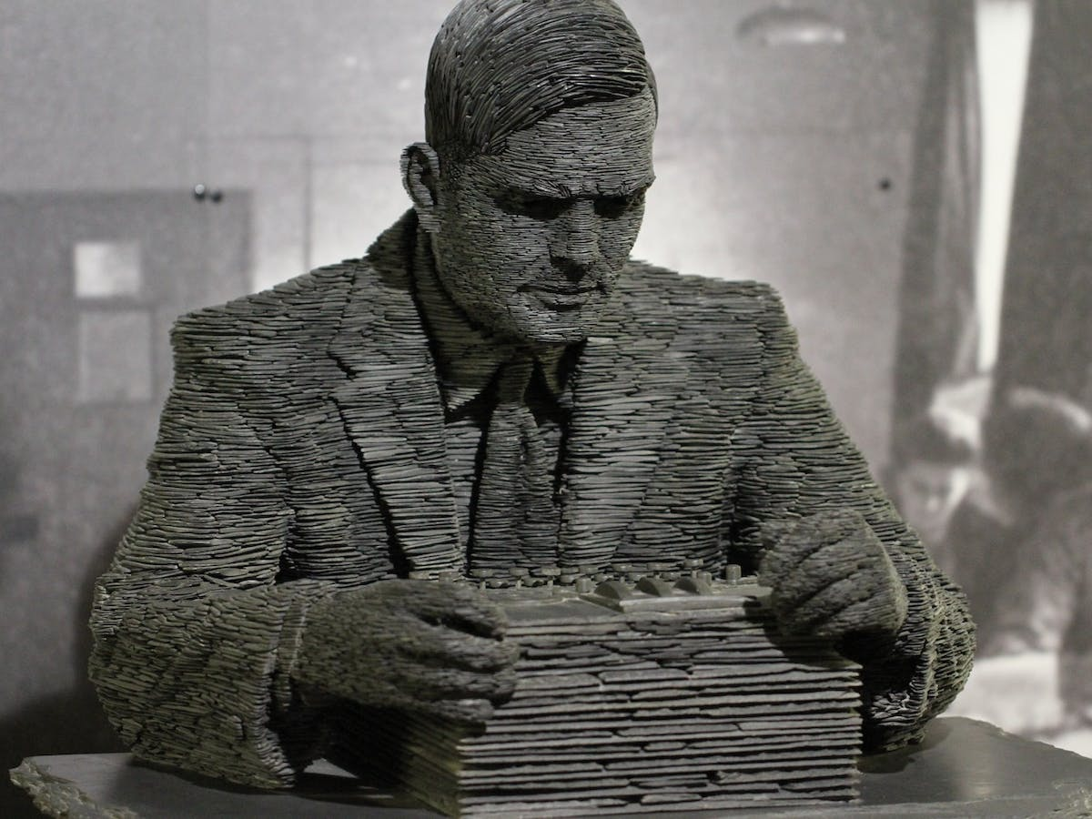
In 2009 the British Government apologised for how Alan had been treated. Now, he is praised as a true hero. He appears on money, statues of him have been built and awards named after him.

Slide 15
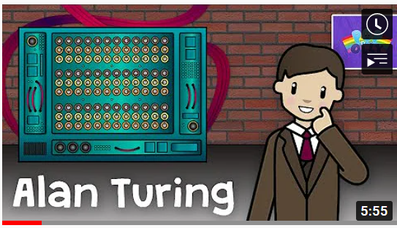
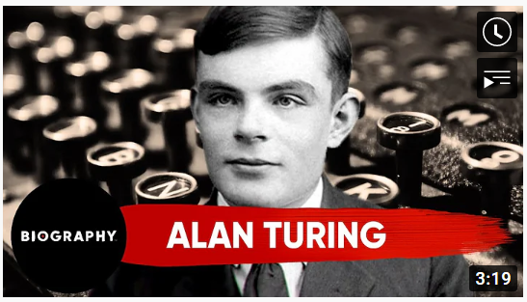
Find out more by clicking on the pictures to watch videos about Alan Turing.

Slide 16
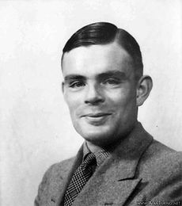
What do you think we can learn from Alan Turing, his life and experiences?
Do you think Alan deserves to be called a hero?
What do you think about how he was treated ?

Slide 17
This powerpoint was made by diversity_mel. It is part of a large series designed to encourage debate and discussion around issues of equality in a bid to make more children happier and thoughtful. You can find more assemblies/ discussion ppts on my website.
My website is www.diversitymel.com
You can email me via my website too. I love to hear how you’ve used my powerpoints and to get your ideas for any you’d like me to make.
You can follow my work on Instagram @diversity_mel
Please do share my powerpoints with other teachers who may be interested.
Please note: I make no money from making and distributing these resources.

