Slide 1
This powerpoint was made by diversity_mel. It is part of a large series designed to encourage debate and discussion around issues of equality in a bid to make more children happier and thoughtful. You can find more assemblies/ discussion ppts on my website.
You can contact me via my website too. I love to hear how you’ve used my powerpoints and to get your ideas for any you’d like me to make.
You can follow my work on Instagram @diversity_mel
Please do share my powerpoints with other teachers who may be interested.
My website is www.diversitymel.com

Slide 2
Lilian Bader – first black woman in the Women’s Auxiliary Air Force – WW2
This assembly is one of a series encouraging children to recognise we can learn from each other and that we can make changes to our world.
This one focusses on Lilian Bader and mentions the men who volunteered from around the world to help the Allies in WW2.
The video has been checked, but please check for yourself before viewing.
Keep a look out – more assemblies on this theme coming soon.

Slide 3
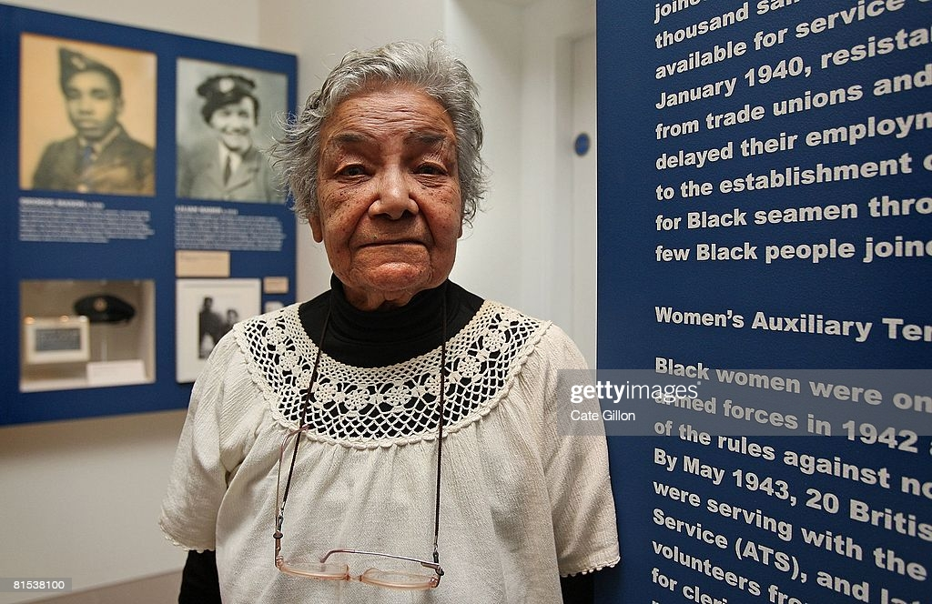
This is Lilian Bader. She died a few years ago, aged 97.
Are there any clues in the picture that help us find out why she is famous?
Let’s see if you’re right…

Slide 4
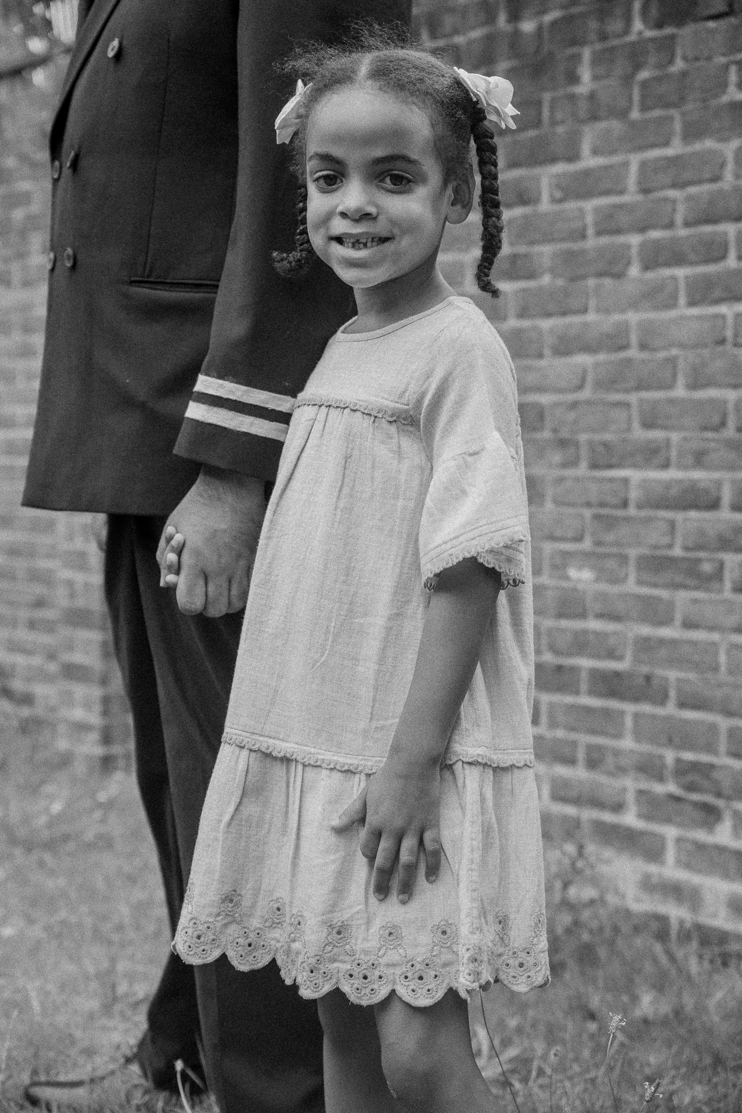
Lilian was born in 1918 in Liverpool, a city in the North of England.
Lilian’s Mum was Irish and her Dad was from an island, thousands of miles away, called Barbados.
Notes:
NOTE: This picture is not of Lilian Bader, but is from a photographic project to recreate her life by Elizabeth Okoh
https://elizabethokoh.com/lilian-bader-first-black-woman-to-join-the-airforce/

Slide 5
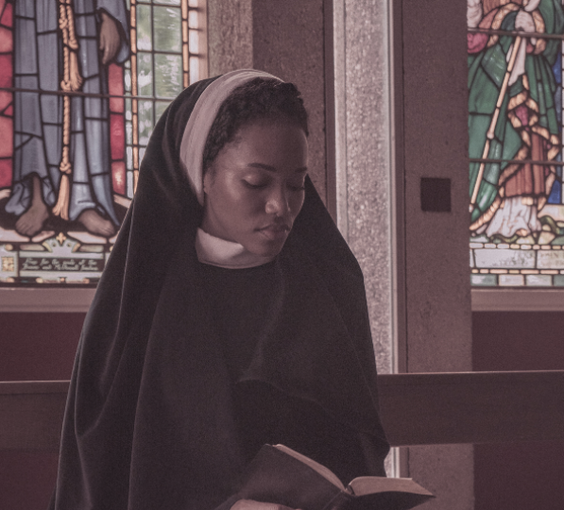
Sadly, Lilian’s Mum and Dad died when she was still very young. She was separated from her brothers and sent to be looked after by nuns.
When she got older, Lilian tried hard to get a job, but she found it really difficult. There was a lot of racism and people didn’t want to employ a mixed-race girl.
Nobody would give me a job… not even the priests and that was when I realised I had a problem with colour.
How do you think this made Lilian feel?
Notes:
NOTE: This picture is not of Lilian Bader, but is from a photographic project to recreate her life by Elizabeth Okoh
https://elizabethokoh.com/lilian-bader-first-black-woman-to-join-the-airforce/

Slide 6
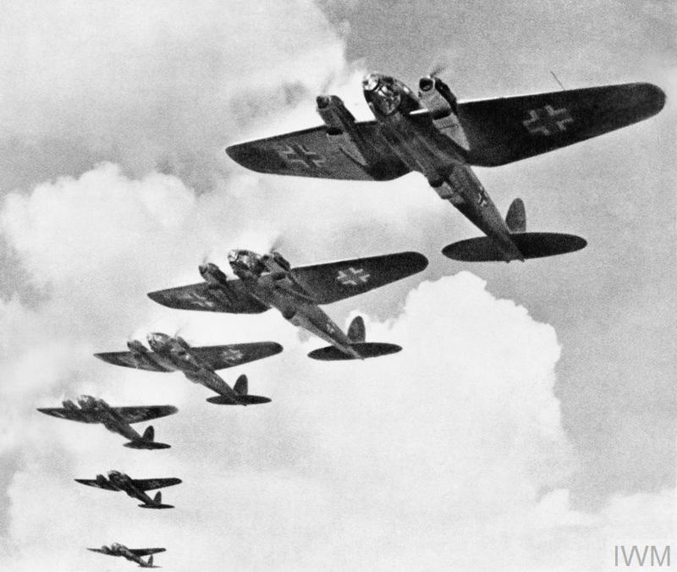
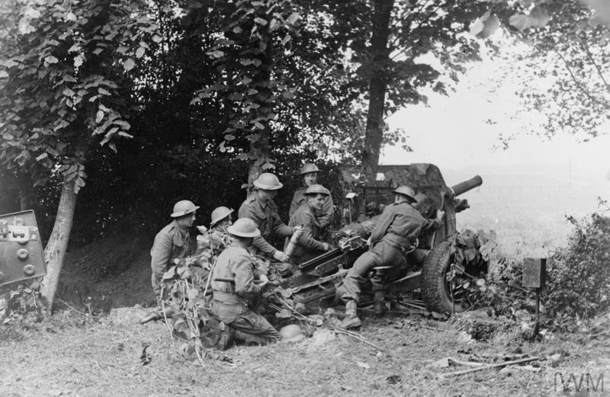
Lilian was 21 when the Second World War broke out. She really wanted to help in some way.

Slide 7
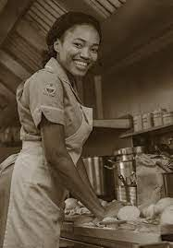
Lilian eventually got a job working in a canteen making food for soldiers. She was really happy to be doing something positive.
However, after 7 weeks, she was told she had to leave the job because her Dad was not from Britain.
Is that fair? How do you think Lilian felt about this?
Notes:
NOTE: This picture is not of Lilian Bader, but is from a photographic project to recreate her life by Elizabeth Okoh
https://elizabethokoh.com/lilian-bader-first-black-woman-to-join-the-airforce/

Slide 8
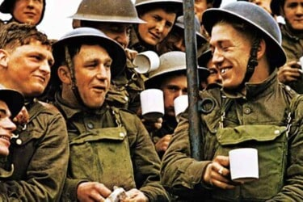
At the start of World War 2, Britain had a ‘colour bar’ which meant that only white men could fight for Britain.
How do you feel about this law??

Slide 9
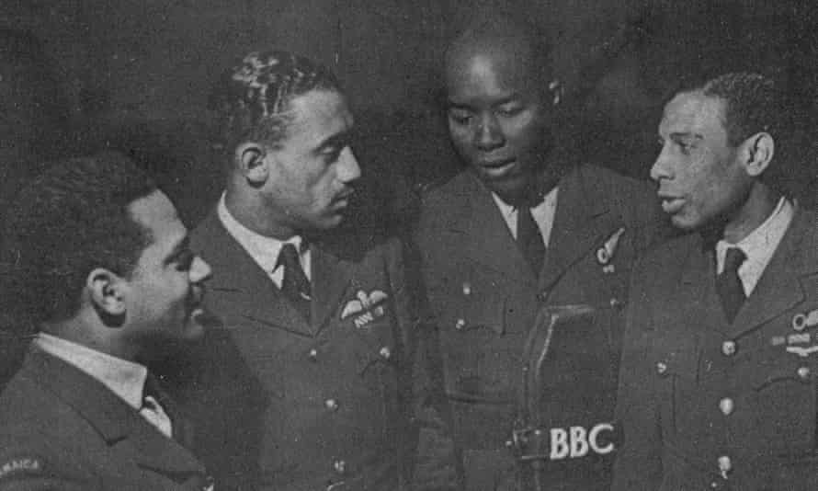
Eventually Britain dropped this law and asked people from all over the world to help them in the fight.
Millions of men came to help, from countries around the world, including India, China, South Africa, Jamaica and many other places.
They made a huge difference in the war, but were often treated poorly and paid less than British men.
Notes:
This issue is explored further in my Remembrance PPT

Slide 10
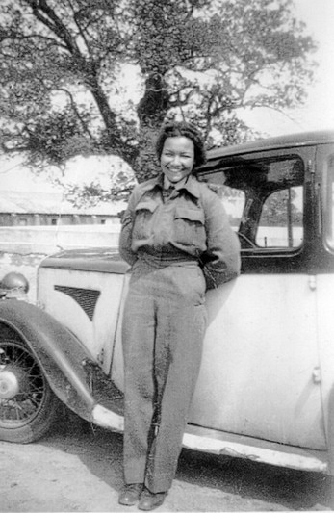
When Lilian heard that black men were serving in the forces, she applied again and got a job in the Women’s Auxiliary Air Force. She had to train for weeks.
When I got there I was the only coloured person in a sea of white faces. That was hard, but someone told me I looked smart in my uniform, which cheered me up no end.

Slide 11
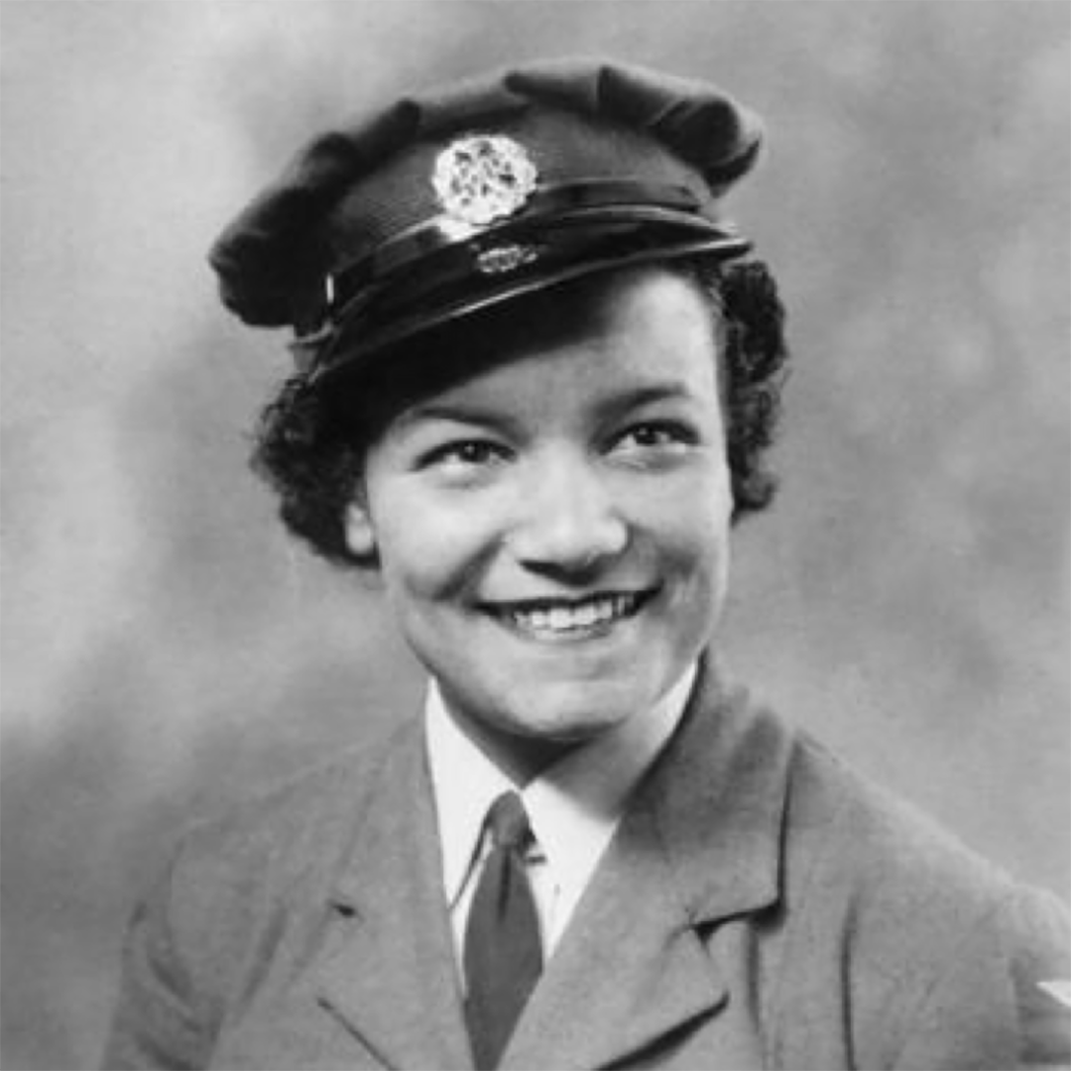
Lilian worked as an instrument repairer. Women had never been allowed to do this job before, but in World War Two they showed they could do a whole variety of jobs really well.
I had to check that everything in the planes worked perfectly. It was very hard work and long hours, but I was proud to be making a difference.

Slide 12
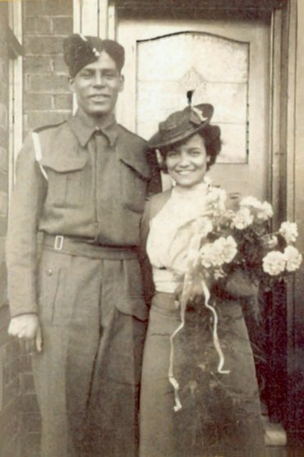
Lilian worked hard and became a Leading Aircraftwoman. In 1943 she married tank driver Ramsey Bader and they had two sons.
Lilian had to leave her job in the military as women couldn’t be mothers and have a job in those days.
Again, Lilian found that racism made it harder for her to find work, but she went back to college, studied hard and became a teacher.

Slide 13
Click on the pic to see a little animation of Lilian’s life.

Slide 14
So Lilian was one of the very first black women to serve in the British military. Through her hard work she helped to change Britain and throughout her life she continued to fight racism.
Were any of your guesses right?
What can we learn from Lilian’s life and the challenges she faced?

Slide 15
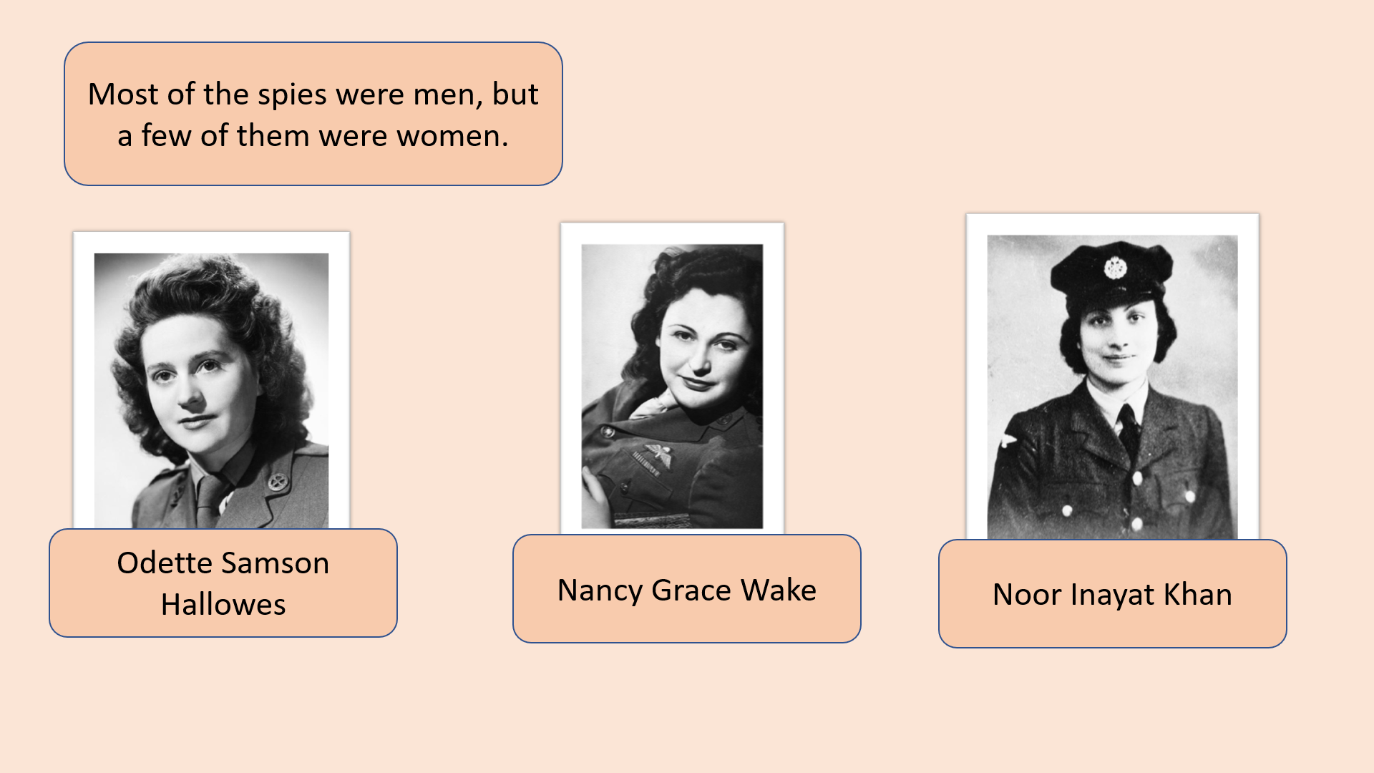
You may be interested in my other ppts, including an assembly on Remembrance, which highlights some of the serving men and women of WW1 and WW2, who are often overlooked and my ppt on female spies in WW2

Slide 16
This powerpoint was made by diversity_mel. It is part of a large series designed to encourage debate and discussion around issues of equality in a bid to make more children happier and thoughtful. You can find more assemblies/ discussion ppts on my website.
You can contact me via my website too. I love to hear how you’ve used my powerpoints and to get your ideas for any you’d like me to make.
You can follow my work on Instagram @diversity_mel
Please do share my powerpoints with other teachers who may be interested.
My website is www.diversitymel.com

