Slide 1
This powerpoint was made by diversity_mel. It is part of a large series designed to encourage debate and discussion around issues of equality in a bid to make more children happier and thoughtful. You can find more assemblies/ discussion ppts on my website.
My website is www.diversitymel.com
You can email me via my website too. I love to hear how you’ve used my powerpoints and to get your ideas for any you’d like me to make.
You can follow my work on Instagram @diversity_mel
Please do share my powerpoints with other teachers who may be interested.
Please note: I make no money from making and distributing these resources.

Slide 2
Bear With – The importance of talk –UKS2, KS3/4
A short visual aid to promote the value of talk, supporting your friends and seeking help when in difficulty.
The final slide could be printed as a poster for display.
There is a KS1/ LKS2 version of this on my website too.
Find many more assemblies on my website DiversityMel.com

Slide 3
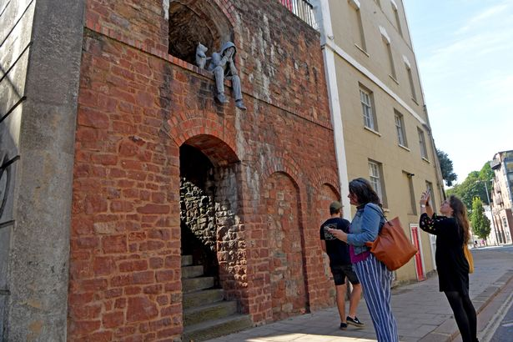
This is a sculpture in Bristol. It was put up one night when nobody was looking.

Slide 4
What can you see?
What could you do if you felt more like the bear?
What does is make you think?
What could you do if you felt more like the person?
Why do you think the artist made it?

Slide 5
If you feel like the bear…
Check on your friends. It’s good to talk.
If you feel like the person…
Talk to someone.
It always helps.

Slide 6
This powerpoint was made by diversity_mel. It is part of a large series designed to encourage debate and discussion around issues of equality in a bid to make more children happier and thoughtful. You can find more assemblies/ discussion ppts on my website.
My website is www.diversitymel.com
You can email me via my website too. I love to hear how you’ve used my powerpoints and to get your ideas for any you’d like me to make.
You can follow my work on Instagram @diversity_mel
Please do share my powerpoints with other teachers who may be interested.
Please note: I make no money from making and distributing these resources.

