Slide 1
This powerpoint was made by diversity_mel. It is part of a large series designed to encourage debate and discussion around issues of equality in a bid to make more children happier and thoughtful. You can find more assemblies/ discussion ppts on my website.
You can contact me via my website too. I love to hear how you’ve used my powerpoints and to get your ideas for any you’d like me to make.
You can follow my work on Instagram @diversity_mel
Please do share my powerpoints with other teachers who may be interested.
My website is www.diversitymel.com

Slide 2
Ada Lovelace – Pursuing your dreams
This assembly is one of a series encouraging children to recognise we can learn from each other.
This one focuses on Ada Lovelace who, unusually for the time, pursued a short career in maths and science and is credited with being the first computer programmer
The video has been checked, but please check the link yourself before using with your class. Thank you.
Cartoon image from The Thrilling Adventures of Lovelace and Babbage by Sidney Padua
Keep a look out – more assemblies on this theme coming soon.

Slide 3
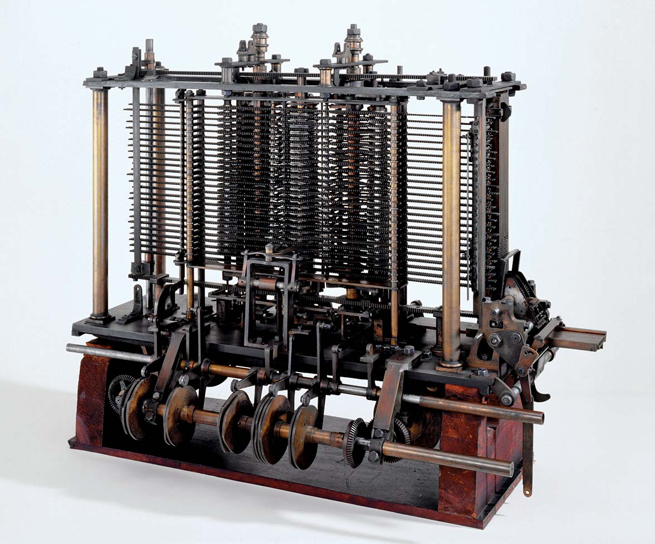
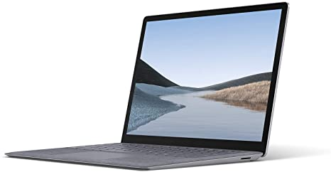
Let’s start with a quick quiz…
Which one of these is a computer?
They both are!

Slide 4
20 years ago
When was the first computer invented?
50 years ago
More than 150 years ago
More than 150 years ago

Slide 5
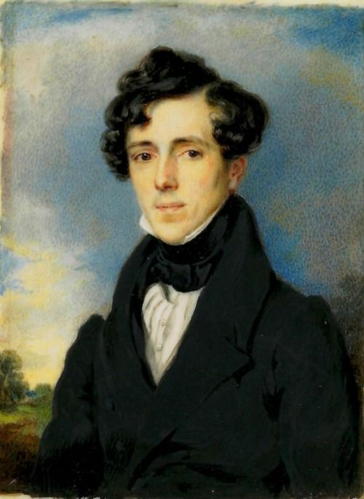
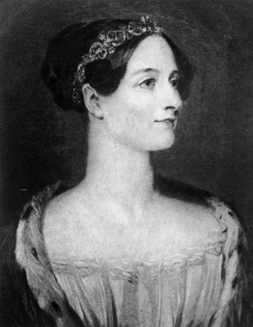
Who invented the first computer?
This man
This wo
-man
It was this woman. Her name was Ada Lovelace. Let’s find out more about her…

Slide 6
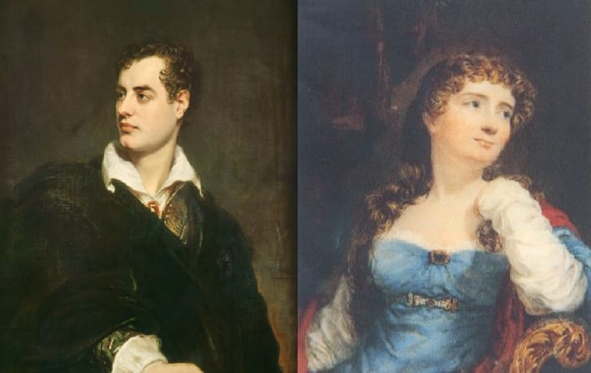
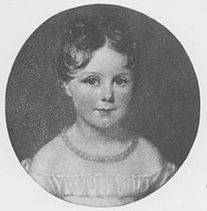
Unfortunately Ada’s parents split up when she was very young, but this didn’t stop her from becoming a brilliant woman herself!
Ada was born in 1815.
She was the daughter of two very clever parents.
Her Dad, Lord Byron, was a brilliant and famous poet.
Her Mum, Annabella Milbanke was a brilliant mathematician.

Slide 7
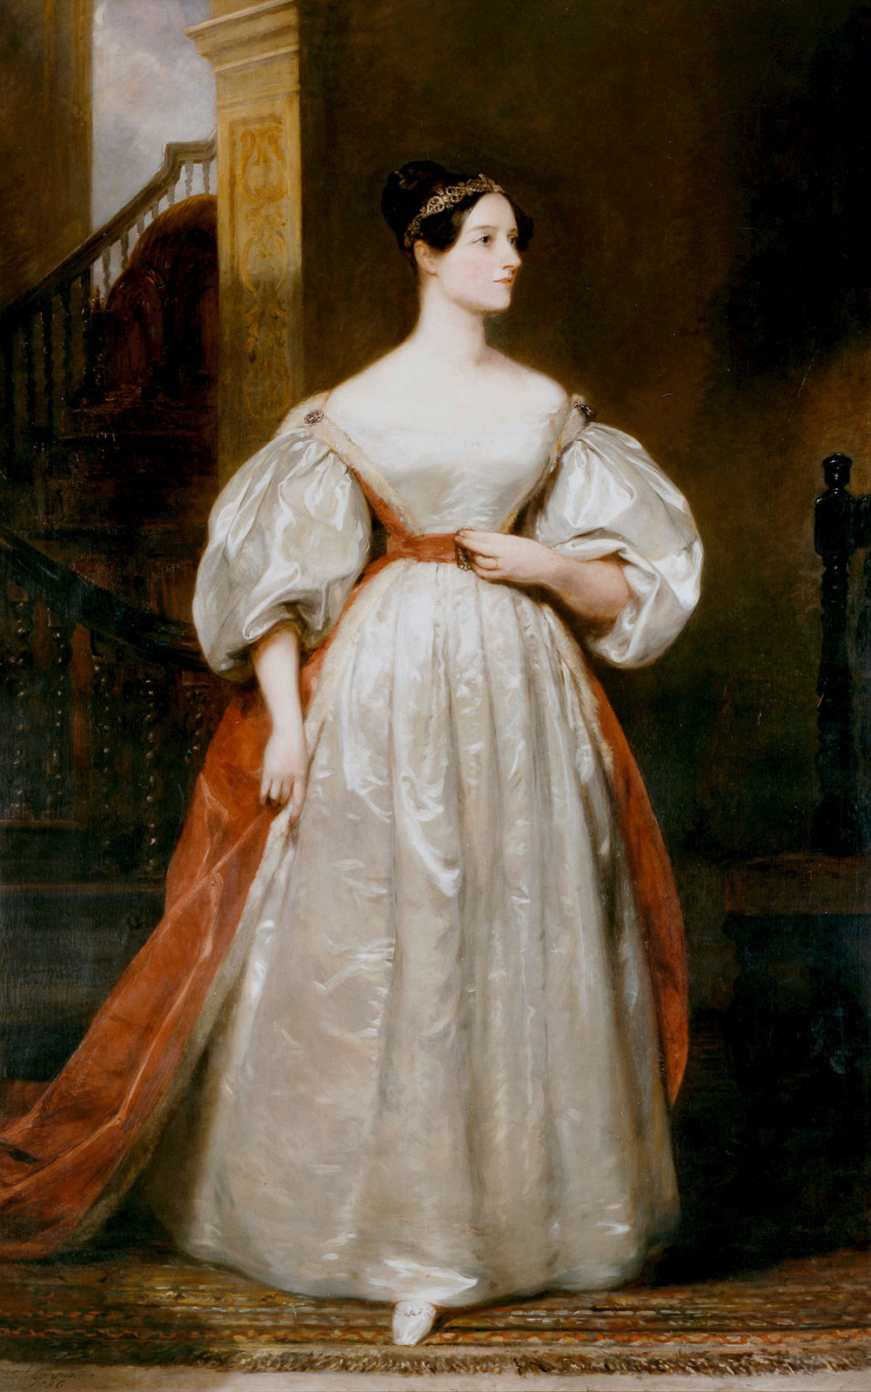
Ada loved to learn and experiment. Which of these things do you think she was able to do?
She used maths to win lots of money gambling
She tried!
She tried!
She learned how to speak French fluently
She invented wings and was able to fly
She could do complicated maths at a time when women weren’t encouraged to do maths at all!
She was often very ill and had to stay in bed but she kept working

Slide 8
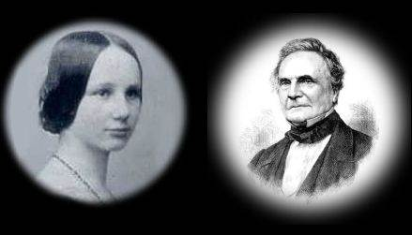
It’s true, Ada was brilliant at maths.
She was maths mad!
She loved maths.
She could see the beauty in it and she loved talking about maths.
At the age of 17 she was introduced to Charles Babbage, who also loved maths.

Slide 9
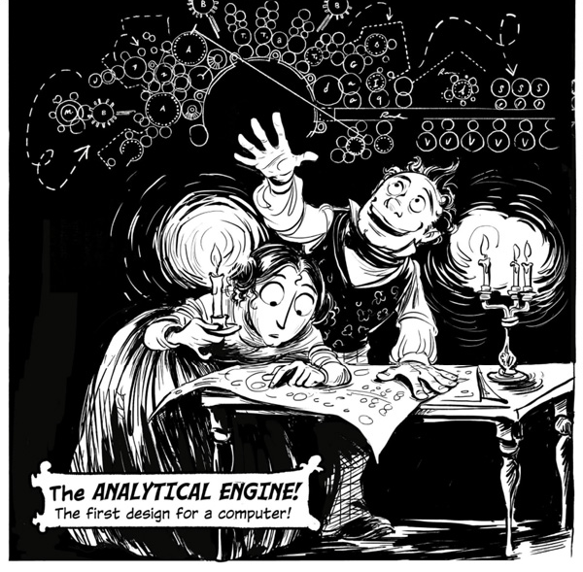
Although they were different ages, Ada and Charles both LOVED maths and talked about it nonstop
I’m trying to invent a machine that can calculate faster than the human brain.
We can do that using maths!

Slide 10
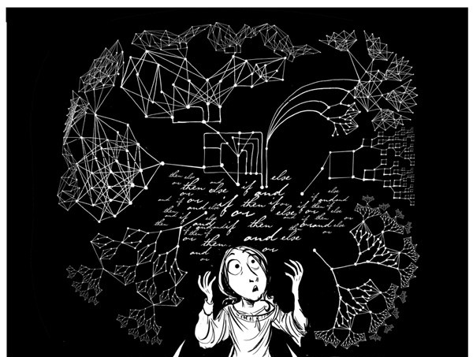
Ada learned about what Charles had already invented and then set about making it better.
I can use what I know about maths to design a machine that will calculate numbers, work with symbols and even play music.

Slide 11
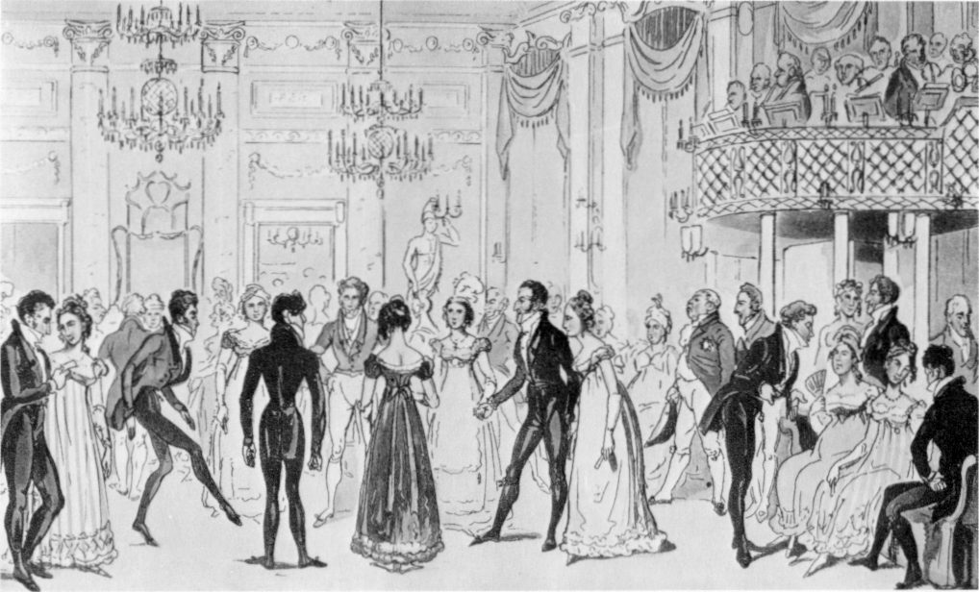
Other people in society weren’t impressed with Ada’s brilliant ideas
A woman shouldn’t be spending her time doing maths
She shouldn’t be working with Babbage. She should stay home with her husband.
Women should dance and sing and play music and look pretty.

Slide 12
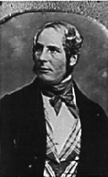
What do you think Ada’s husband thought about her breaking society’s rules?
My wife is so clever!
I want to support her and help her to be her best.
I don’t listen to people who think women shouldn’t work as mathematicians and scientists.
Go Ada!
Fortunately Ada’s husband didn’t care what other people thought.

Slide 13
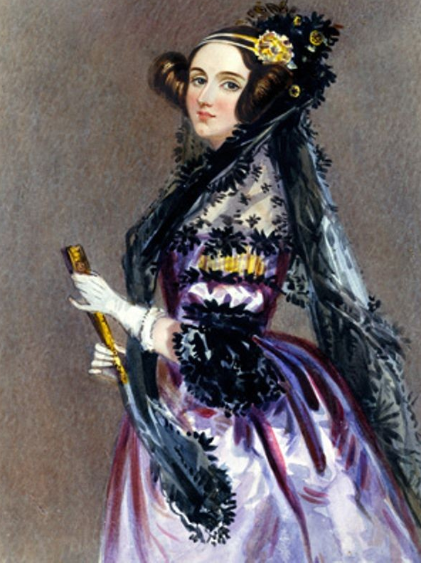
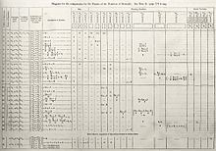
Ada and Charles never saw their Analytical Engine (computer) made. People didn’t really listen to their ideas back then. Ada died age 36, but her notes were used over 100 years later to make the first computer.
All Ada’s hard work had finally paid off. She is now seen as the first computer programmer
Ada’s notes

Slide 14
Click on the picture to watch Ada’s story

Slide 15
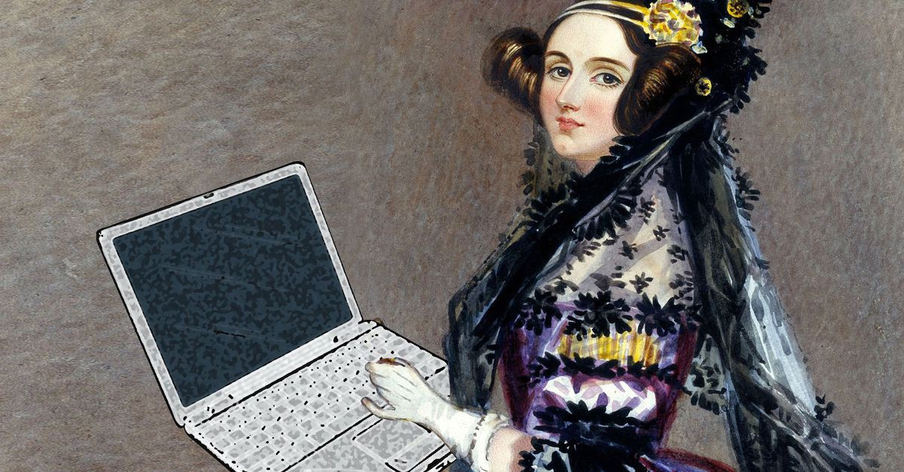
Was she right to work on maths when it wasn’t something women were supposed to do?
What can we learn from Ada?
Was Ada right to keep going even when people didn’t really listen to her ideas?
Is maths just for boys and men? Are there other women who are brilliant at maths?
What are you good at? Would you keep going if people said you should stop?

Slide 16
This powerpoint was made by diversity_mel. It is part of a large series designed to encourage debate and discussion around issues of equality in a bid to make more children happier and thoughtful. You can find more assemblies/ discussion ppts on my website.
You can contact me via my website too. I love to hear how you’ve used my powerpoints and to get your ideas for any you’d like me to make.
You can follow my work on Instagram @diversity_mel
Please do share my powerpoints with other teachers who may be interested.
My website is www.diversitymel.com

