Slide 1

This powerpoint was made by diversity_mel. It is part of a large series designed to encourage debate and discussion around issues of equality in a bid to make more children happier and thoughtful. You can find more assemblies/ discussion ppts on my website.
My website is www.diversitymel.com
You can email me via my website too. I love to hear how you’ve used my powerpoints and to get your ideas for any you’d like me to make.
You can follow my work on Instagram @diversity_mel
Please do share my powerpoints with other teachers who may be interested.
Please note: I make no money from making and distributing these resources.

Slide 2
Violet Piercy – Marathon Runner
Violet Piercy was the first woman in the UK to publicly run a marathon…and she did it all in court shoes!
This ppt tells her story and brings us up to date with marathon running for women in the UK.
The video has been checked, but please check it for yourself too.
Find many more assemblies on my website DiversityMel.com

Slide 3
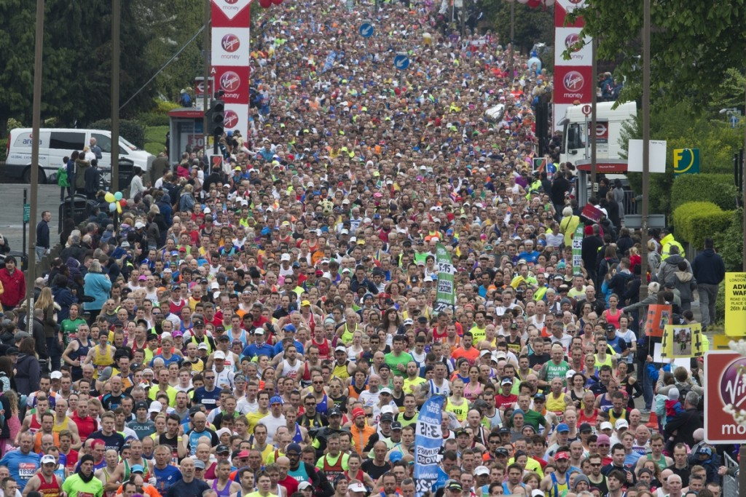
What do you think is happening here?
This is the London Marathon. It is a running race over 26.2 miles.
This year it will take place on Sunday 23 April

Slide 4
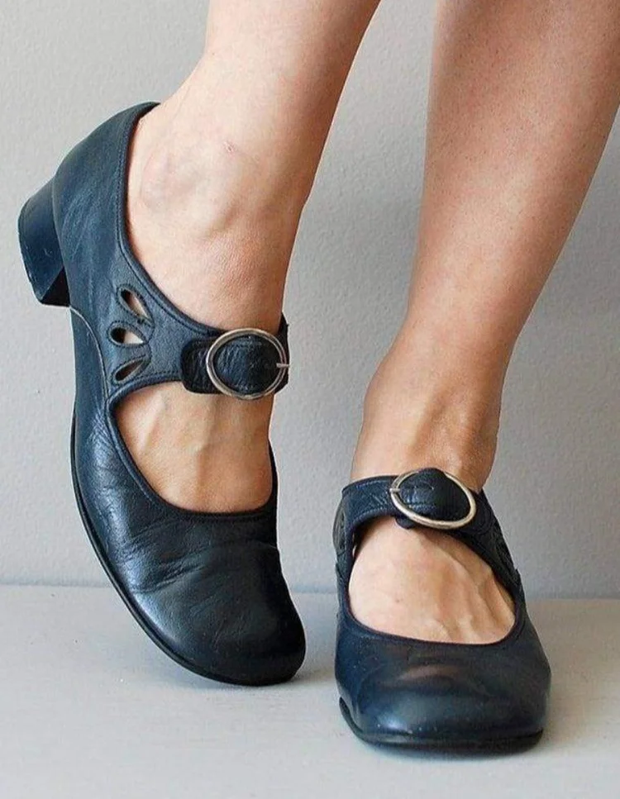
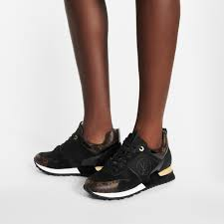
26.2 miles is a very long way and takes most people hours to run!
Which shoes do you think would be better for running and why?

Slide 5
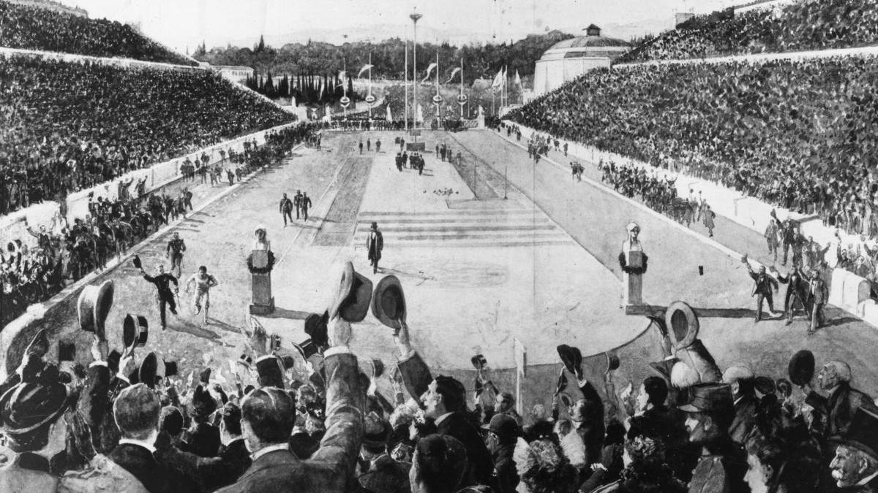
So the next day she ran the race on her own to show she could do it. It took her 5 ½ hours.
The first marathon race was held over 100 years ago in 1894 as part of the Olympic Games.
17 men ran in the race. Stamata Revithi was the only woman who asked to run, but she wasn’t allowed to compete.
Sadly there are no pictures of her.

Slide 6

Why do you think women were not allowed to run in races?
Many people thought that women simply couldn’t run more than 100m.
They worried it might make them very ill or even finish them off!
Some people said it would make women grow beards and turn into men if they went running!

Slide 7
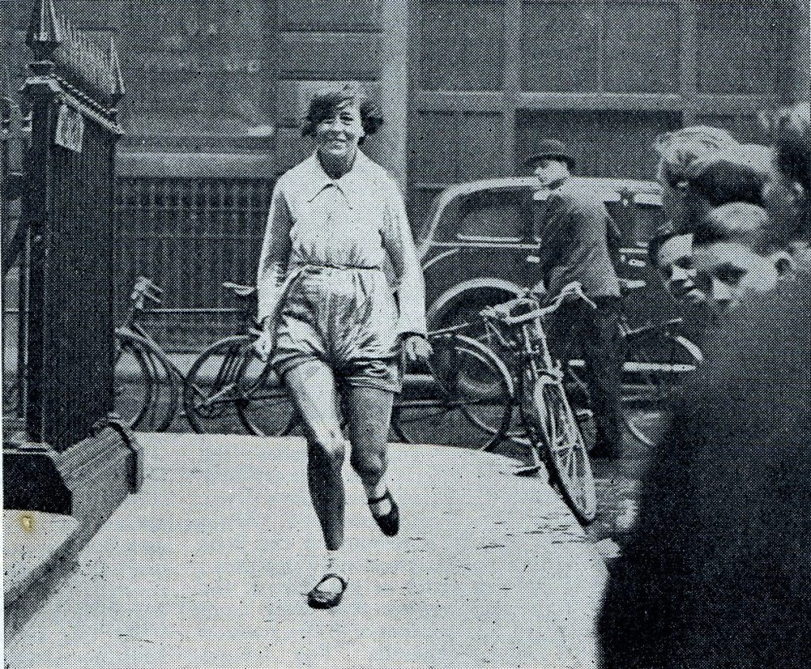
Violet Piercy didn’t believe that at all. She knew it was all completely wrong.
She loved running and became famous for it.
Can you see her shoes?

Slide 8
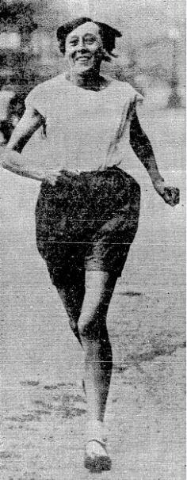
In 1926 Violet ran a marathon on her own from Windsor to London in 3 hours and 40 minutes.
I did it to prove that women’s stamina was just as good as a man’s.
And she didn’t stop there – she ran another two marathons on her own and many other races too.

Slide 9
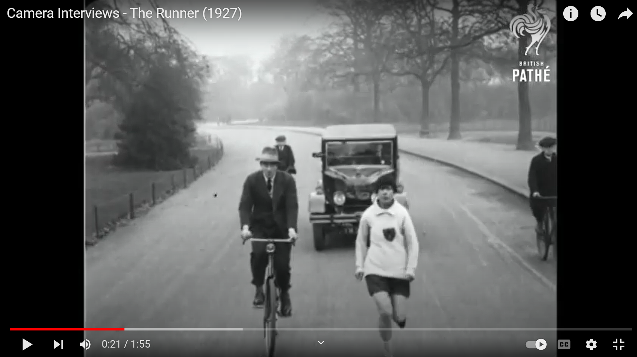
You can see Violet running a marathon in this news reel from 1927.
Don’t forget to look at her shoes!
(It’s so old there’s no sound)

Slide 10
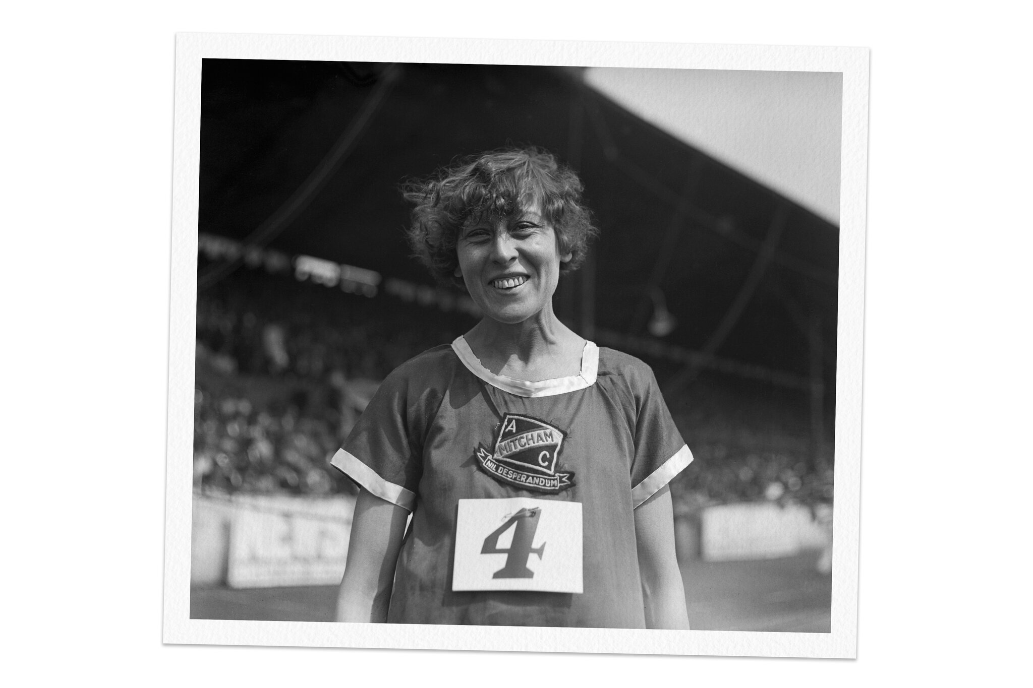
In 1936 (age 46) Violet was allowed to run ahead of the men on an official marathon route. It took her 4 hours and 25 minutes.
The newspaper said ‘She made some men not look so good!’
I was not really competing with the men runners. I only wanted to prove that women could stick the distance.
Why do you think Violet wanted to run the official race so much?

Slide 11
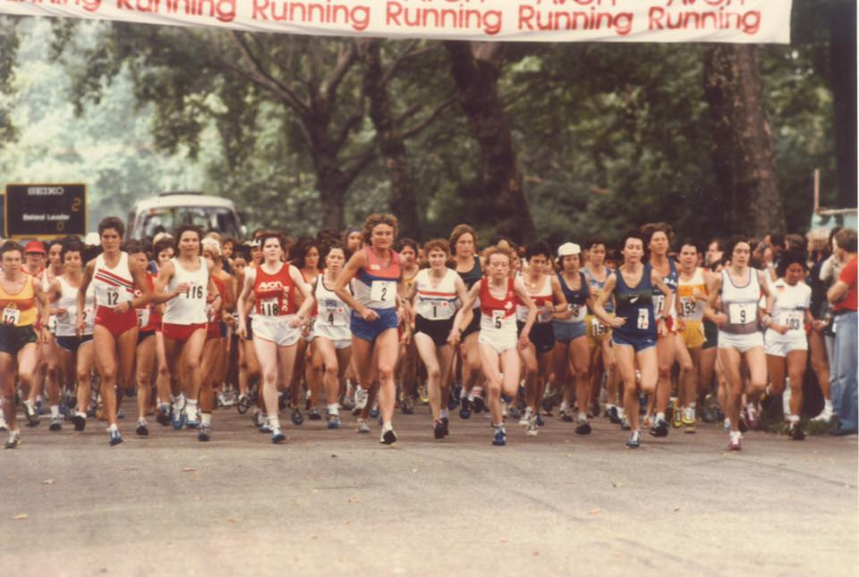
Violet had always run on her own and it took another 44 years until 1980, when women were finally allowed to run in the London Marathon.

Slide 12
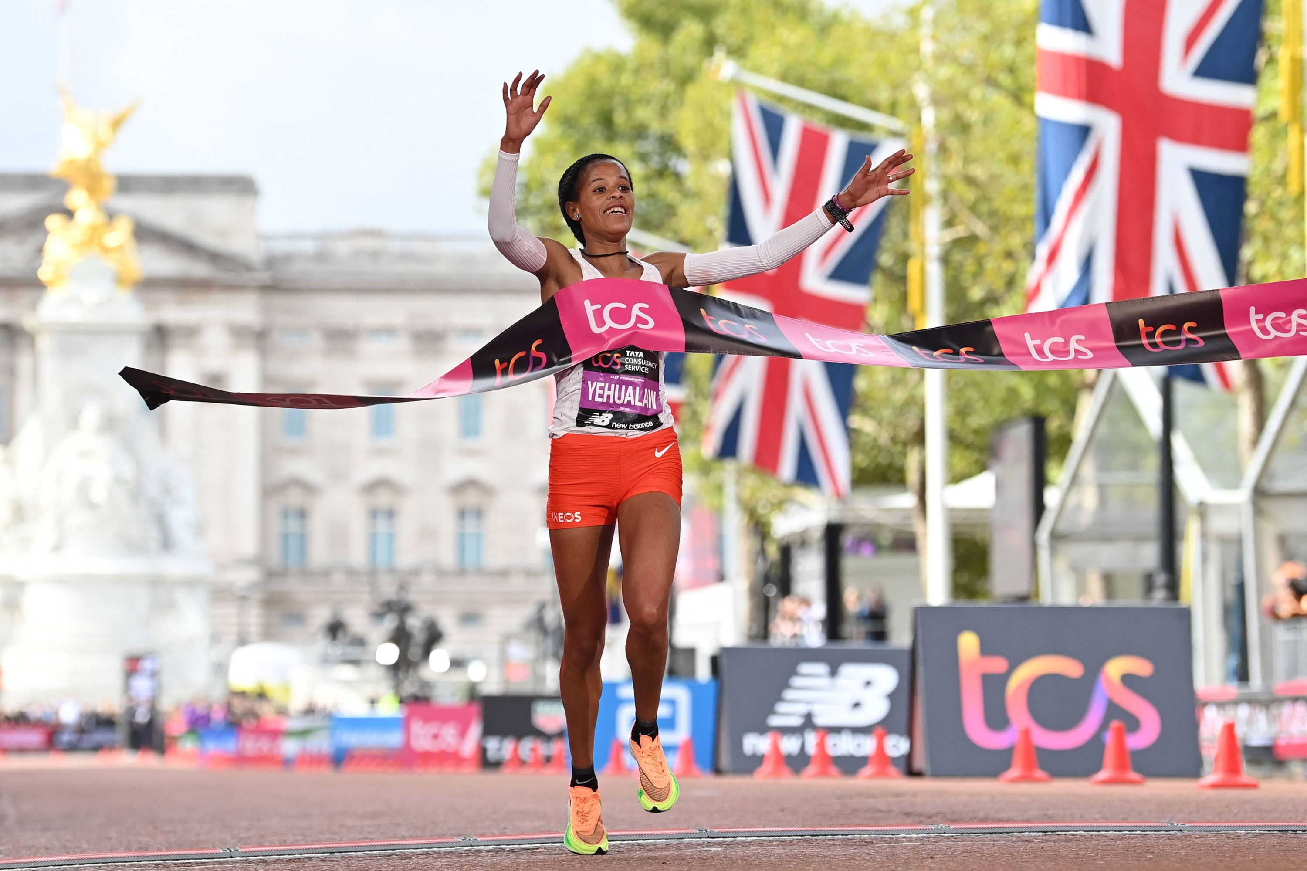
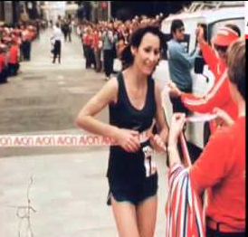
200 women ran and the race was won in 2 hours 35 minutes by Lorraine Moller from New Zealand.
2022’s race was run in 2 hours and 17 minutes by
Yalemzerf Yehualaw from Ethiopia.

Slide 13
Why do you think women can run faster now?
What do you think Yalemzerf and Violet might say to each other if they could meet?
Can you work out how much quicker Yalemzerf
(2 hours 17 minutes)
was than Violet
(3 hours 40 minutes)

Slide 14
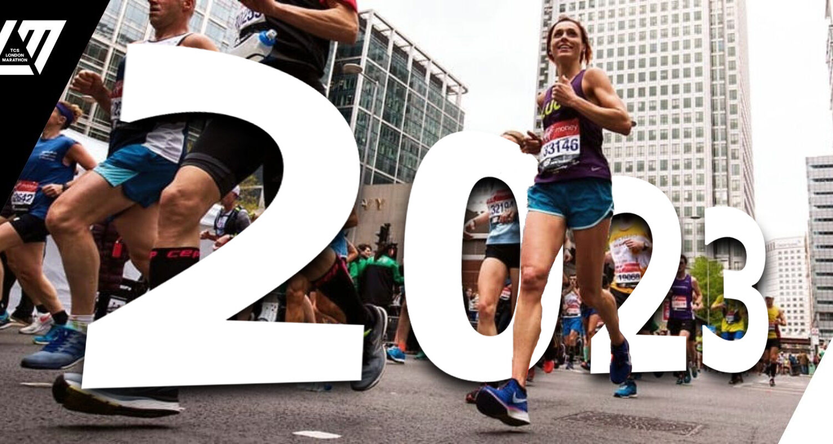
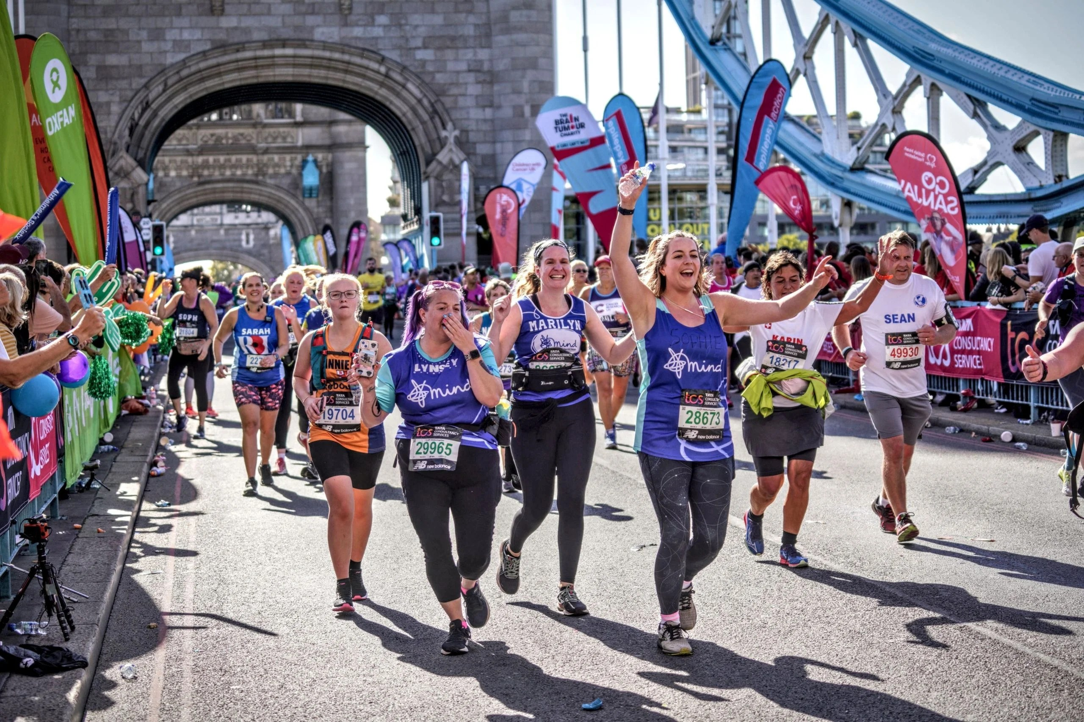
On Sunday 23 April, 50,000 people will run in the London Marathon, including 21,000 women… I bet Violet would be delighted.

Slide 15
This powerpoint was made by diversity_mel. It is part of a large series designed to encourage debate and discussion around issues of equality in a bid to make more children happier and thoughtful. You can find more assemblies/ discussion ppts on my website.
My website is www.diversitymel.com
You can email me via my website too. I love to hear how you’ve used my powerpoints and to get your ideas for any you’d like me to make.
You can follow my work on Instagram @diversity_mel
Please do share my powerpoints with other teachers who may be interested.
Please note: I make no money from making and distributing these resources.

