Slide 1
This powerpoint was made by diversity_mel. It is part of a large series designed to encourage debate and discussion around issues of equality in a bid to make more children happier and thoughtful. You can find more assemblies/ discussion ppts on my website.
My website is diversitymel.com
You can email me via my website too. I love to hear how you’ve used my powerpoints and to get your ideas for any you’d like me to make.
You can follow my work on Instagram @diversity_mel
Please do share my powerpoints with other teachers who may be interested.

Slide 2
Preet Chandi – first South Asian woman to walk solo to the South Pole
This assembly is one of a series encouraging children to recognise we can learn from each other.
This one focuses on Preet Chandi who is undertaking a solo walk to the South Pole. You can follow her journey on www.polarpreet.com
Find many more assemblies on my website DiversityMel.com

Slide 3
What’s the hardest thing you’ve done physically?
Does it involve walking, running, lifting something heavy or something else?

Slide 4
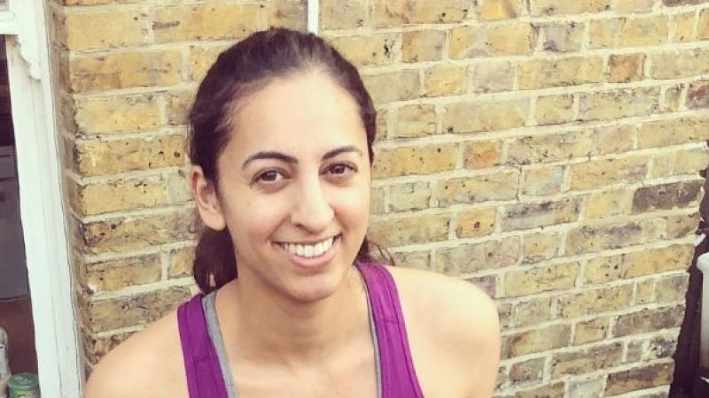
This is Preet Chandi. She is an adventurer.
I know I don’t look like a traditional adventurer, but I want to show you that anyone can be an adventurer – YOU TOO!

Slide 5
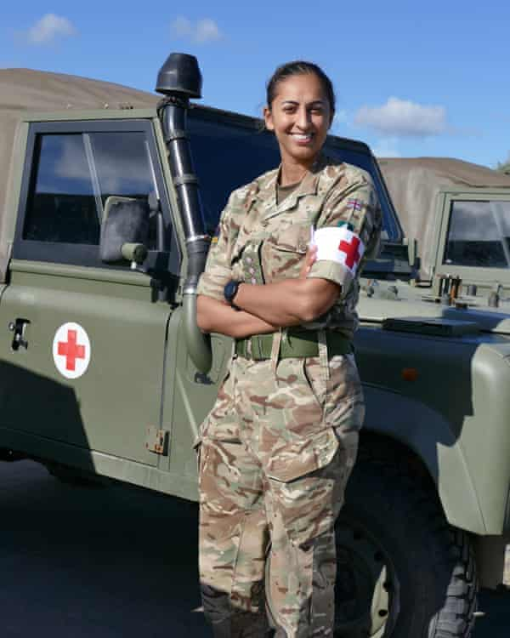
Preet is a captain in the British Army
Can you spot a clue in the picture as to her role in the army?
Preet helps with training medical staff who look after someone who is injured or ill.

Slide 6
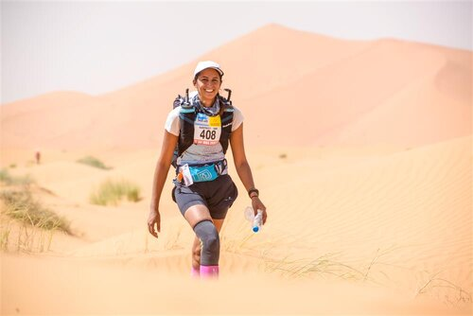
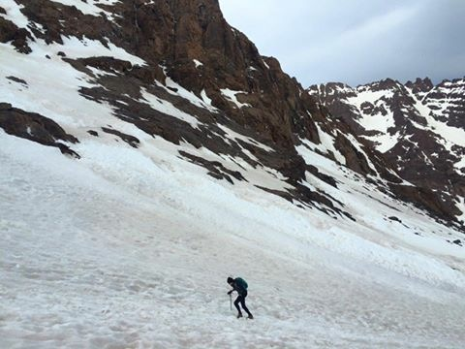
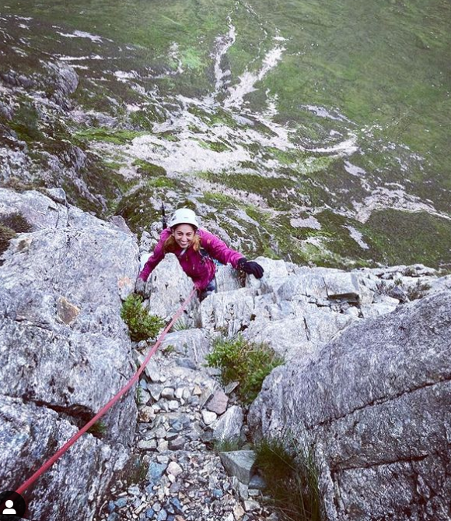
As well as the adventures in her job, Preet pushes her body and mind to do really tough challenges…
…including running 50 mile long marathons, climbing high mountains and trekking in difficult conditions.

Slide 7
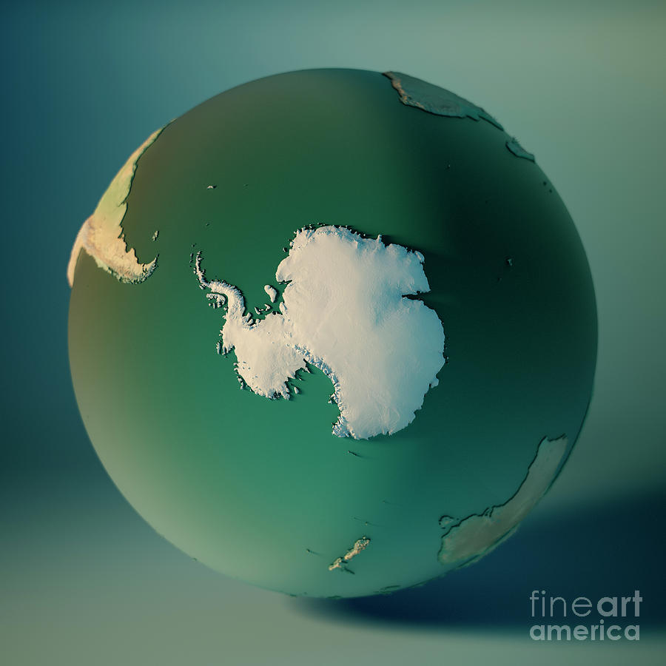
Preet’s latest adventure involves her travelling 20,000 miles from her home in the UK to Antarctica, which is right at the bottom of our planet.

Slide 8
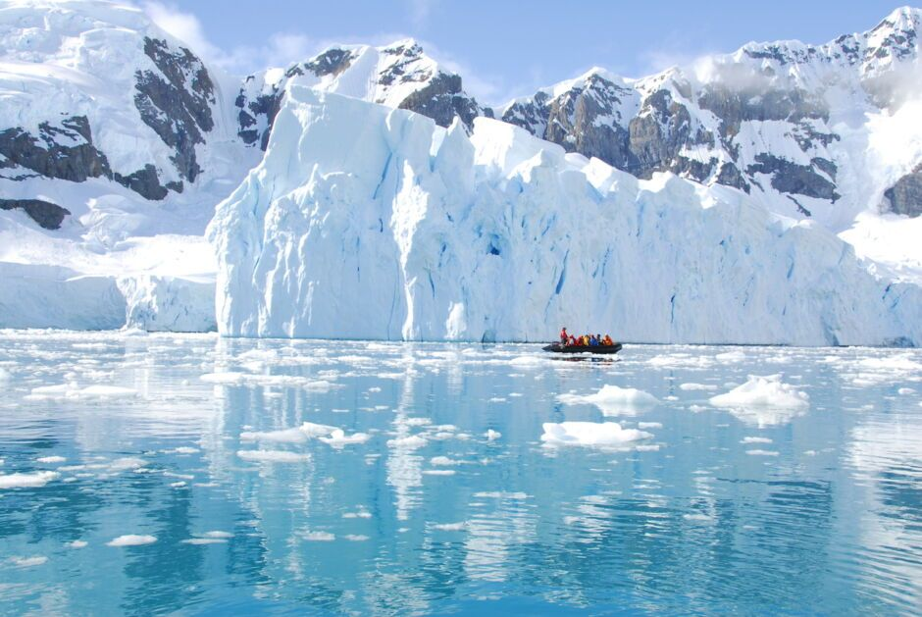
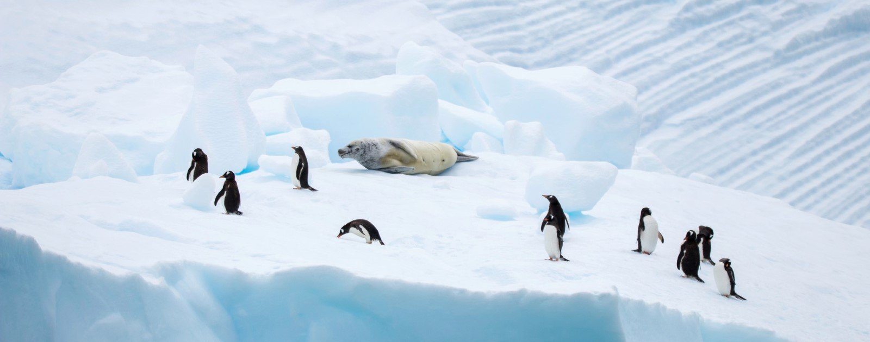
Antarctica is a beautiful place. No humans live there permanently. It has huge mountains covered in snow, giant sheets of ice and is home to penguins, seals and whales

Slide 9
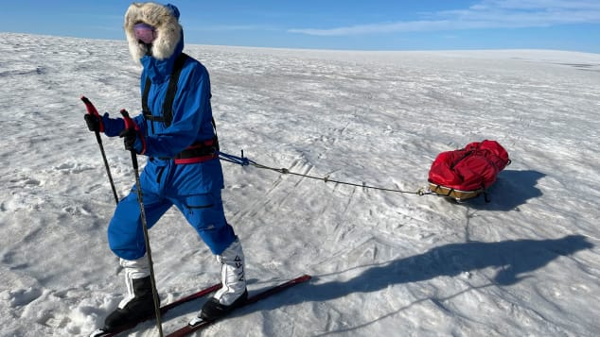
Preet is walking 700 miles on her own to reach the South Pole and as far as she can get by 22 January 2023. She is carrying everything she needs in a pulk (sled) named Simran, after her niece.
What challenges do you think Preet is facing, especially being completely on her own?

Slide 10
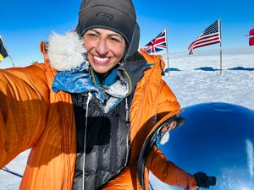
After 57 days of walking alone, Preet made it to the South Pole on 9 January 2023
I made it back to the South Pole! It’s a really incredible place to be. It has been really tough getting here this year. I have been skiing between 13 and 15 hours a day and getting roughly 5 hours sleep a night.

Slide 11
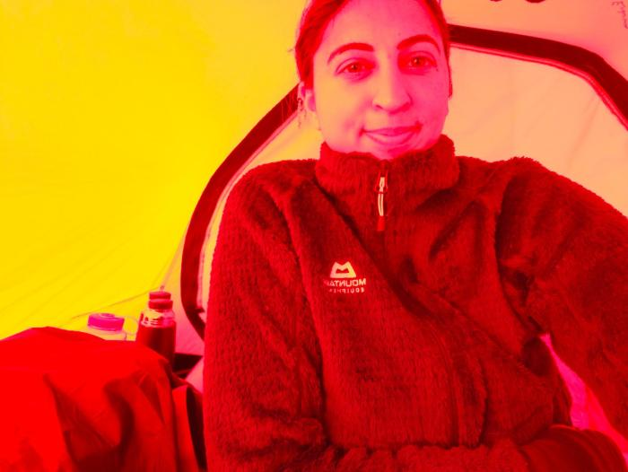
Preet could have stopped at the South Pole, but she has carried on to see how far she can get.
I could have finished at the South Pole but I thought about all the reasons I wanted to do this journey and wanting others to push their boundaries. So I’ll continue to push mine and do as much as I can in the time I have left.

Slide 12
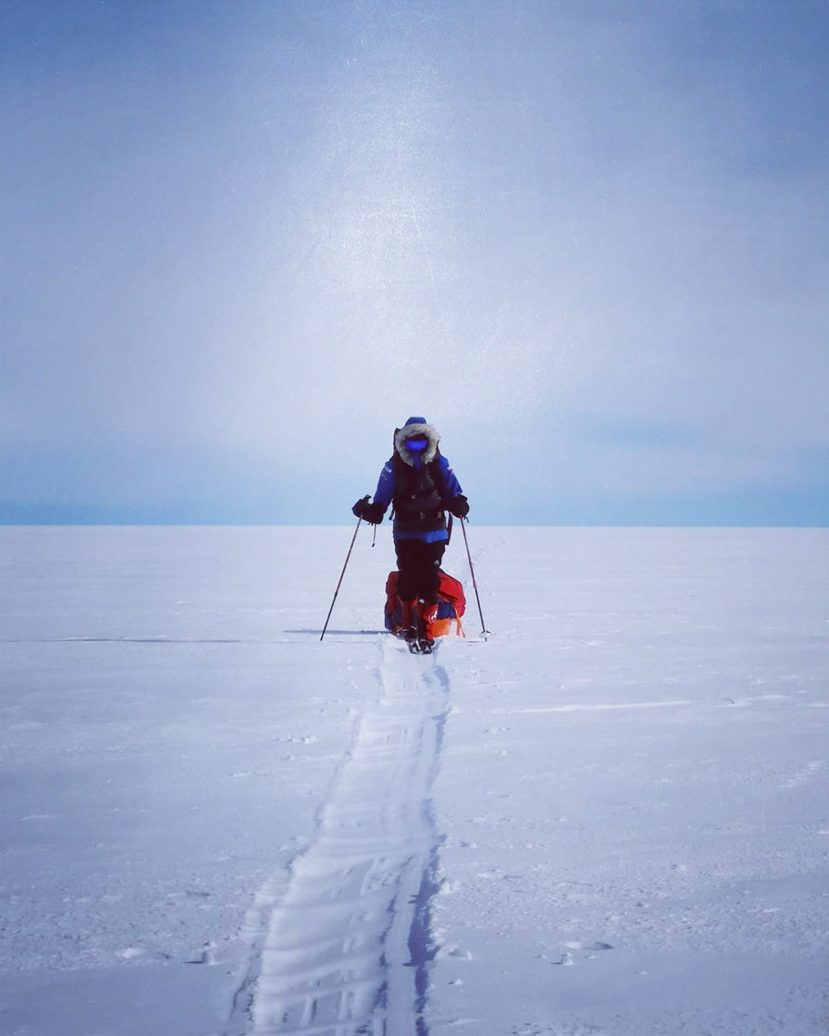
I didn’t know anything about Antarctica when I decided to trek there. Stepping out of your comfort zone is scary
Why do you think Preet is choosing to do something that’s a bit scary?

Slide 13
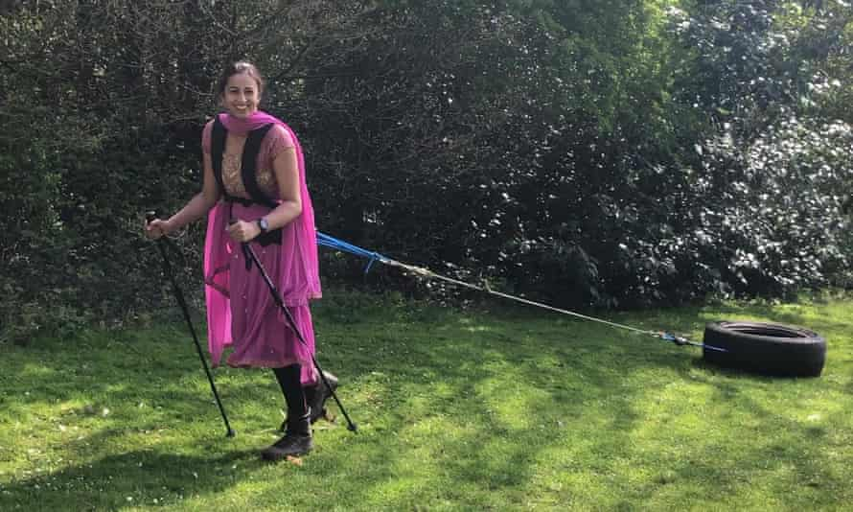
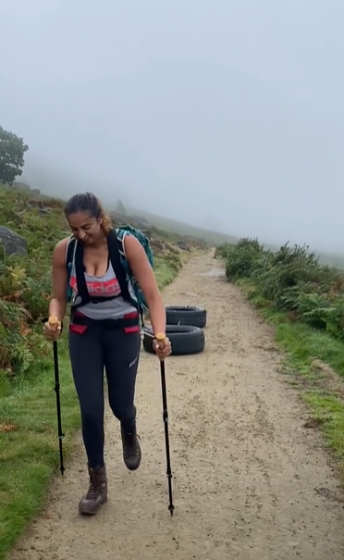
Preet has had to train hard for months. She practices pulling a heavy pulk, by dragging tyres behind her on long walks.
Notes:
I

Slide 14
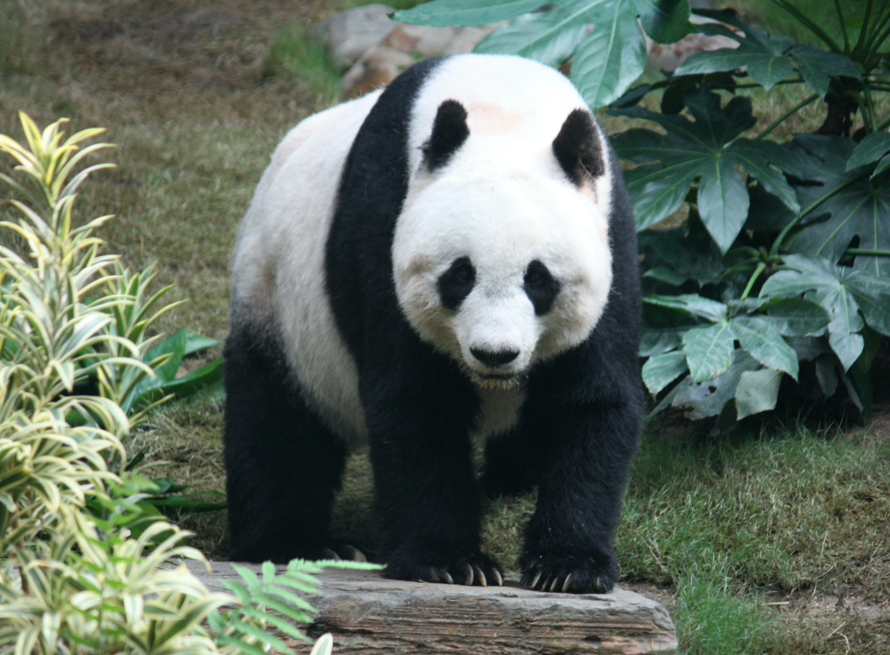
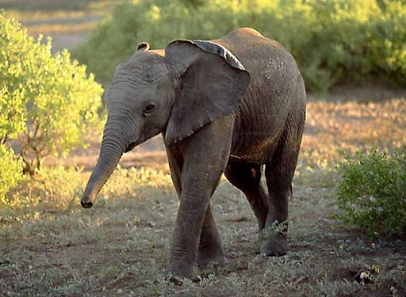
Preet’s pulk weighs over 95kg, which is about the same as a baby elephant or a panda bear!

Slide 15
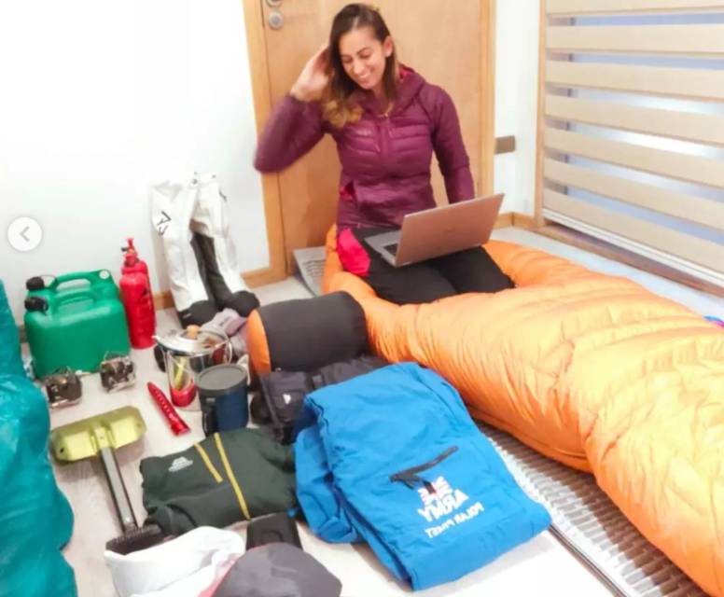
This is Preet sorting out all her equipment.
Can you spot the warm sleeping bag, the shovel for snow and the cans for holding fuel to heat water and food?

Slide 16
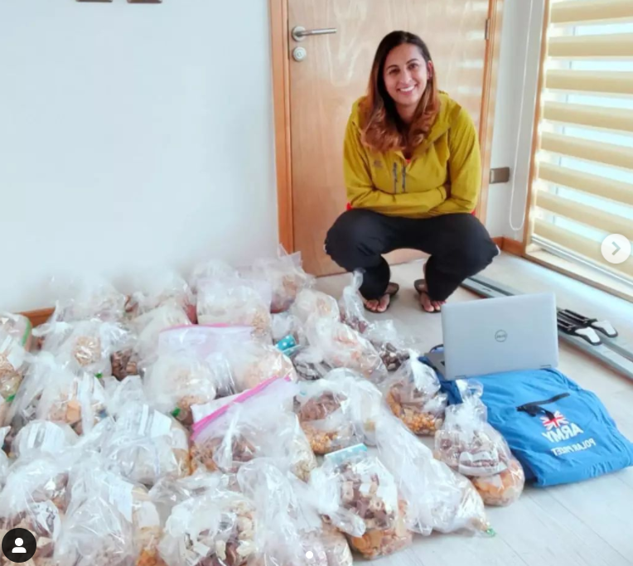
It took Preet two days to sort out all the food she needs on her trip.
Why does she need so much food?
For breakfast and dinner she will heat some water and eat freeze-dried food, but during the day she will snack on chocolate, nuts and cheese.

Slide 17
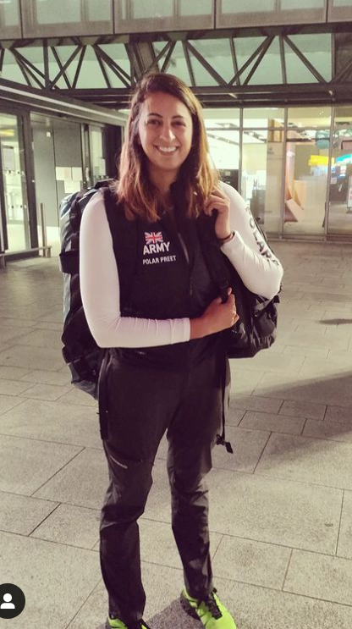
Preet is the first woman of colour to walk on her own to the South Pole.
It’s important to me to be a role model. I’m a Sikh and a British South Asian woman. I NEVER thought I’d be going to South Pole, but I want to show that anyone can be an adventurer.

Slide 18
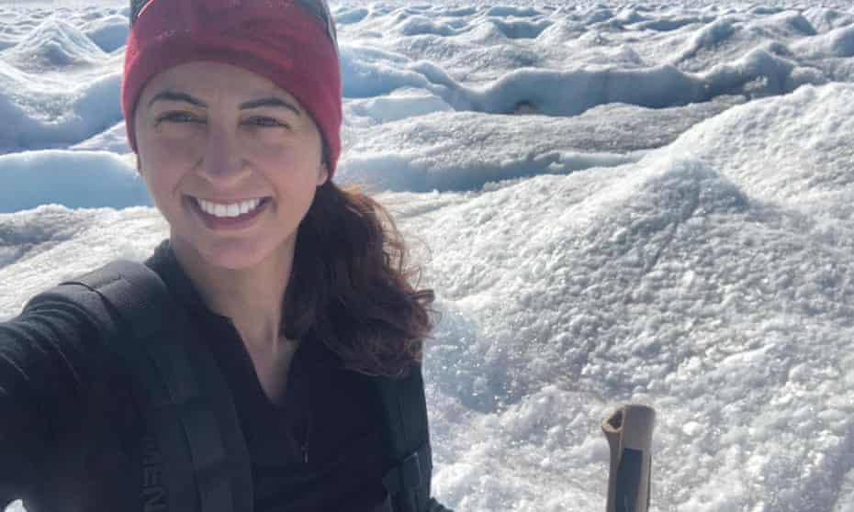
It’s OK to push your boundaries and do hard things. I know that can be scary, that’s OK. Maybe even you don’t know what you can do… yet!
I want to inspire you to believe in yourself. Believe that nothing is impossible!
Preet really wants YOU to feel inspired by her journey. She is encouraging everyone to do something challenging, whatever it is.

Slide 19
You can follow Preet’s journey on a map and listen to her daily voice blogs at her website www.polarpreet.com

Slide 20
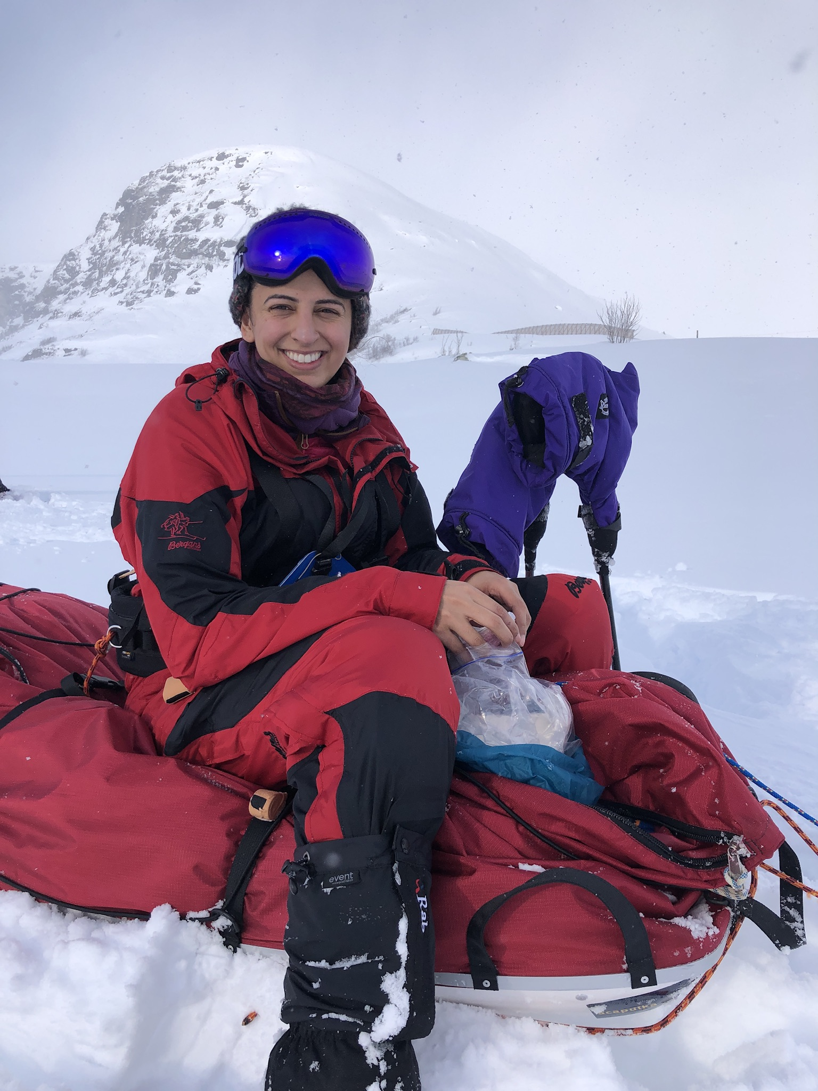
What can we learn from Preet and her adventures?
How does she inspire you?
What skills and attributes (special things) has she developed to be an adventurer?

Slide 21
Follow on work…
This 14-minute video features Preet answering questions about her trip and is pitched for KS2/3 children. It would be great for learning more about the trip.

Slide 22
This powerpoint was made by diversity_mel. It is part of a large series designed to encourage debate and discussion around issues of equality in a bid to make more children happier and thoughtful. You can find more assemblies/ discussion ppts on my website.
My website is diversitymel.com
You can email me via my website too. I love to hear how you’ve used my powerpoints and to get your ideas for any you’d like me to make.
You can follow my work on Instagram @diversity_mel
Please do share my powerpoints with other teachers who may be interested.

