Slide 1

This powerpoint was made by diversity_mel. It is part of a large series designed to encourage debate and discussion around issues of equality in a bid to make more children happier and thoughtful. You can find more assemblies/ discussion ppts on my website.
You can contact me via my website too. I love to hear how you’ve used my powerpoints and to get your ideas for any you’d like me to make.
You can follow my work on Instagram @diversity_mel
Please do share my powerpoints with other teachers who may be interested.
My website is www.diversitymel.com

Slide 2
Rosa Parks – Is it ever OK to commit a crime?
This assembly is one of a series encouraging children to recognise we can learn from each other.
This one focuses on Rosa Parks, who refused to give up her seat for a white passenger on a segregated bus. Her actions led to the desegregation of buses and a step forward in equality for African Americans.
NOTE: some of the pictures use the word ‘coloured’ and the video uses the word ‘negro’. It is worth being clear with children that these are not words we use to describe people anymore. Appropriate words to use are ‘black’, ‘African American’ or ‘People of Colour’.
The video has been checked, but please check the link yourself before using with your class. Thank you.
Keep a look out – more assemblies on this theme coming soon.

Slide 3

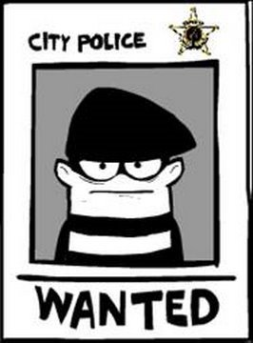
Is it ever OK to commit a crime?

Slide 4
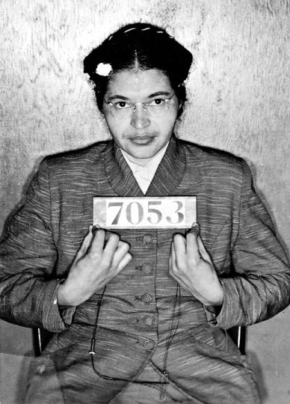
This is Rosa Parks. 65 years ago she committed a crime.
Let’s find out more so you can decide if she was right to do this, or not…

Slide 5
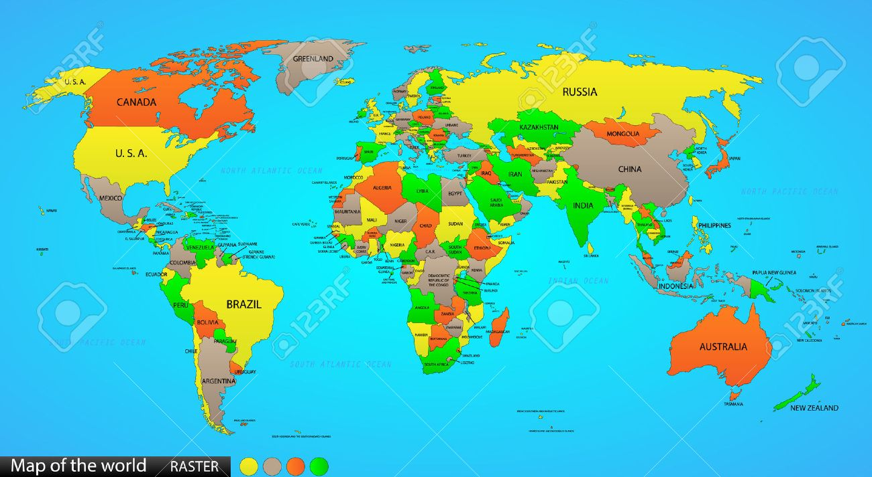
Rosa was born over 100 years ago in a country called the United States of America
England
United States
of America
(USA)

Slide 6

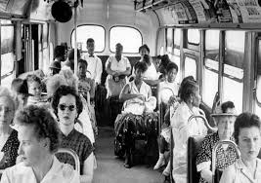
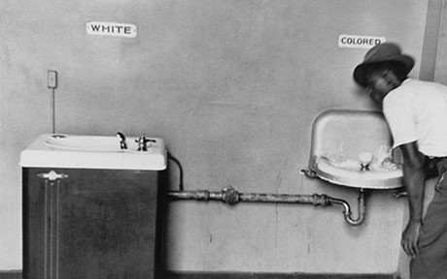
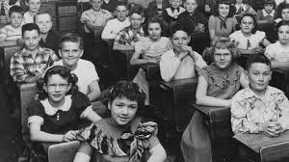
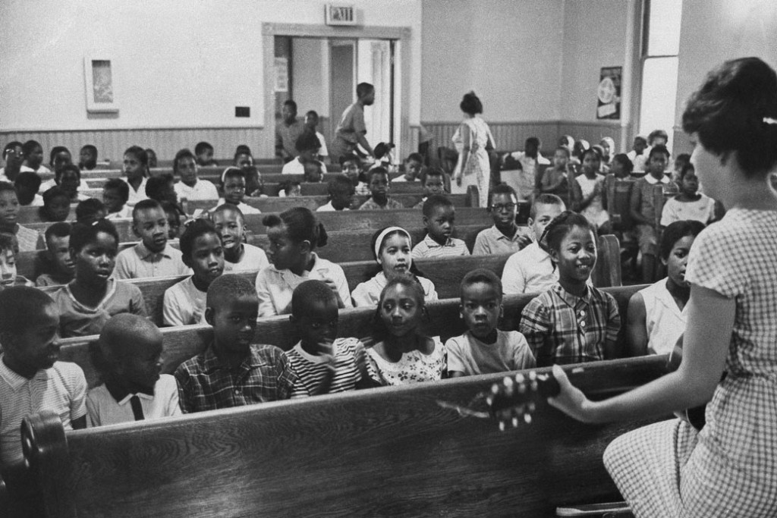
At that time black people and white people were treated very differently in America.
They had to sit in different parts of the bus, with more room for white people.
Black people and white people had to use different water fountains and toilets.
They even had to go to different schools.

Slide 7
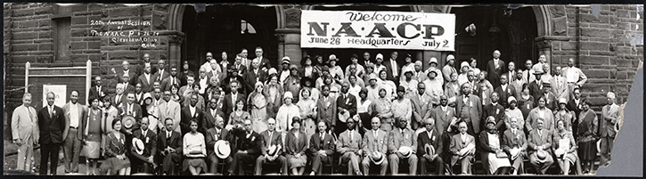
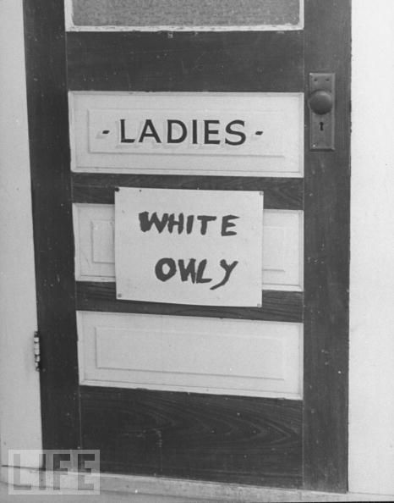
Things were supposed to be equal, but they weren’t. Much more money was spent on schools and toilets and restaurants for white people, so life was much harder for black people.
A group of people joined together to start fighting these unfair laws and help make things fairer for everyone. It was called the NAACP.

Slide 8
Rosa didn’t like the fact that things were so unfair and unequal between black and white people. She joined the NAACP and started to campaign for equality.

Slide 9
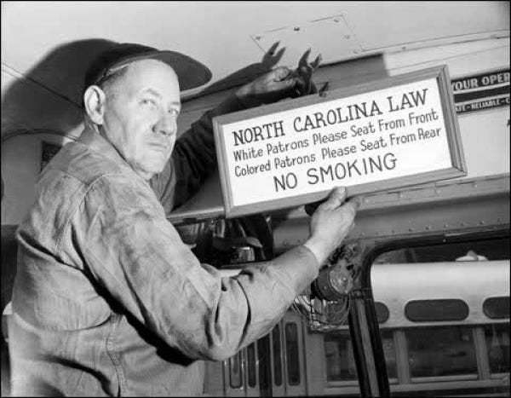
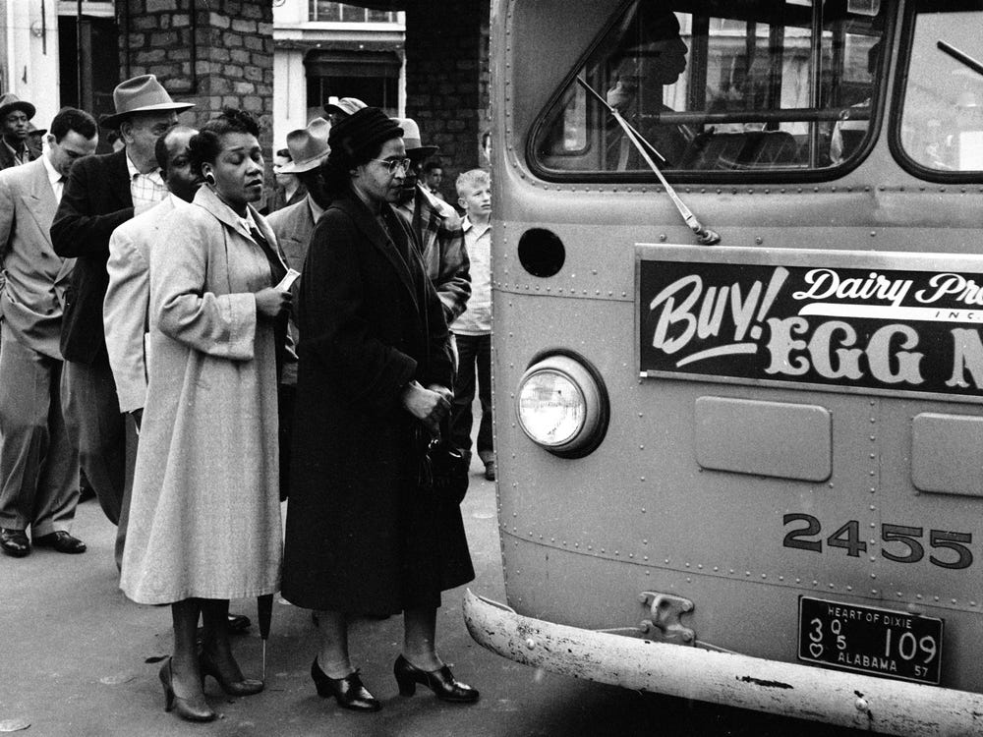
One day Rosa was travelling home from work as usual.
She got onto the bus and sat in one of the seats for black people.
It was a busy day and the bus began to fill up…

Slide 10
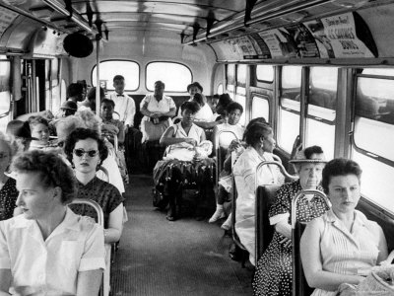
It was the law that black people had to give up their seats so that white people could sit down.
Rosa didn’t like this law. It was unfair, but what should she do?

Slide 11
What do you think she should do?
If she stood up and gave up her seat, nothing would change – it would still be unfair and unequal.
If she sat down and refused to give up her seat she could be arrested and taken to prison.

Slide 12
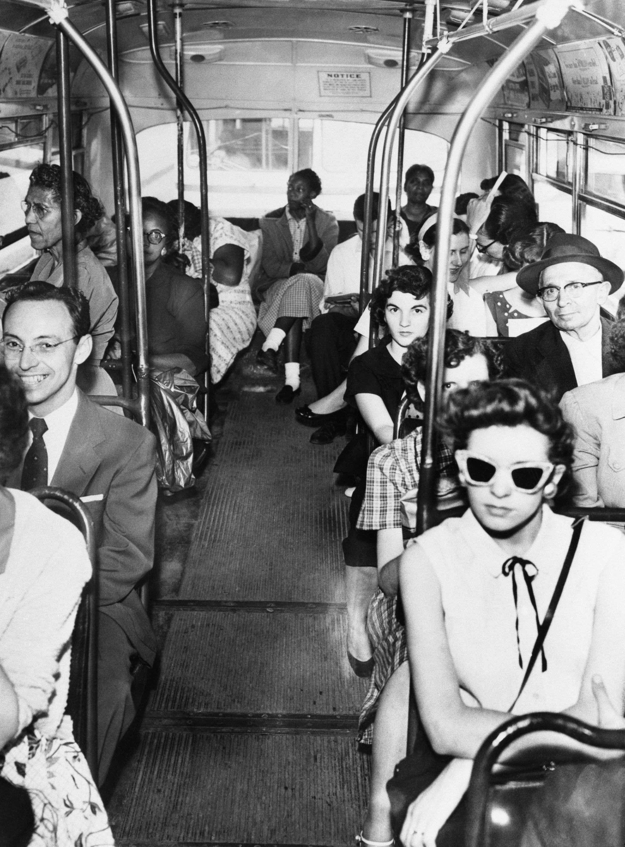
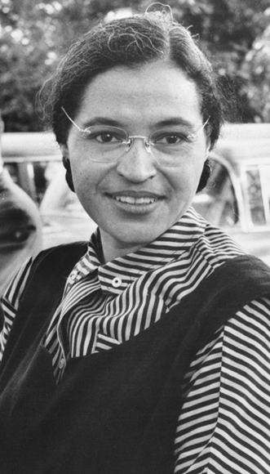
Rosa decided not to move. She was nervous about being in trouble, but she wanted equality more.
I’ve had enough. This is unfair.
I’m not going to stand up.

Slide 13
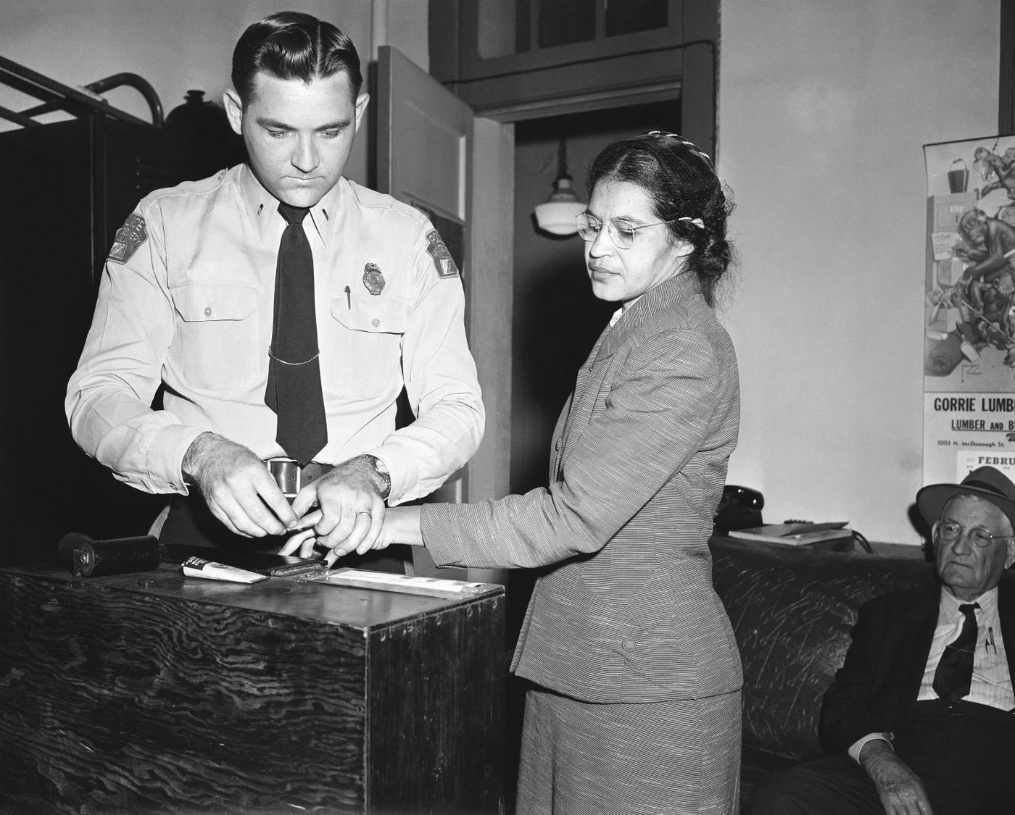
Rosa was in BIG trouble. She was arrested and taken to the police station.
Rosa had broken the law and would be tried in a court to decide if she should go to prison or not.
She had to spent the night in jail.
How do you think Rosa might have felt?

Slide 14
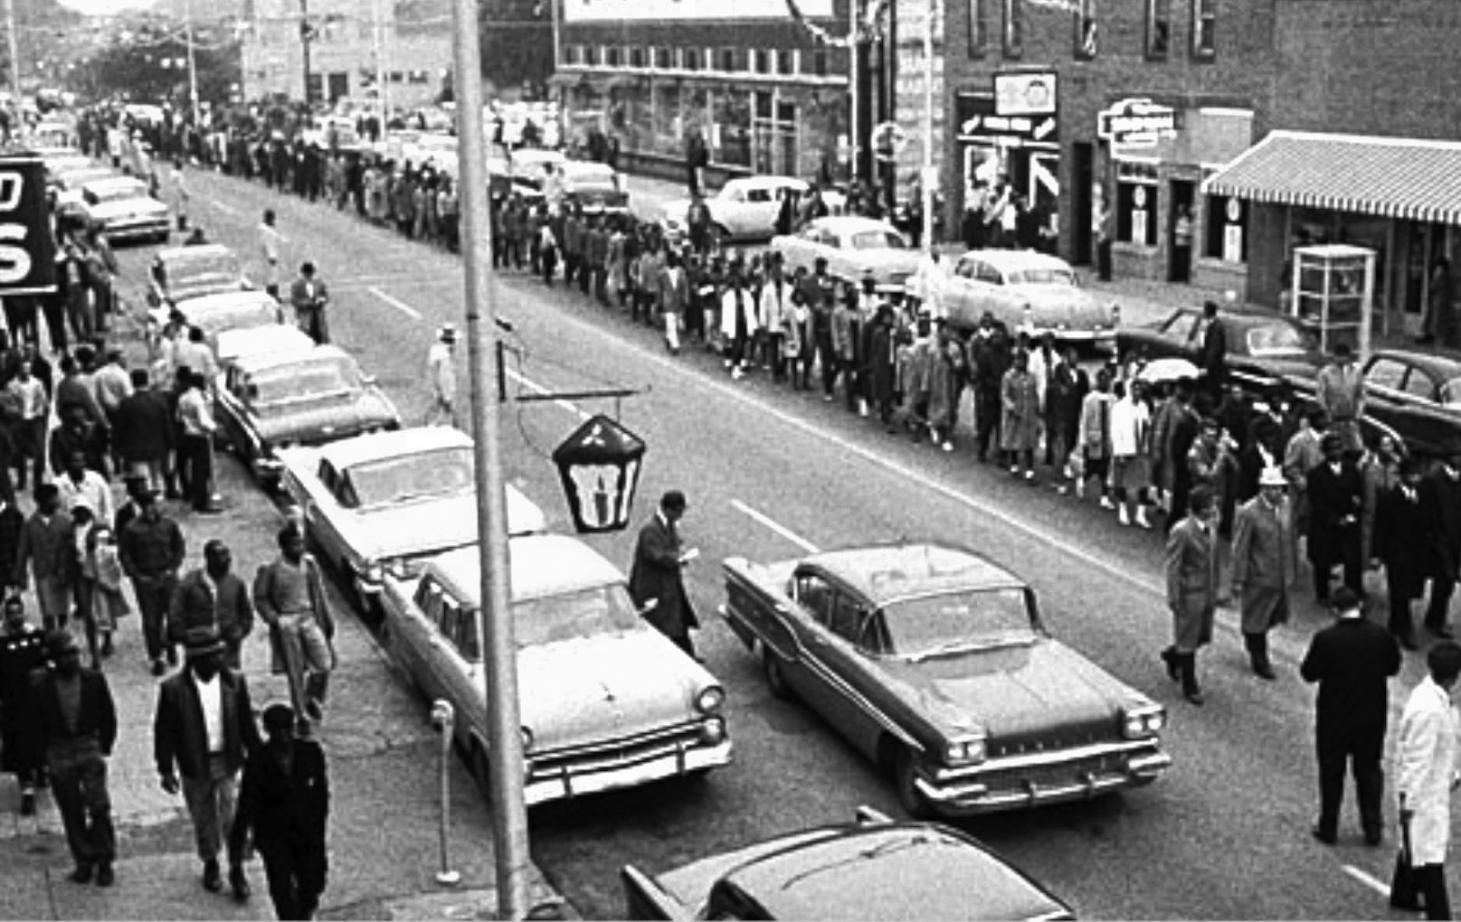
The buses should treat everyone the same!
Let’s not use the buses while they are being unfair!
Rosa had LOTS of supporters.
People decided not to use the buses as the bus companies were being so unfair.
Instead they walked to work…every day for over a year!
Phew, that’s tiring!

Slide 15
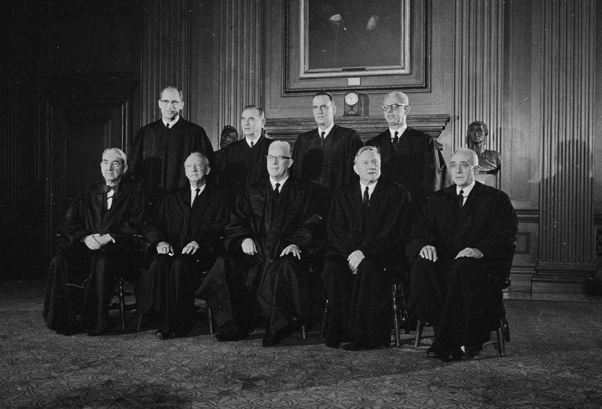
The buses must let people sit wherever they want to.
The most important judges in America sat and decided if Rosa should go free and buses should be forced to treat people fairly.
What do you think they decided?
Black people and white people should be treated equally on the buses.

Slide 16
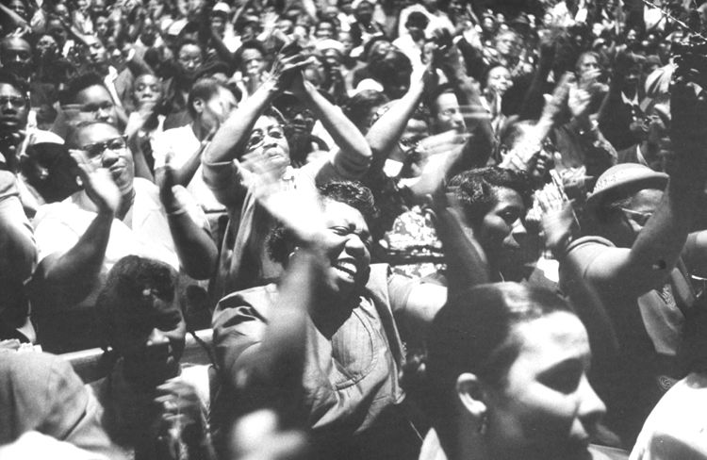
People celebrated and cheered.
It was a victory for fairness for everyone.
There was still a long way to go before all the laws were scrapped, but this was a great achievement.

Slide 17
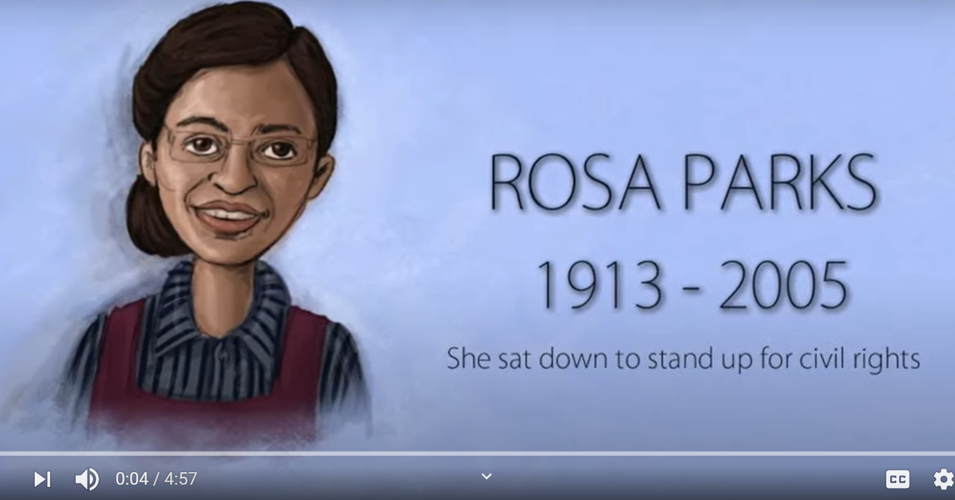
You can watch a video of Rosa Parks’ sit down by clicking on the video.

Slide 18
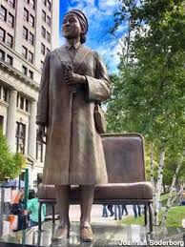
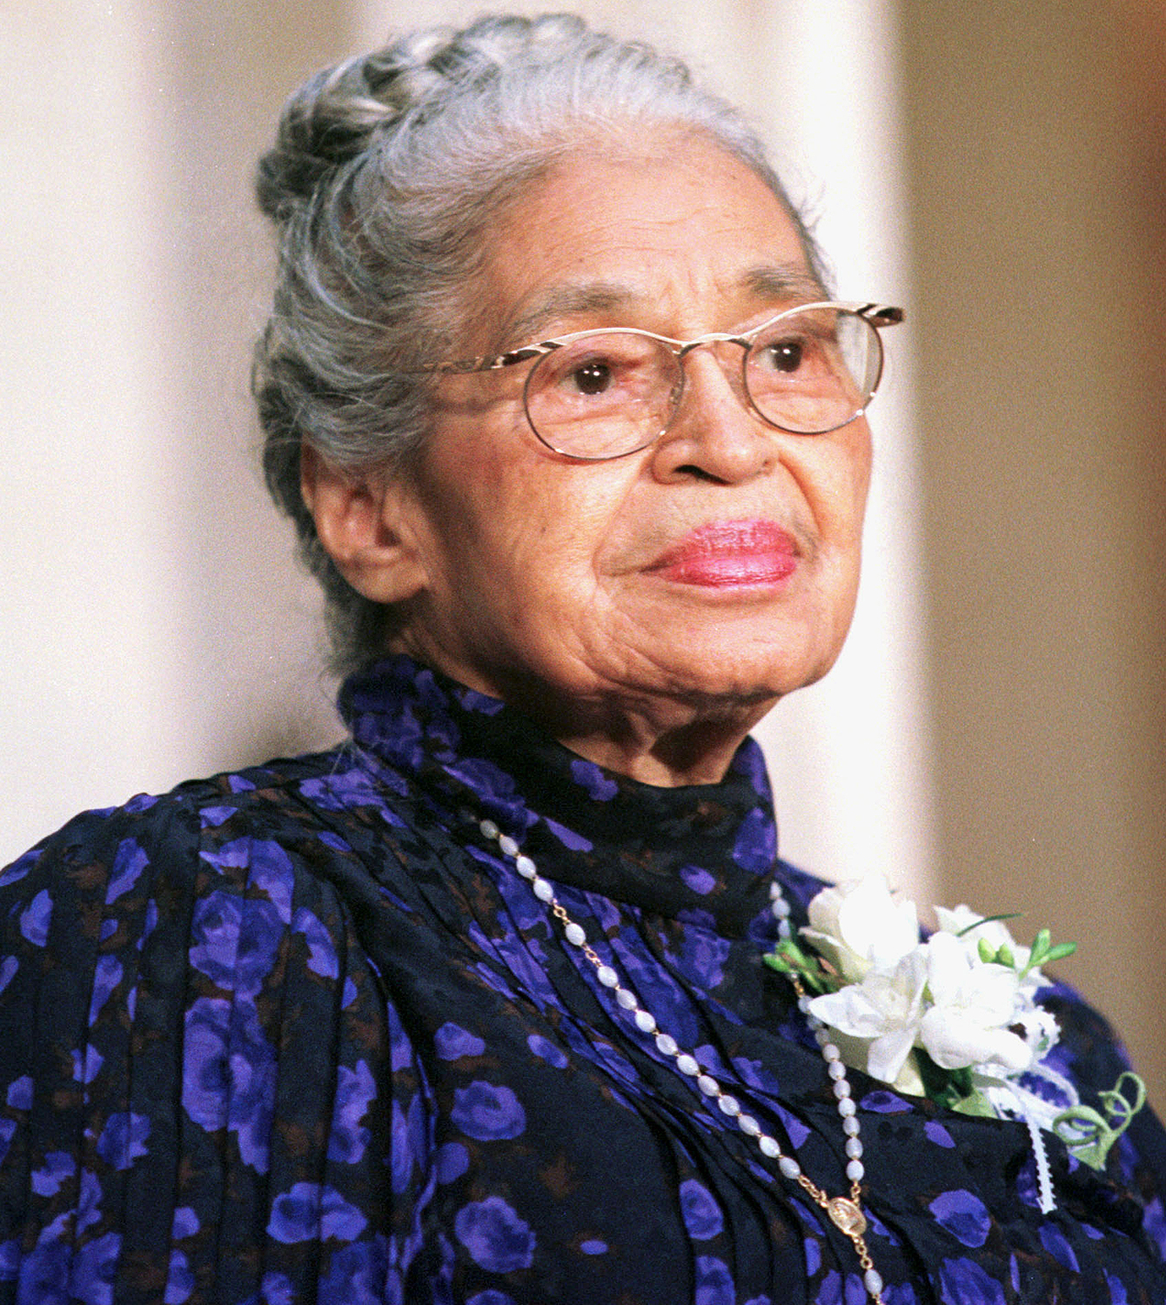
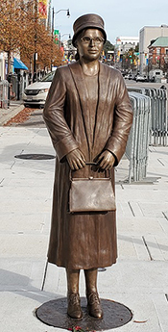
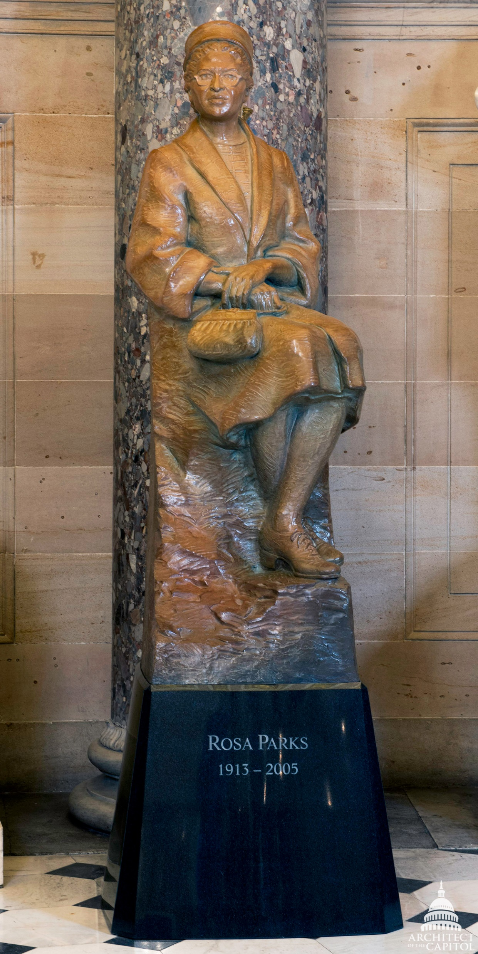
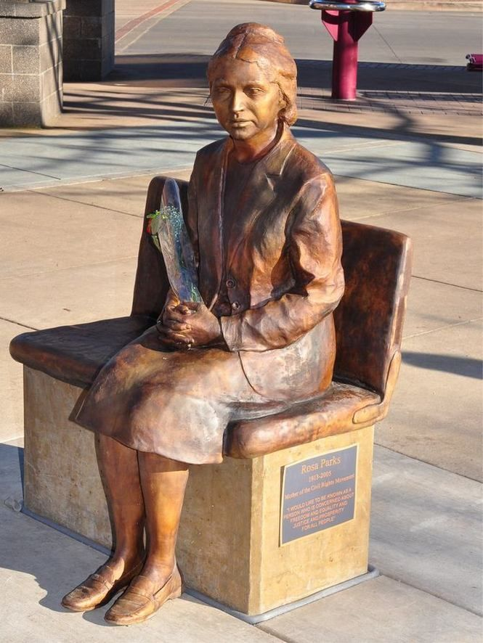
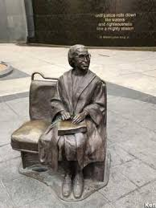
Rosa continued to work for equality and fairness all her life.
She has a road named after her and statues all across America

Slide 19

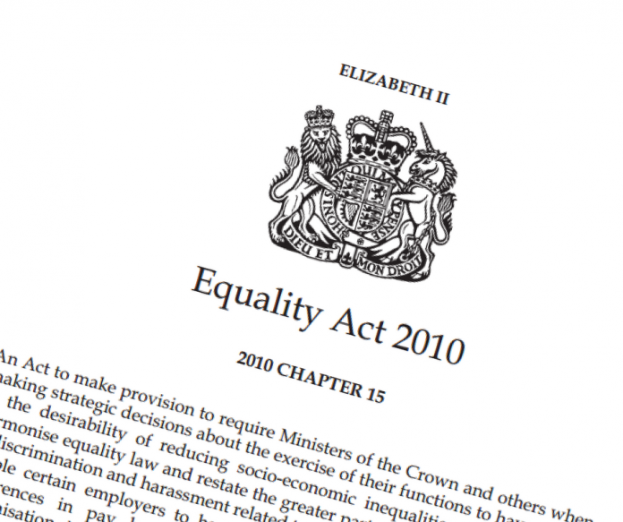

When someone is treated differently because of the colour of their skin, it is called racism.
Racism is against the law in the UK.
People in this country can go to prison for being racist.

Slide 20
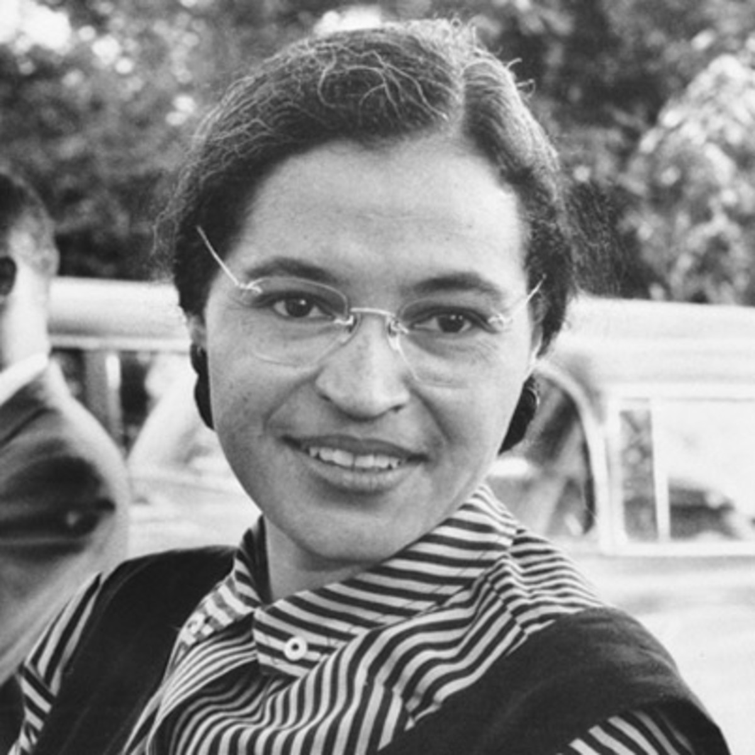
What can we learn from Rosa Parks?
Do you think she was right to break the law to change the law?
What can you do to help create a fair and equal world?

Slide 21
This powerpoint was made by diversity_mel. It is part of a large series designed to encourage debate and discussion around issues of equality in a bid to make more children happier and thoughtful. You can find more assemblies/ discussion ppts on my website.
You can contact me via my website too. I love to hear how you’ve used my powerpoints and to get your ideas for any you’d like me to make.
You can follow my work on Instagram @diversity_mel
Please do share my powerpoints with other teachers who may be interested.
My website is www.diversitymel.com

