Slide 1
This powerpoint was made by diversity_mel. It is part of a large series designed to encourage debate and discussion around issues of equality in a bid to make more children happier and thoughtful. You can find more assemblies/ discussion ppts on my website.
My website is www.diversitymel.com
You can email me via my website too. I love to hear how you’ve used my powerpoints and to get your ideas for any you’d like me to make.
You can follow my work on Instagram @diversity_mel
Please do share my powerpoints with other teachers who may be interested.
Please note: I make no money from making and distributing these resources.

Slide 2
Bear With – How to be a good friend
Showing sadness and displaying emotions can be hard, in particular for many boys who have been socialised to hide their emotions. This is a useful discussion PPT to encourage children to think about being a good friend.
There is an UKS2/ KS3/4 version of this with just a few talking point slides at the end of this presentation.
The video has been checked, but please check it for yourself too.
Find many more assemblies on my website DiversityMel.com

Slide 3
What can you see?
This is a sculpture in Bristol. It was put up one night when nobody was looking.
It is there to help people talk and be there for each other.
What does is make you think?

Slide 4
Sometimes we might feel like the person in the statue and sometimes we might feel like the bear.
That’s why friendship is so important.

Slide 5
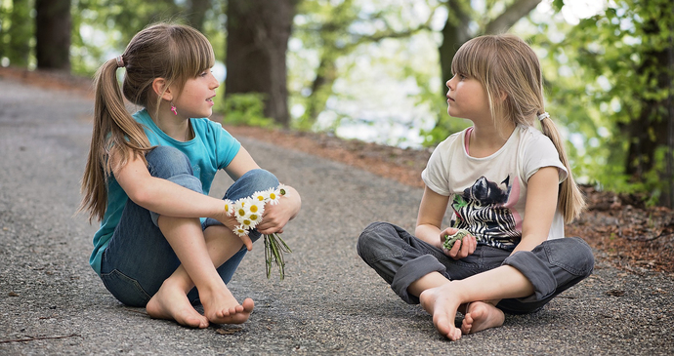
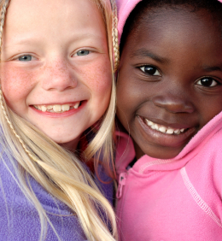
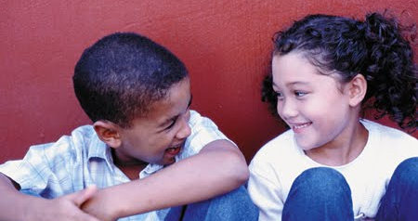
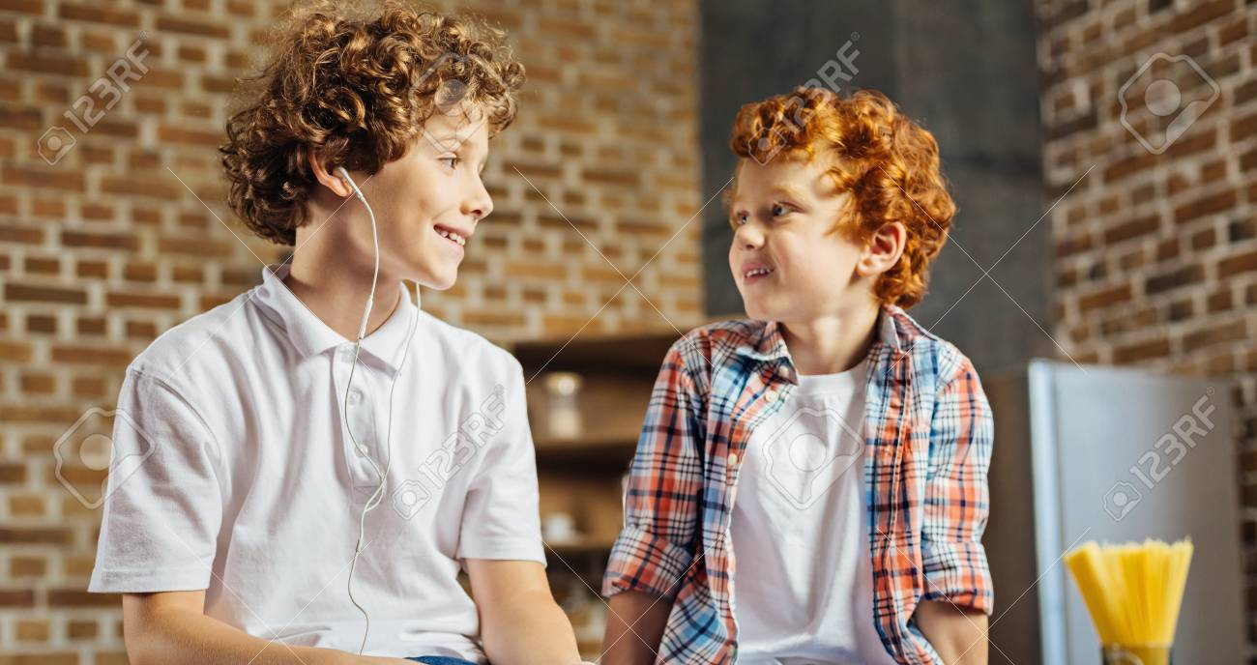
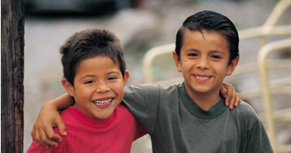
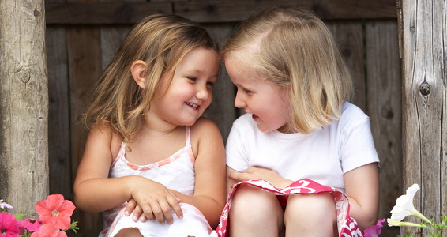
What is the best thing about having friends?
When might we need our friends the most?

Slide 6
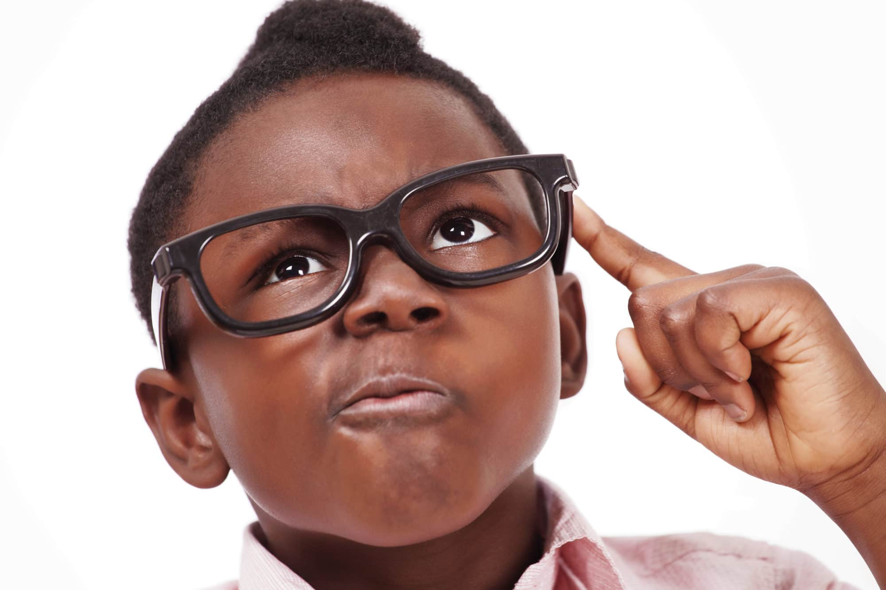
A friend is someone who…
Can you think of anything else?
Helps you
Shares things
Smiles at you
Sticks up for you
Is kind
Listens when you talk
Plays games with you
Makes you feel good

Slide 7
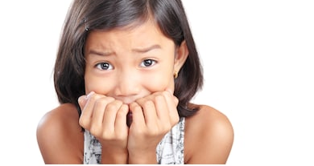
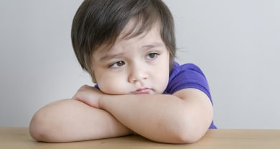
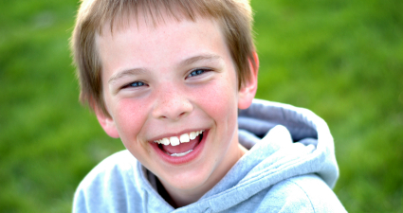
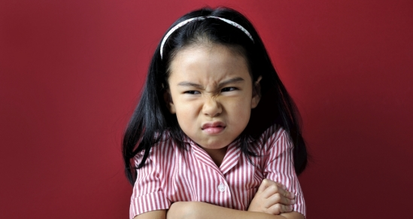
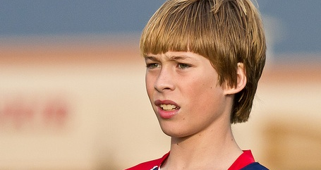
Which emotions do you think these children are feeling? How can you tell?

Slide 8
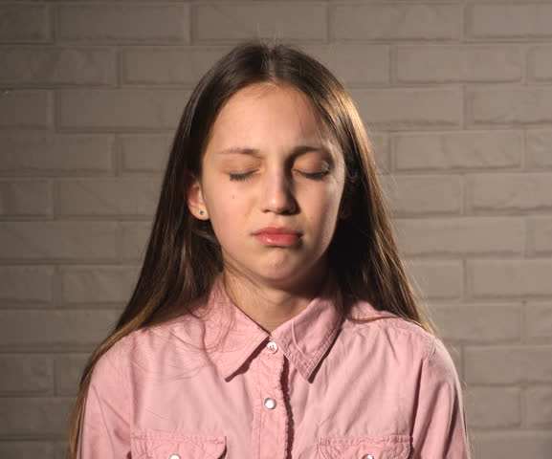
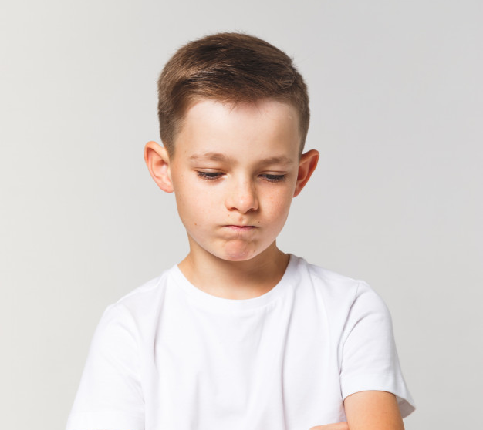
Are you OK?
How do you know if your friend is sad?
What could you say to your friend if you think they are sad?
Would it help to talk to me?
I’ll always be your friend
Would you like me to get an adult to talk to you?

Slide 9
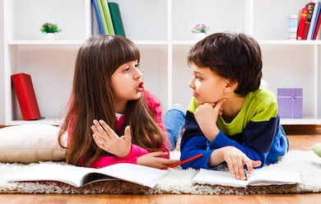
Why can it be helpful to talk about a problem?
Do you agree? Are there any other reasons?
It can feel good to share something that is worrying you
Your friend can say nice things and help you feel better
Your friend understands why you aren’t at your best
Your friend can help you get help if you need it

Slide 10
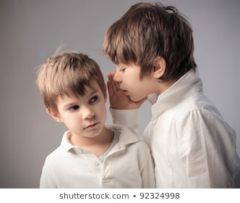
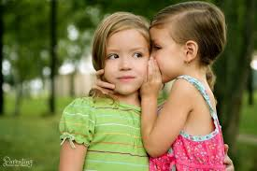
When is it OK to keep a friend’s secret? When is it not OK?
If you would spoil a nice surprise by talking
If you think someone might be in danger
Vote
or
If it’s not something other people need to know
Can you think of real-life examples of these things?
If you are hurting someone by keeping the secret

Slide 11
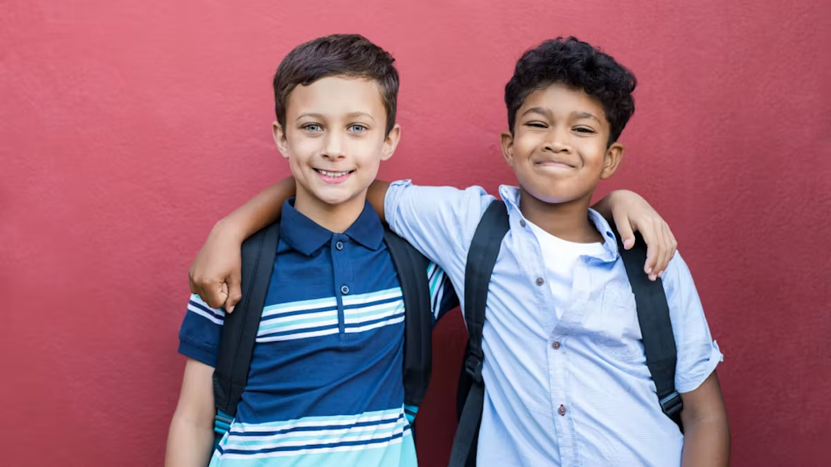
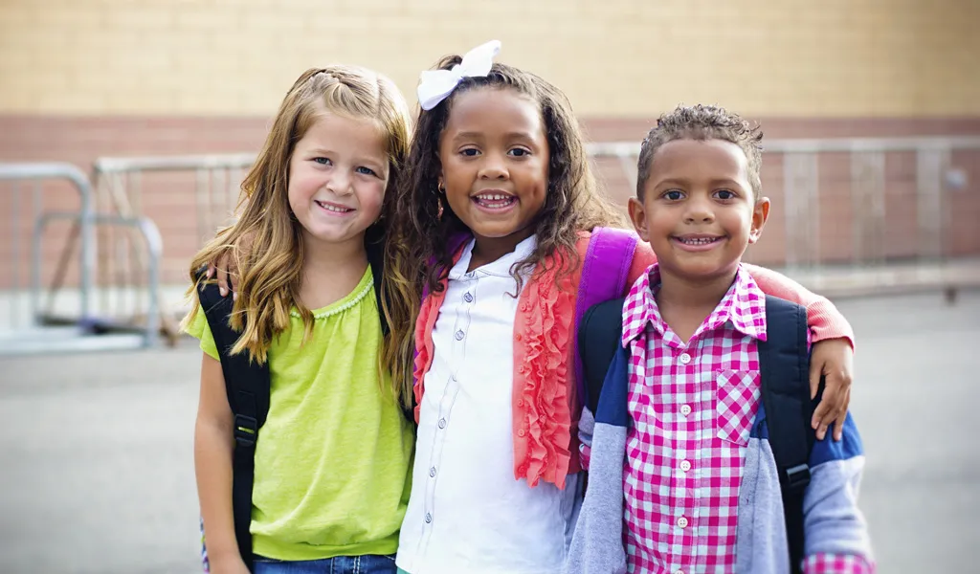
What is a compliment? What makes a good compliment?
Thanks, you really helped me.
You were great at that, well done!
Wow, you must have worked so hard on that.

Slide 12
What can you do today to be a good friend?

Slide 13
Click on the pic to finish with a song about friendship.

Slide 14
This powerpoint was made by diversity_mel. It is part of a large series designed to encourage debate and discussion around issues of equality in a bid to make more children happier and thoughtful. You can find more assemblies/ discussion ppts on my website.
My website is www.diversitymel.com
You can email me via my website too. I love to hear how you’ve used my powerpoints and to get your ideas for any you’d like me to make.
You can follow my work on Instagram @diversity_mel
Please do share my powerpoints with other teachers who may be interested.
Please note: I make no money from making and distributing these resources.

Slide 15
Bear With – The importance of talk –UKS2, KS3/4
A short visual aid to promote the value of talk, supporting your friends and seeking help when in difficulty.
The final slide could be printed as a poster for display.
There is a KS1/ LKS2 version of this on my website too.
Find many more assemblies on my website DiversityMel.com

Slide 16
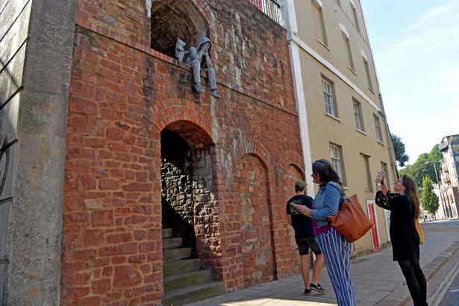
This is a sculpture in Bristol. It was put up one night when nobody was looking.

Slide 17
What can you see?
What could you do if you felt more like the bear?
What does is make you think?
What could you do if you felt more like the person?
Why do you think the artist made it?

Slide 18
If you feel like the bear…
Check on your friends. It’s good to talk.
If you feel like the person…
Talk to someone.
It always helps.

