Slide 1
This powerpoint was made by diversity_mel. It is part of a large series designed to encourage debate and discussion around issues of equality in a bid to make more children happier and thoughtful. You can find more assemblies/ discussion ppts on my website.
You can contact me via my website too. I love to hear how you’ve used my powerpoints and to get your ideas for any you’d like me to make.
You can follow my work on Instagram @diversity_mel
Please do share my powerpoints with other teachers who may be interested.
My website is www.diversitymel.com

Slide 2
Hedy Lamarr – Don’t judge a book by its cover
This assembly is one of a series encouraging children to recognise we can learn from each other.
This one focuses on Hedy (pronounced Head-y) Lamarr, who was a glamorous and famous Hollywood actress, but also a brilliant scientist and inventor.
All links and videos have been fully checked, but I recommend you double check them first : )
Keep a look out – more assemblies on this theme coming soon.

Slide 3
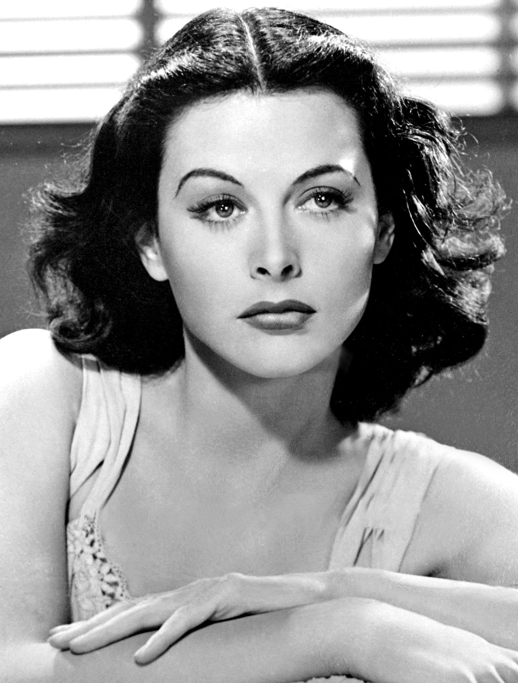
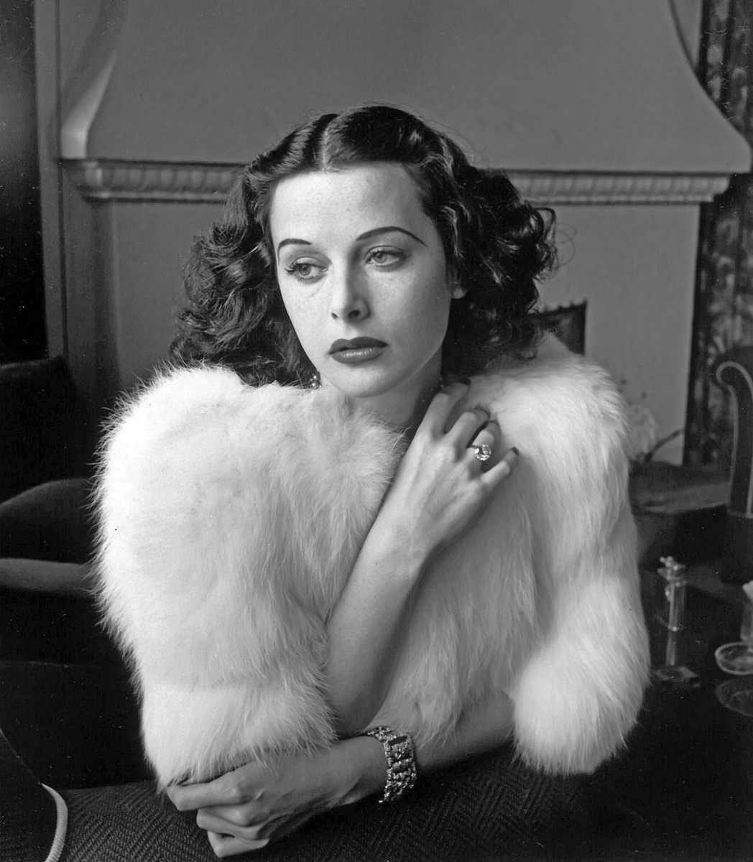
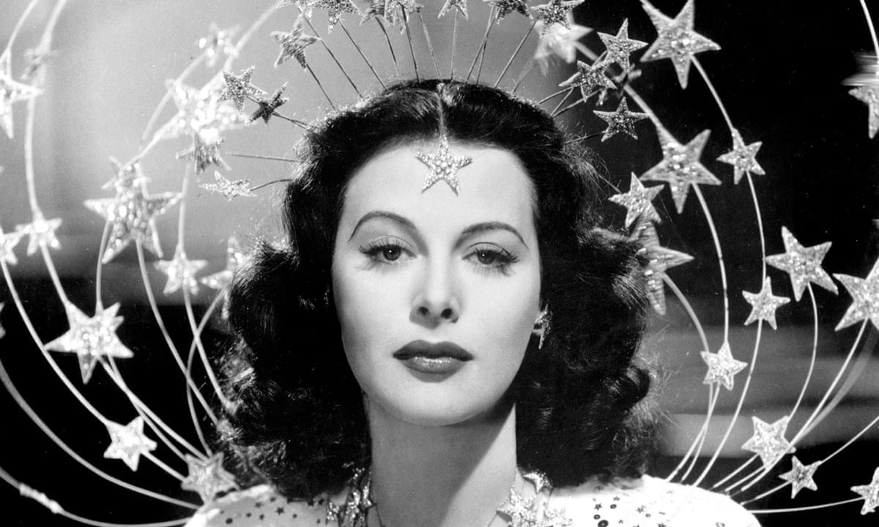
This woman’s name is Hedy Lamarr. What do you think she did as a job?

Slide 4
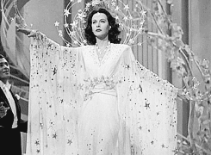
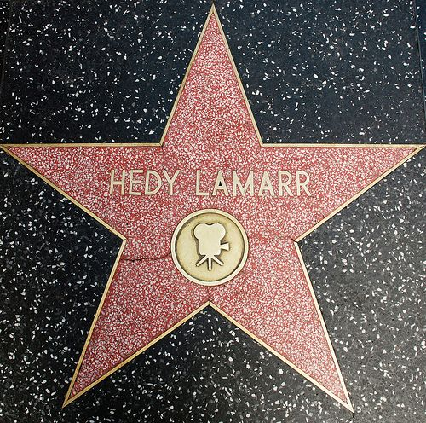
Did you guess actress?
Hedy was a really famous actress in the 1930s and 1940s
What words would you use to describe her?

Slide 5
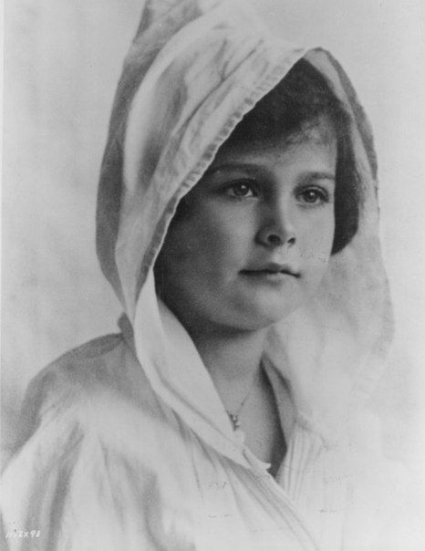
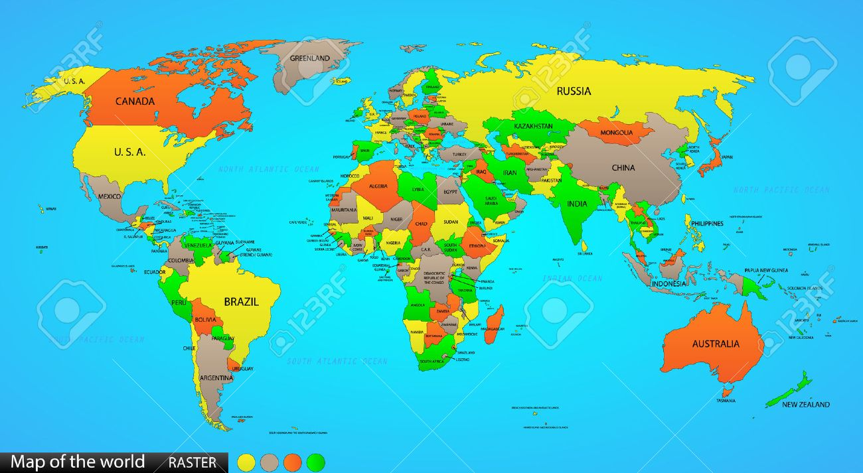
Hedy was born in Austria in 1917. She was born into a Jewish family.
Hedy always wanted to be an actress and she became famous in Europe, before travelling to America where she became a top movie star.
Austria
United States
of America

Slide 6
As well as acting, Hedy loved science. She taught herself by watching others, reading and talking to other people.
She was always experimenting.

Slide 7
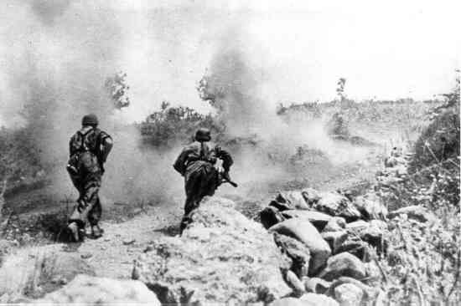
In 1939 World War Two started. Jewish people in Europe were imprisoned and killed.
In 1941, the US joined the UK and other countries to try and stop this.

Slide 8
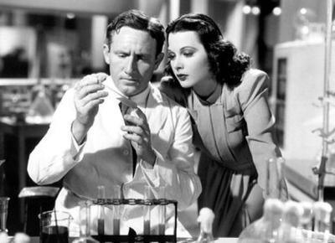
I can use my love of science and maths to help people in Europe. We need to stop these terrible things from happening.
Hedy started to feel uncomfortable living the life of a glamorous actress when so many people were suffering.

Slide 9
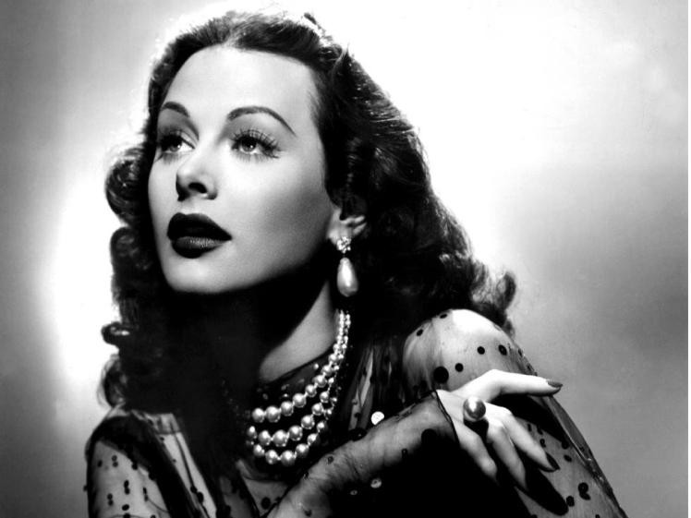
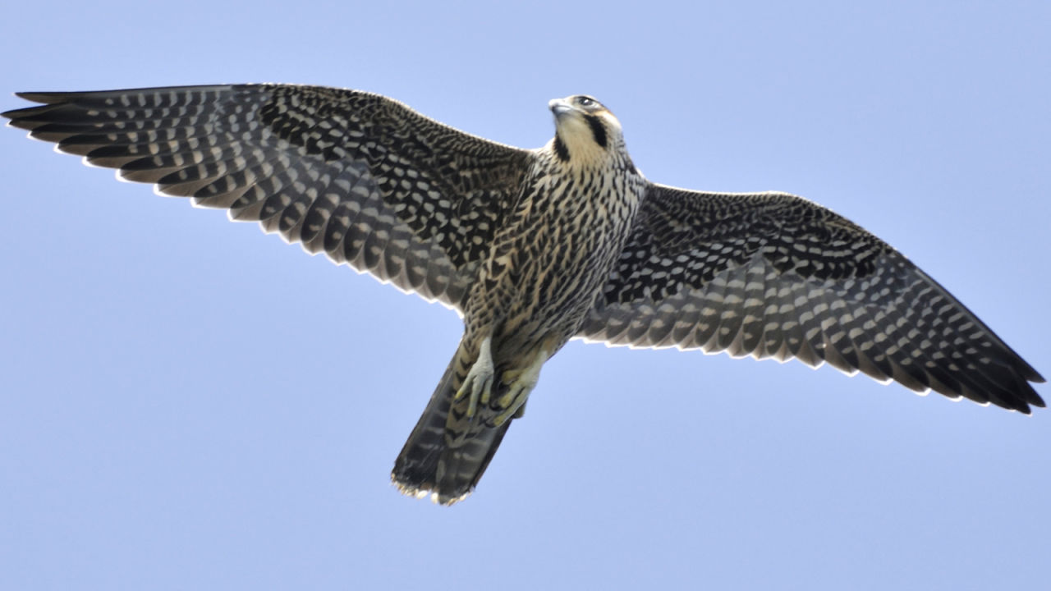
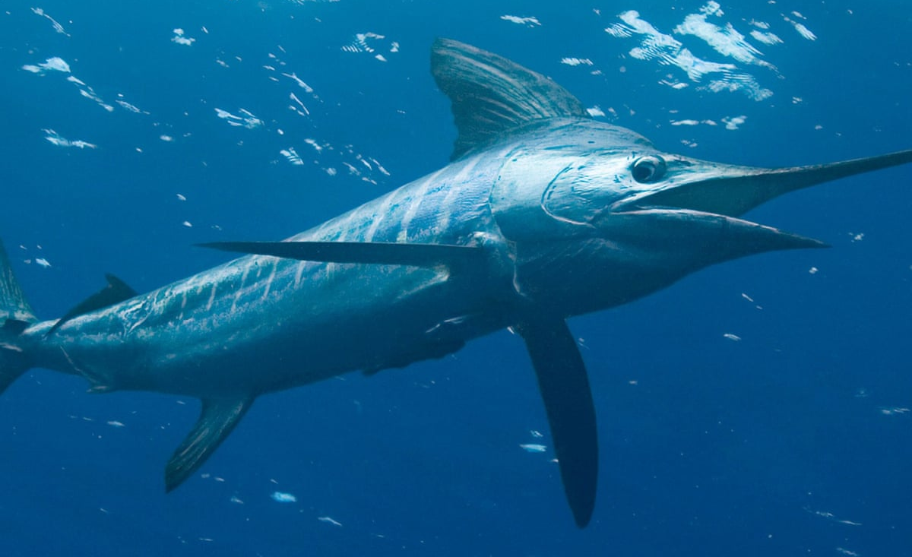
One of the first things she did was to help her friend redesign planes to make them go faster.
I looked at the shape of the planes and I thought… I bet we can learn how to go faster from nature…
I should study the fastest fish and the fastest bird and see what I can learn from them
Peregrine Falcon
Marlin Fish

Slide 10
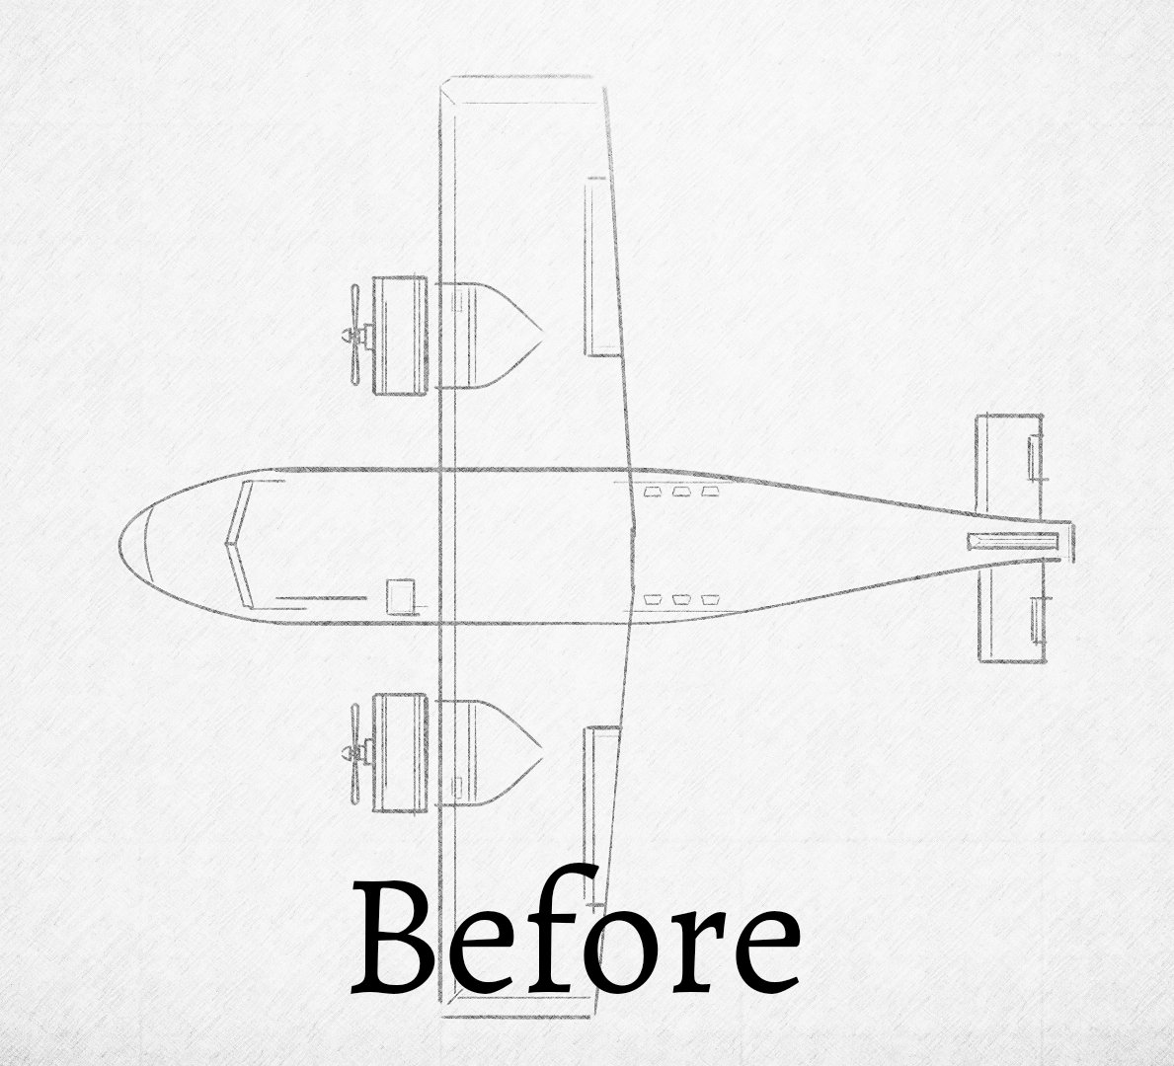
Can you spot the difference between the two planes?
How had Hedy used what she had learned to make the plane faster?
Hedy used what she saw in nature to redesign planes to make them go faster.

Slide 11
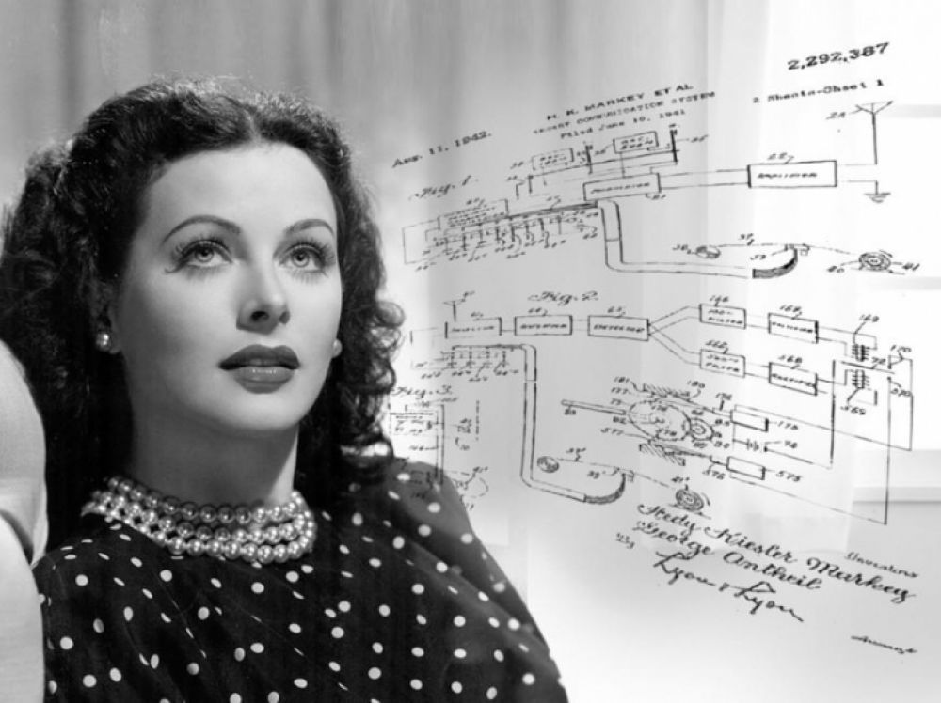
She didn’t stop there. Hedy helped to design a special system to send messages between planes and ships and their weapons systems.

Slide 12
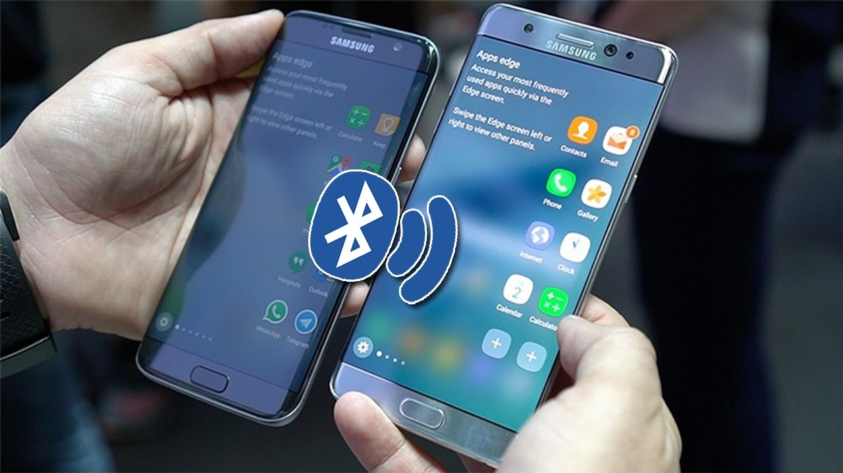
Hedy’s system grew into the Bluetooth and Wifi we use today.
Have you benefitted from Hedy’s designs?

Slide 13
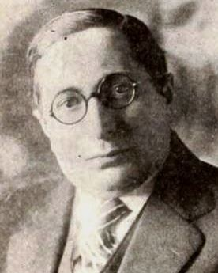
Do you think Hedy’s bosses in Hollywood liked that she was spending her time doing Science?
This is not OK Hedy – the public just want you to be a beautiful woman. They don’t want you to think as well!
What do you think? What would you do if you were Hedy?
No-one is going to stop me from being who I am. You can be beautiful and use your brains to

Slide 14
Click to hear more about Hedy’s life

Slide 15
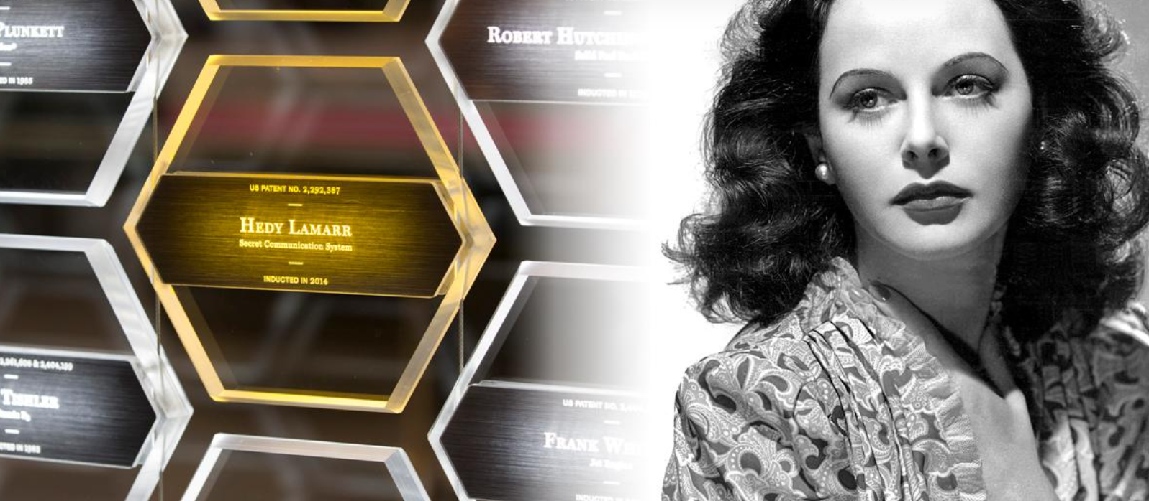
Hedy died in 2000, but in 2014 she was made a member of the National Inventors Hall of Fame

Slide 16
What can we learn from Hedy Lamarr? Was she right to take a break from acting to help save lives?
What would you say to the men who told her she should stop thinking and just be a beautiful woman?
What can you learn from looking at how animals and birds behave?

Slide 17
This powerpoint was made by diversity_mel. It is part of a large series designed to encourage debate and discussion around issues of equality in a bid to make more children happier and thoughtful. You can find more assemblies/ discussion ppts on my website.
You can contact me via my website too. I love to hear how you’ve used my powerpoints and to get your ideas for any you’d like me to make.
You can follow my work on Instagram @diversity_mel
Please do share my powerpoints with other teachers who may be interested.
My website is www.diversitymel.com

